Slide 1
SIEO 2023 – Sun Valley Dealing with Shorted Pipe Casings

Slide 2
Agenda
AMPP SP0200-2023 – Pipe Casings
Florida DEP
API 2610
API 655 TR
AMPP SP21474
PRCI - #1 & #2
DOT PHMSA and the Special Permit Process
AMPP – VCI Application Options
API – Double Bottoms & VCI
Summary

Slide 3
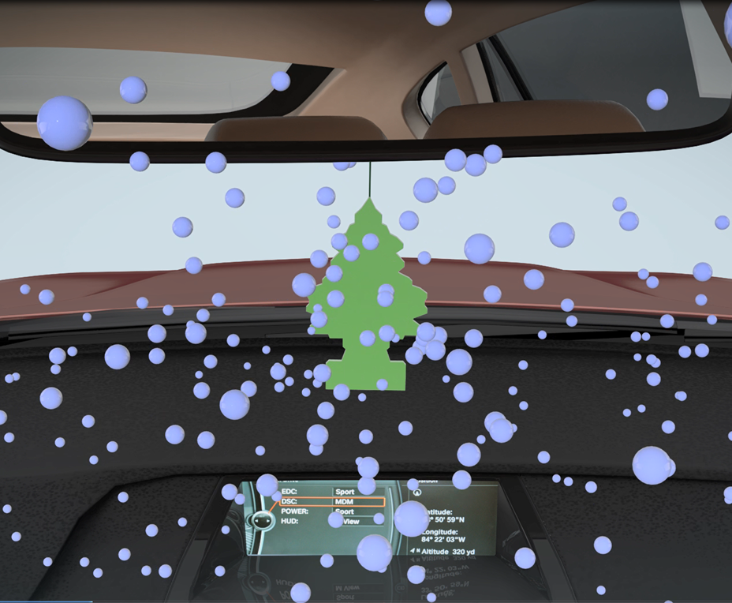
VCI
What are VCI’s?
And how do they work?

Slide 4
NPMS National Pipeline Mapping System
Approximately 2,600,000 miles of identified pipeline
Estimated number of pipe casings ranges from 1,000,000 to 2,600,000

Slide 5
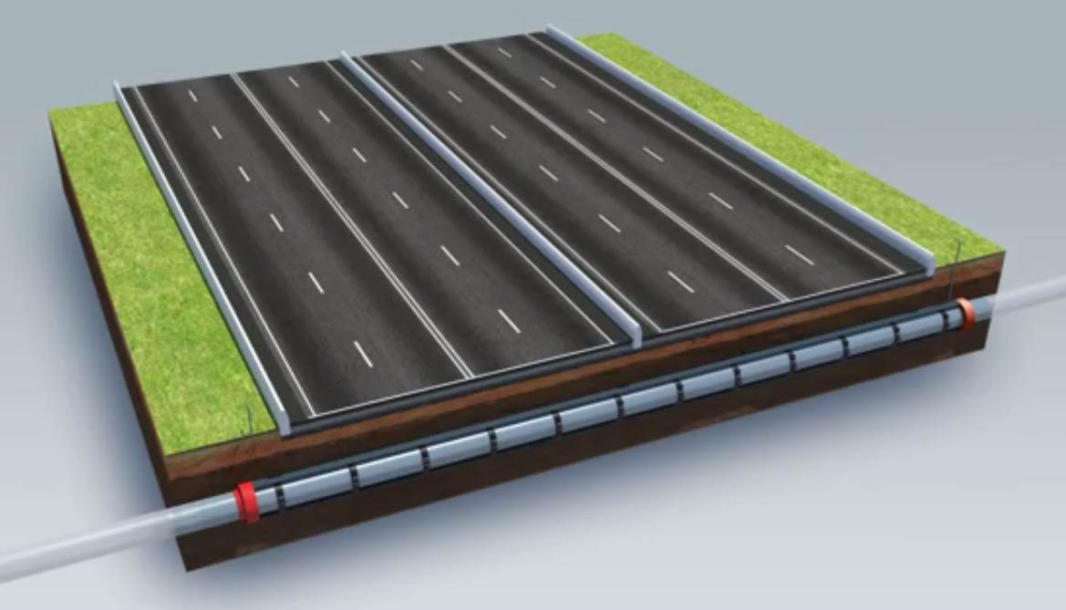
Why were casings used
Carrier pipe inside a structural support pipe
Spacers isolate the carrier from contact with casing
Carrier inside casing is isolated from Cathodic Protection (CP)
Metallic Short
Electrolytic Couple
Notes:
Whether you use the term Pipe Casing or Cased Crossing, it is effectively having a carrier pipe run through a steel casing when going under roads, railway or waterways. Industry is trying to phase the use of casings out as thicker wall pipe is easier to maintain, but it is estimated that there are well over 1 million cased crossings in place today.

Slide 6
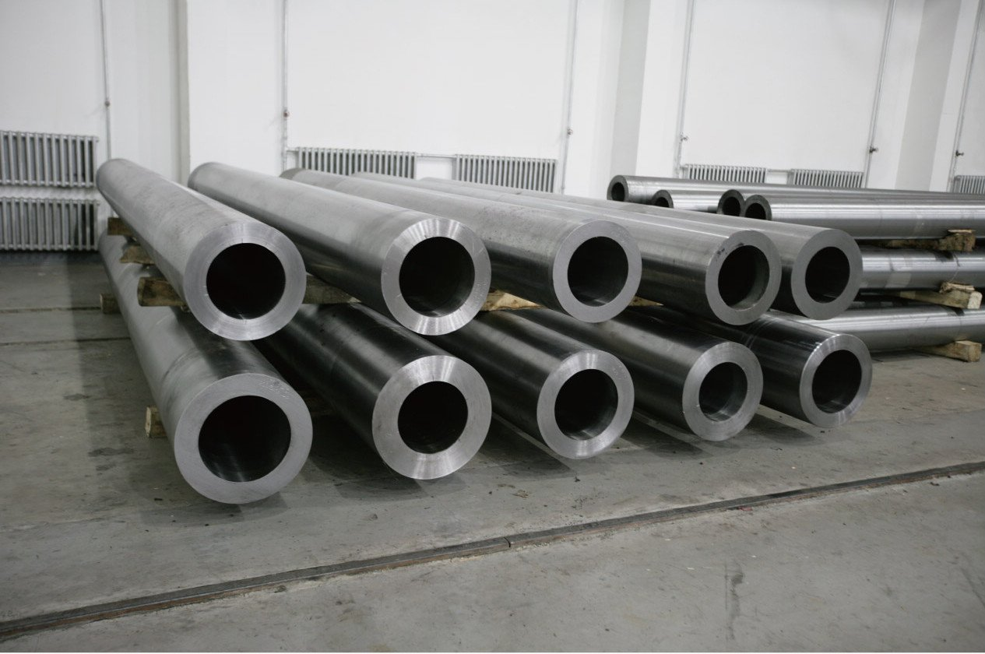
Construction Practices
New casings have limited applications
Railway
Owner standards
Some others
Thick wall pipe, horizontally directional drilled (HDD)

Slide 7
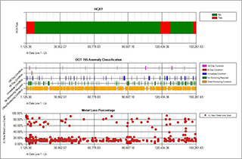
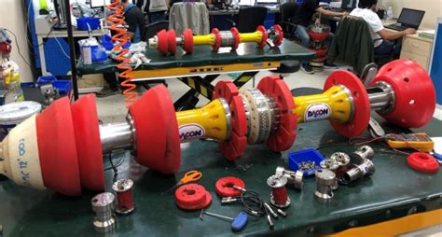
In-Line Inspection
ILI tools can identify anomalies on the carrier pipe inside a casing
Corrosion depth measurements on the carrier determine priority
PHMSA Mega-Rule is expanding the inspection requirements

Slide 8
What is causing the Anomaly?
Ground settling
Spacer degradation
Ingress of water or other contaminants
Vapor space corrosion

Slide 9
PHMSA Options
Clear the short, if practical;
Fill the casing/pipe interstice with high dielectric casing filler “or” other material which provides a corrosion inhibiting environment;
Reference NACE SP0200

Slide 10
NACE (AMPP) SP0200-2014
Appendix A - Options for Mitigation of Carrier Pipe Corrosion In the Casing Annulus (Non-Mandatory)
A1. The technology and chemistry are readily available to actively manage corrosion inside cased pipelines through the use of a wax petrolatum system and/or multi-phase vapor corrosion inhibitors.
A2. Filling the Casing Annulus with Petrolatum Wax or Petroleum-based Compounds

Slide 11
NACE (AMPP) SP0200-2014 cont.
Section A3 Treating the Casing Annulus with Corrosion-Inhibiting Products
A3.2 There are two fundamental options available to accomplish this method of corrosion mitigation inside casings:
A3.3 Option 1: Fill the Casing with Corrosion-Inhibiting Gel Filler
A3.4 Option 2: Leave the Casing Annulus Unfilled and Apply a Multiphase Vapor Corrosion Inhibitor System

Slide 12
Pipe-Casings: Metallic Short
Vent Pipe
Roadway
Ground Level
Cathodic Protection Current
(will go to Casing)
End Seal
Casing
End Seal
Mud Water
Spacers
Spacers
Spacers
Spacers
Carrier Pipe
Corrosion on Carrier Pipe
Cased Carrier Pipe
Cathodic Protection Current
Notes:
When the earth moves or settles, the pipe and casing also move and physically come in contact with each other. This scenario is referred as Metallic Short. The CP current reaching the carrier pipe is shielded by the casing, the casing becomes part of the electric circuit and starts receiving CP current. Corrosion on the carrier pipe is initiated due to rain/mud water and no protection is offered in this case. This is a high-risk scenario for oil & gas pipelines.

Slide 13
Pipe-Casings: Electrolytic Couple
Vent Pipe
Roadway
Ground Level
Cathodic Protection Current
(may go through)
End Seal
End Seal
Casing
Mud Water
Spacers
Spacers
Cased Carrier Pipe
Spacers
Spacers
Corrosion on Carrier Pipe
Carrier Pipe
Cathodic Protection Current
Notes:
When the end seals are compromised (failed), rain/mud water gets into the casing and corrosion on carrier pipe is initiated at coating anomalies. This scenarios is referred to as Electrolytic Couple. CP current may get through the casing and reach the carrier pipe, however the required polarization levels are not achieved. The magnitude of current reaching the carrier pipe to cause adequate polarization depends on the resistivity of mud/rain water.
Most casings in the USA have mud/rain water and are in electrolytic couple.

Slide 14
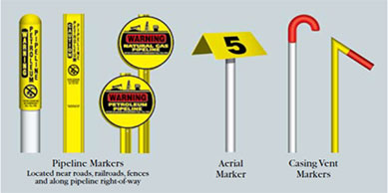
Before you go!
General Casing Information
Camera Inspection of Vent Pipes
Casing Air Flow
Casing Pressure Test
Site Access Information

Slide 15
Other Questions?
Is the casing shorted – Metallic or Electrolytic?
Vent pipe size and penetration size through the casing?
Is the vent pipe, open, closed, has a relief valve, can it be modified?
Vent pipe connection – which one is top and which one is bottom?
Will they be digging and repair/replace the seals?
Is the casing below the water table?
Elevation difference along the length of the casing?
Most current ILI (In-Line Inspection) report? History of service?
Casing depth in relation to Frost depth?

Slide 16
CP to Carrier in Casing
Clear the short
No CP penetrates to carrier
Apply High Dielectric
No CP penetrates to carrier, non-conductive
Apply Corrosion Inhibitor
CP penetrates to carrier, inhibitor medium is conductive

Slide 17
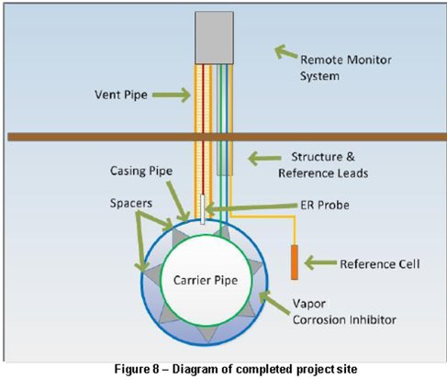
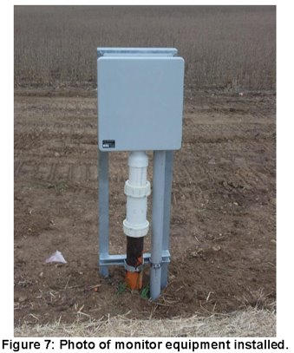
Monitoring Equipment

Slide 18
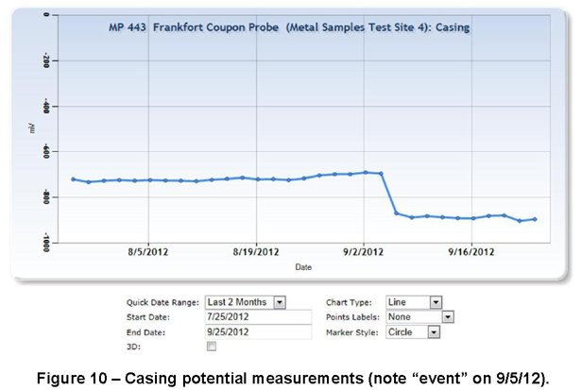
Casing Potential
Metallic short event

Slide 19
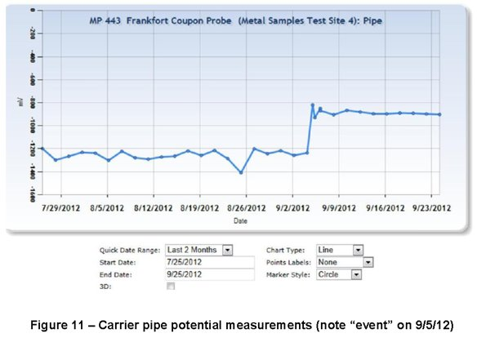
Carrier Potential
Metallic short event

Slide 20
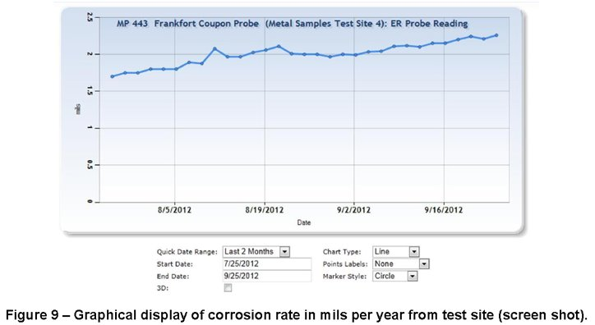
Corrosion Trend Line
Corrosion Rate remained low, even after Metallic Short event

Slide 21
Storage Tanks
Aboveground Storage Tank Regulations

Slide 22
Current Documents
Florida DEP - 2012
62-762.502 Storage Tank System Requirements for Field Erected Storage Tanks
62-762.702 Repairs, Operation and Maintenance of Field Erected Storage Tank Systems

Slide 23
Current Documents
API 2610
Design, Construction, Operation, Maintenance, and
Inspection of Terminal and Tank Facilities
Section 12.5 Volatile Corrosion Inhibitors (VCI)
API 12R1
Installation, Operation, Maintenance, Inspection, and
Repair of Tanks in Production Service

Slide 24
Current Documents
API Technical Report 655
FIRST EDITION, APRIL 2021
Vapor Corrosion Inhibitors for Storage Tanks
1 Scope.................................................................................. 1
2 Normative References......................................................... 2
3 Definitions............................................................................ 2
4 VCI Application Method Options.......................................... 4
5 Elements That Affect VCI Installation and Maintenance...... 9
6 Monitoring and Replenishment............................................ 13
7 VCI and Cathodic Protection............................................... 14

Slide 25
Future Documents
AMPP SP21474-2023 (originally NACE TG 543)
Standard for External Corrosion Control of On-Grade Carbon Steel Storage Tank Bottoms
Original draft – 2016
Expected to publish - 2023

Slide 26
Published Studies
Vapor Corrosion Inhibitors Effectiveness for Tank Bottom Plate Corrosion Control
Contract PR–015–153602
Determine whether the VCIs are effective in mitigating corrosion to a level comparable to a working CP system for tank bottoms
Determine the best way to monitor efficacy of VCIs
Whether the VCIs are compatible with CP or not.

Slide 27
Published Studies
Vapor Corrosion Inhibitors Effectiveness for Tank Bottom Plate Corrosion Control – PHASE 2
Contract PR–644-183611
VCIs’ performance comparison with effective cathodic protection (CP) systems.
Evaluated tank bottom corrosion monitoring tools.
Investigated VCIs’ migration behavior.
Determined VCIs performance in the presence of high levels of chlorides and bacterial activity.
Evaluated VCI delivery methods considering tank pad conditions.

Slide 28
DOT-PHMSA
Federal Regulatory Status – DOT/PHMSA

Slide 29
DOT-PHMSA
Started with 2021 Appropriations Act, Signed December 2020
Aboveground storage tanks. -The agreement directs PHMSA to conduct a review of current and new corrosion control techniques that may be used to improve leak prevention of regulated aboveground storage tanks. PHMSA is directed to submit a report within 1 year of enactment of this Act to the House and Senate Committees on Appropriations, the House Committee on Transportation and Infrastructure, and the Senate Committee on Commerce, Science and Transportation detailing the findings on supplementary or alternative techniques to cathodic protection systems and the application of such techniques to aboveground storage tanks.

Slide 30
DOT-PHMSA & Special Permits
Report to Congress
Determine the effectiveness including the operational life of VCIs in the field under varying conditions across the range of geographical locations around the country or the world.
Improve in-situ monitoring of VCI performance by developing new monitoring procedures or new monitoring systems.
Determine how to best apply VCIs to make sure the entire tank bottom area is protected.

Slide 31
DOT-PHMSA & PRCI
Fast Facts
Research Award Recipient: | Pipeline Research Council International 15059 Conference Center Drive, Suite 130 Chantilly, Virginia 20151 Phone:703-205-1600 Fax:703-205-1607 Chantilly, VA 20151
AOR/TTI: | Samuel Maldonado, samuel.maldonado @ dot.gov, 404-832-1152 Robert Smith, Robert.W.Smith @ dot.gov, 919-238-4759
Contract #: | 693JK32210001POTA
Project #: | 993
Researcher Contact Info: | Pavan K. Shukla Battelle Savannah River Alliance, LLC, Bldg. 773-41A Savannah River Site, Aiken, SC 29808 Phone: 803-725-4309 Email: Pavan.Shukla @ srnl.doe.gov
Downloads of Project Reporting
Since Jan 1, 2017 | 0
Technology and Commercialization
Technology Demonstrated? | TBD
Commercialized (in whole/part)? | TBD
Financial and Status Data
Project Status: | Active
Start Fiscal Year: | 2022 (09/30/2022)
End Fiscal Year: | 2025 (10/30/2024)
PHMSA $$ Budgeted: | $250,001.00
Fast Facts
Research Award Recipient: | Pipeline Research Council International 15059 Conference Center Drive, Suite 130 Chantilly, Virginia 20151 Phone:703-205-1600 Fax:703-205-1607 Chantilly, VA 20151
AOR/TTI: | Ben Kendrick, benjamin.kendrick @ dot.gov, 713-272-2893 Robert Smith, Robert.W.Smith @ dot.gov, 919-238-4759
Contract #: | 693JK32210002POTA
Project #: | 994
Researcher Contact Info: | Pavan K. Shukla Battelle Savannah River Alliance, LLC, Bldg. 773-41A Savannah River Site, Aiken, SC 29808 Phone: 803-725-4309 Email: Pavan.Shukla @ srnl.doe.gov
Downloads of Project Reporting
Since Jan 1, 2017 | 0
Technology and Commercialization
Technology Demonstrated? | TBD
Commercialized (in whole/part)? | TBD
Financial and Status Data
Project Status: | Active
Start Fiscal Year: | 2022 (09/30/2022)
End Fiscal Year: | 2025 (09/29/2025)
PHMSA $$ Budgeted: | $400,015.00

Slide 32
DOT-PHMSA & Special Permits
Special Permit Process
A special permit is an order that waives compliance with a regulatory requirement if the pipeline operator requesting it demonstrates the need, and PHMSA determines that granting a special permit would not be inconsistent with pipeline safety.
Special permits can be used for alternate technologies where an industry consensus standard has not been issued, and special permits are often used before PHMSA adopts new regulations on a new technology or practice.

Slide 33
Future Documents
AMPP – VCI applications
TR – State of the Art Report on VCI Applications for Corrosion Control for Pipeline, Casings and Aboveground Storage Tanks
AMPP – Double Bottom Tanks
TR 21553 – External Corrosion of Double Bottom Aboveground Tanks

Slide 34
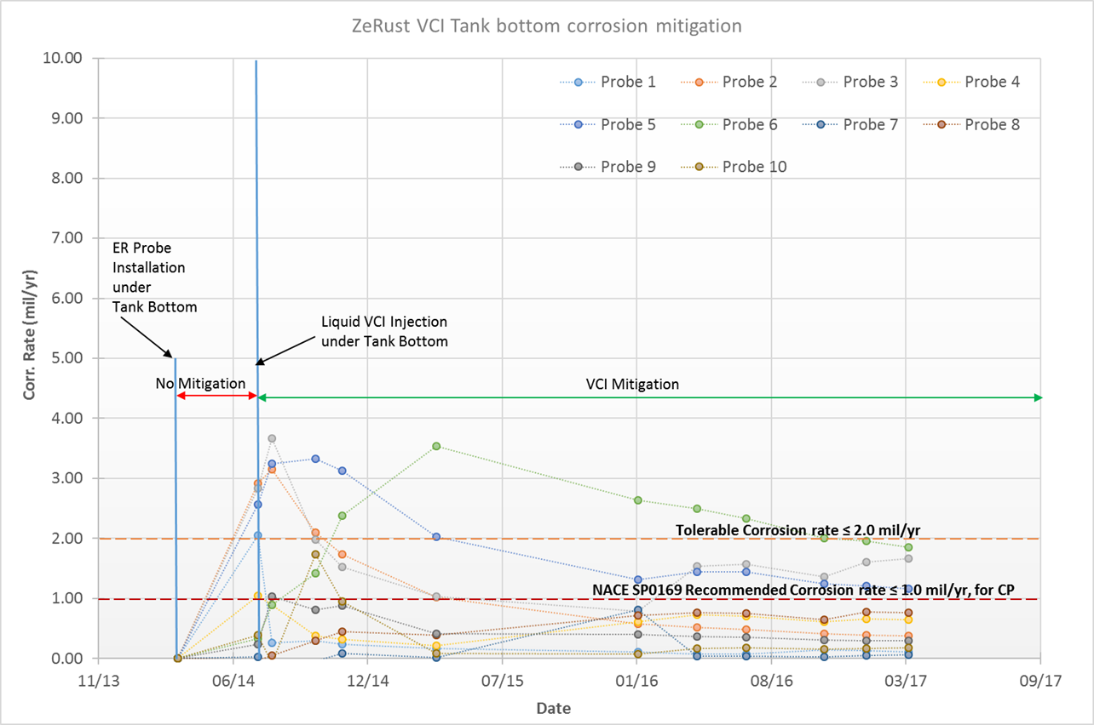
Sample Data

Slide 35
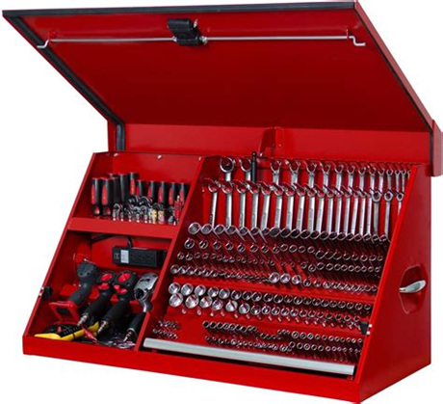
Summary
Changing regulations are requiring proactive approach to corrosion mitigation
Prioritizing higher risk is important
There are options (tools in the kit)
Evaluate
Affect to CP

Slide 36
THANK YOU!
Any questions?
You can contact me at: kbaker@ntic.com (832) 465-5668
Notes:
VCIs are cost effective tool that is available in your fight against corrosion.

