Slide 1
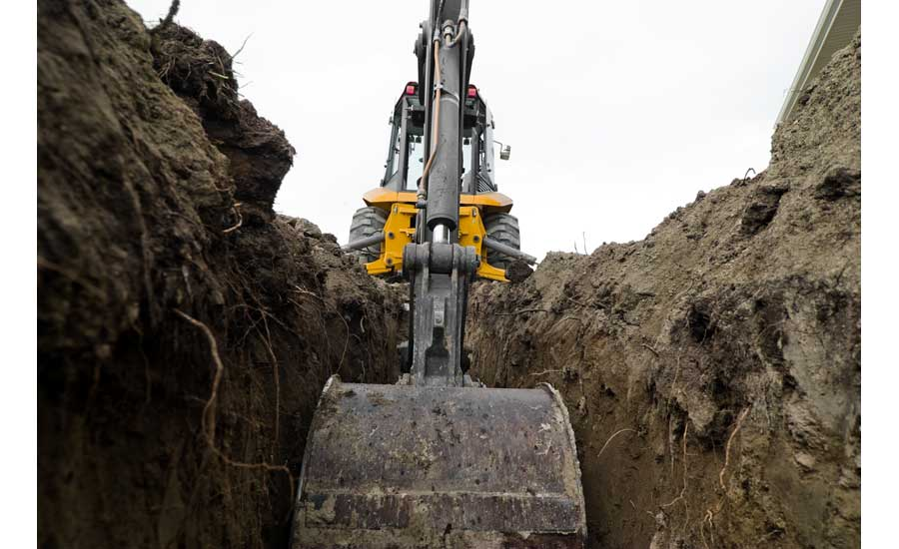
Trench Excavation and Your Safety

Slide 2
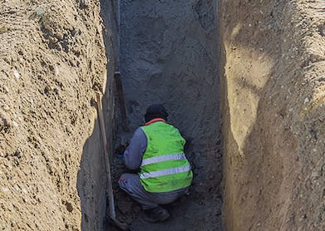
Questions?
Raise of hand- how many of you will conduct work inside a trench this coming year?
If I offered, you $100.00 to go into this trench to cad-weld a handicap onto a steel gas line.
There is a 50/50 chance the trench caves-in on you.
Would you, do it?
Notes:
Question #2
How long to cad-weld a handicap- double your hourly wage
I would assume we would all say no- $100.00 is not worth our lives

Slide 3
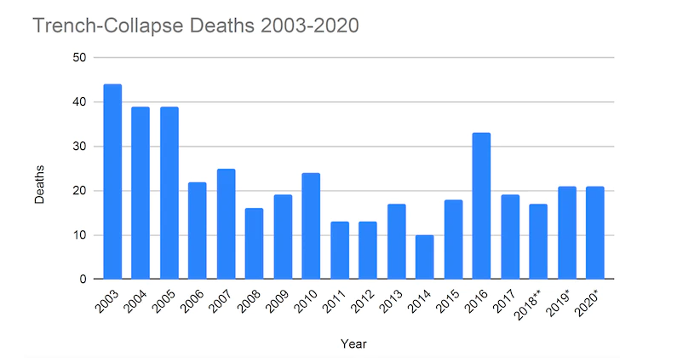
Notes:
BUT, across the US every year some one enters that trench- and dies
Don’t want to bother asking is it safe- make it safe
Friday night
Only going to take a few minutes
I have done it before (many times)- Normalization of Deviation
37% of all trenching incidents occur at depths of less than 5 feet.
Develop extremely fast
Secondary collapses are very common
Co-workers attempting to rescue someone can also become victims
** Data reported by NIOSH Science Blog.
* Data compiled by Equipment World from OSHA and media reports.

Slide 4
Notes:
All trenches are excavations, but not all excavations are trenches

Slide 5
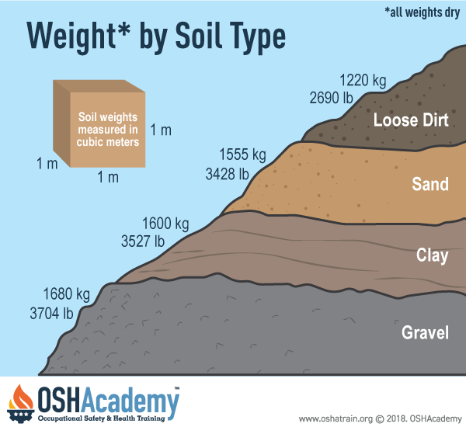
Notes:
As mentioned, develop extremely fast 3,500 lbs. of soil
1’ cubic meter of soil falling into a trench equals weight of a VW Beetle
1’ cubic meter equals 3.2 feet
37% of all trenching incidents occur at depths of less than 5 feet.
If Standing
Lower extremities- no blood or oxygen flow- if your able to take a breath… what happens? Cave-in worsens
Kidney
Heart
Lungs
If kneeling-working
Internal injuries-head, neck, back
Suffocation

Slide 7
OSHA Trench Safety “5 Things You Should Know to Stay Safe in a Trench”
Ensure
Ensure safe entry and exit – a means of egress must be provided when a trench is at least 4 feet deep and must not require more than 25 feet of travel.
Have
Trenches must have cave-in protection – slope it, shore it, or shield it
Keep
Keep materials away from the edge of a trench – heavy loads from material or equipment can put too much pressure on trench walls.
Look
Look for standing water or other hazards – standing water can greatly reduce the strength of the soil
Enter
Never enter a trench unless it has been inspected – a competent person is required to inspect trenches

Slide 8
Ensure safe entry and exit – a means of egress must be provided when a trench is at least 4 feet deep and must not require more than 25 feet of travel. 1. Ladder 2. Ramp 3. Stairway
Notes:
ENSURE
Ladder- 3’ above and tied off

Slide 9
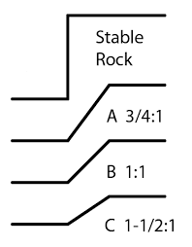
Notes:
HAVE- Trenches must have cave-in protection – slope it, shore it, or shield it

Slide 10
Notes:
Discussion:
Shoring systems:
A shoring system that supports the side of an excavation using some form of pneumatic or hydraulic system to support each side of the trench.
Shielding systems:
Can be premanufactured or commonly referred to as "trench boxes" or "trench shields” and can be a permanent structures or portable. It's designed to prevent cave-ins.
Shoring or Shielding needs to extend 18” above where sloping meets your system

Slide 11
Benching vs Sloping
Notes:
Besides Slope, Shore or shield…. There is a 4th benching
Can someone explain why benching is not allowed in Type C soil?
Answer- Because Type C has no cohesiveness to be able to hold the soil together to support a bench, thus no benching is allowed.

Slide 12
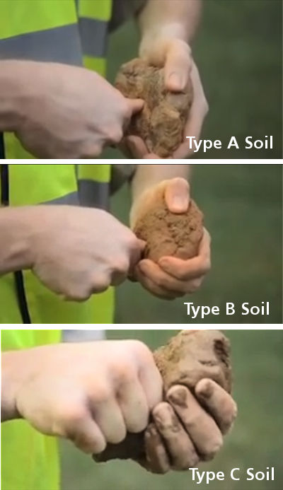
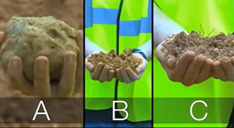
Notes:
Cohesiveness of the soil
Type A- High cohesiveness
Type B- Moderately stable with a moderate cohesive strength
Type C- Least stable soil with little to no cohesive strength
Solid Rock- Self explanatory

Slide 13
Example Federal vs State Shoring Requirement's
State run OSHA Programs
Oregon, Washington, Wyoming & Minnesota
States with Federal programs
Idaho, Montana, North & South Dakota
Trigger depth for shoring
Oregon, Wyoming, 5 Ft.
Minnesota, Idaho, Montana,
North & South Dakota
Washington 4 Ft.

Slide 14
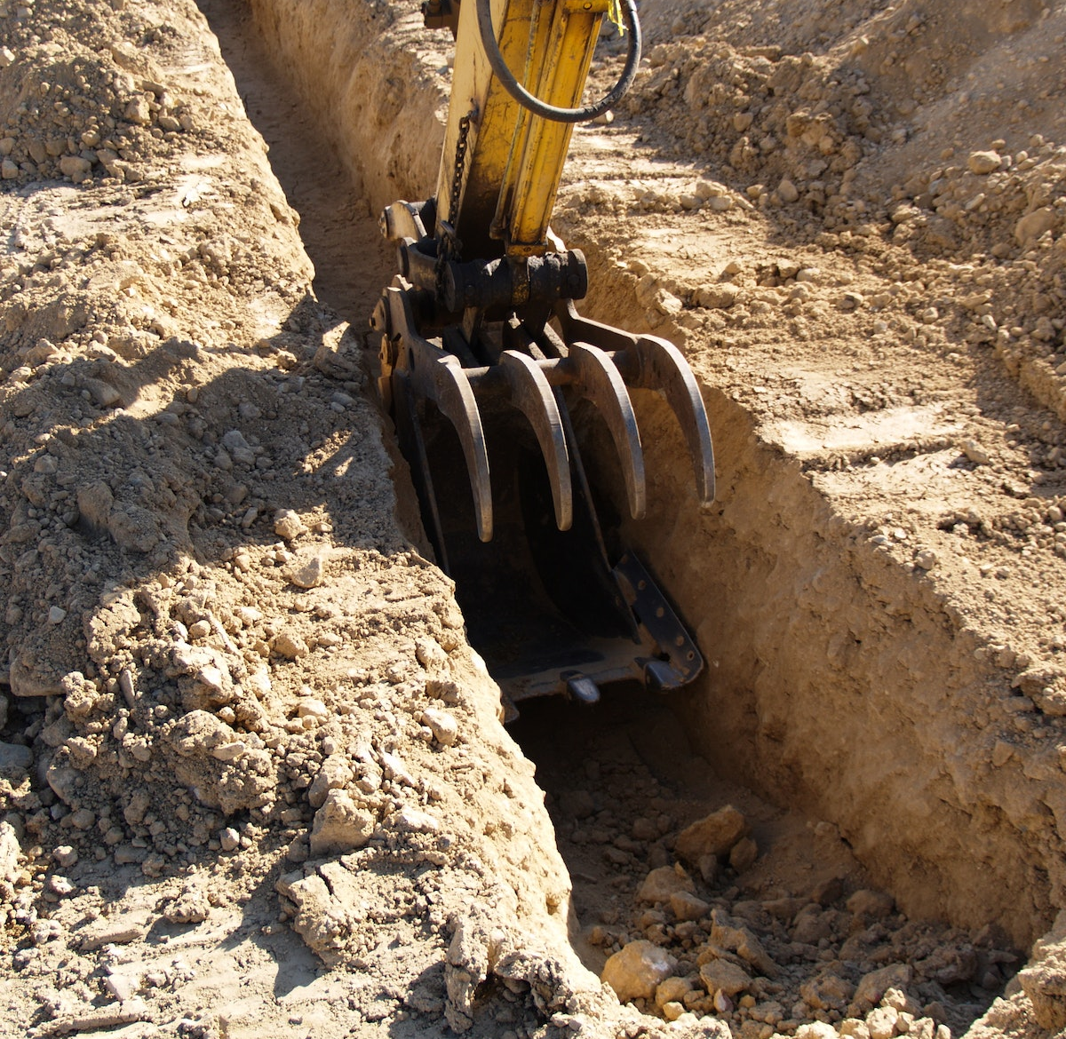
Keep Heavy Loads 2’ from Trench Edge
Notes:
KEEP
What other then spoil pile= heavy load?
Tools(welder, air compressor, portable light units) and
Equipment (dump truck, backhoes)… even hand tools- fall in hitting you as you work.

Slide 15
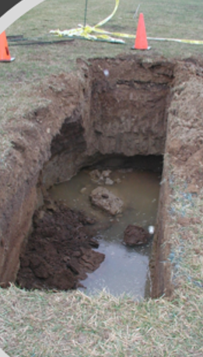
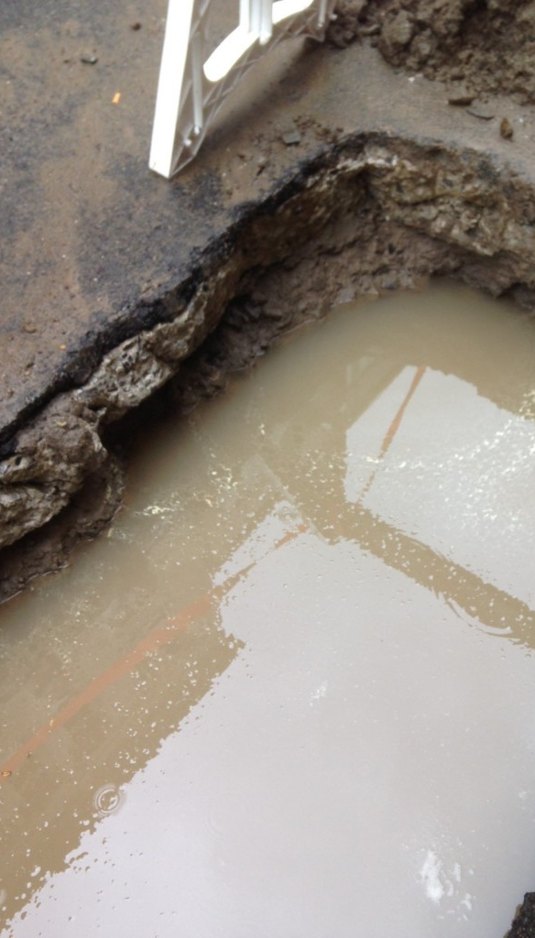
Look for Standing Water
Notes:
LOOK
What other things should we be looking for?
Other utilities
Adjacent structures- needing support systems
Air monitoring- O2, H2S, Methane

Slide 16
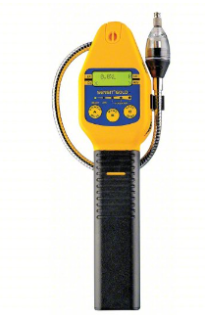
Air Monitoring
Where oxygen deficiency (atmospheres containing less than 19.5 percent oxygen) or a hazardous atmosphere exists or could reasonably be expected to exist, such as in excavations in landfill areas or excavations in areas where hazardous substances are stored nearby, the atmospheres in the excavation shall be tested before employees enter excavations greater than 4 feet in depth.
Notes:
competent person expected to determi

Slide 17
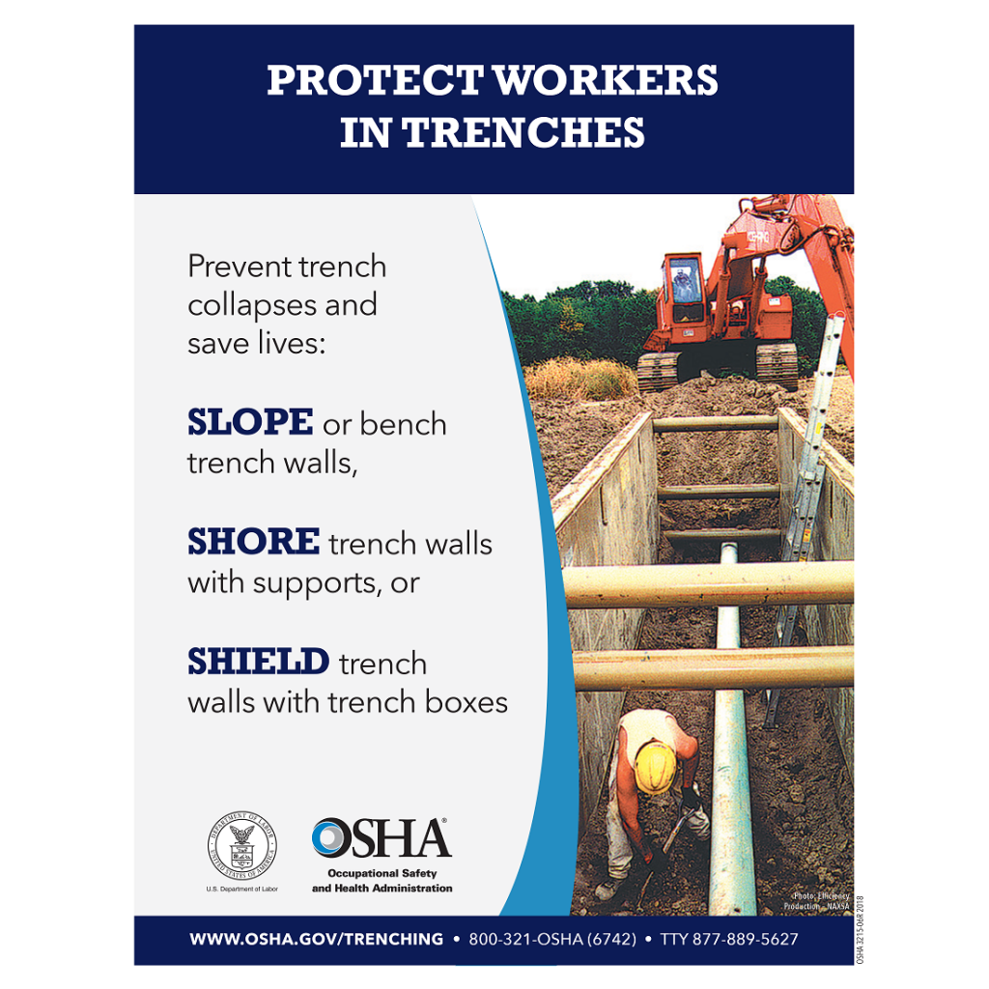
Notes:
Remember- slope, shore or shield. When in doubt, check-in with the competent person on-site. OSHA requires that there be a “Competent Person” present whenever a worker enters a trench or excavation

Slide 18
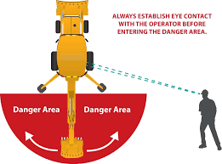
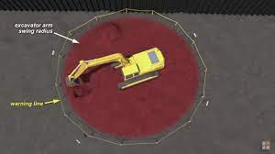
BEST PRACTICES FOR YOUR SAFETY
Stay out of the Swing Area
Notes:
Our Company Policy- Workers shall not be in a trench within the swing area during excavation.
Best practice for all
As you approach make eye contact with operator
Ask for the equipment to be shut down
No high idle- accidental bump- injury

Slide 19
Trench Cave In - YouTube

Slide 20
Who do our choices affect?
Emotional effects
Rescuers and family
Notes:
Ripple Effect:
today's decision effects more than just you as an individual.
It effects your family, friends’, and co-workers in a way that will dramatically change one's life.
Father, Mom, Husband, Wife, Son, Daughter
Graduations, weddings, anniversary, hunting, camping trips

Slide 21
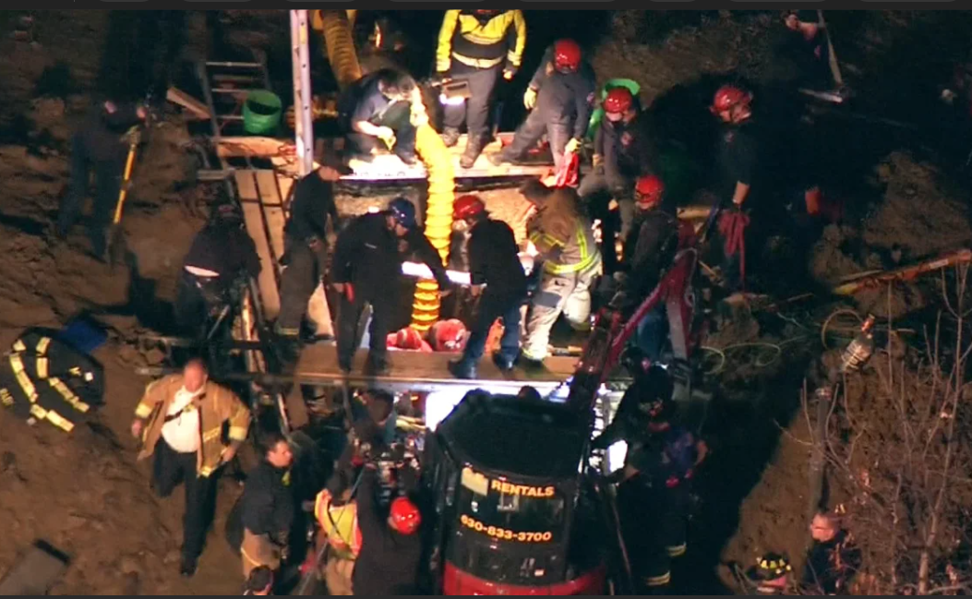
Notes:
In the event of trench cave-in, majority of the time if becomes a body retrieval not a rescue.

Slide 22
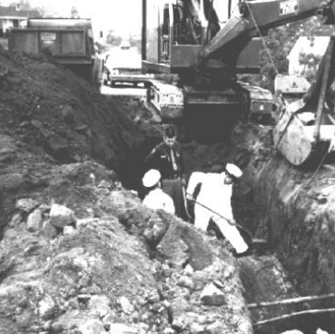
Thank You
Notes:
We have come along way since this picture

