Slide 1

Top Ten Misunderstandings Regarding Over-Voltage Protection
Mike Tachick
Dairyland Electrical Industries Inc.
SIEO, Jan 2016

Slide 2
Why this topic?
Over-voltage can be a confusing subject
I see repeated mistakes, errors by industry personnel
Consequences of these misunderstandings can be lethal

Slide 3
Ground mats aren’t great AC mitigation grounds…
Gradient control mats are intended to limit step and touch voltage
Address AC fault and lightning conditions, depending on design
Installed around test stations and piping
Installed in/under high resistivity fill

Slide 4
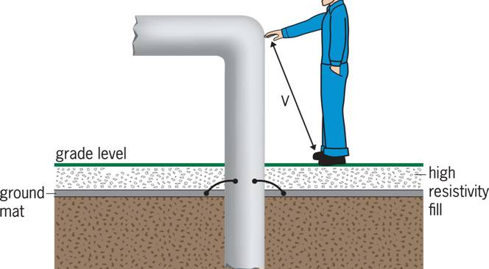
Ground mats aren’t great AC mitigation grounds…

Slide 5
Ground mats aren’t great AC mitigation grounds…
Ground mat hopefully limits earth gradient and touch voltage
High resistivity fill further limits effects upon person over the mat (limits current)
High resistivity➔ High resistance to earth
High resistance➔ Little AC mitigation

Slide 6
Ground mats aren’t great AC mitigation grounds…
Gradient control mats serve useful purpose for step/touch protection
Are part of AC mitigation design for test stations and facilities
But other mitigation components perform voltage reduction from between pipe and earth

Slide 7
Conductor length matters
Any conduction path has inductance
Inductance resists current changes and creates large voltage differences when current abruptly changes
Resulting voltage between connection points can be large

Slide 8
Conductor length matters
Matters most where insulation (or people) can’t withstand resulting voltage
Examples: insulated joint, coating, insulated fittings
Result without remediation: arcing

Slide 9
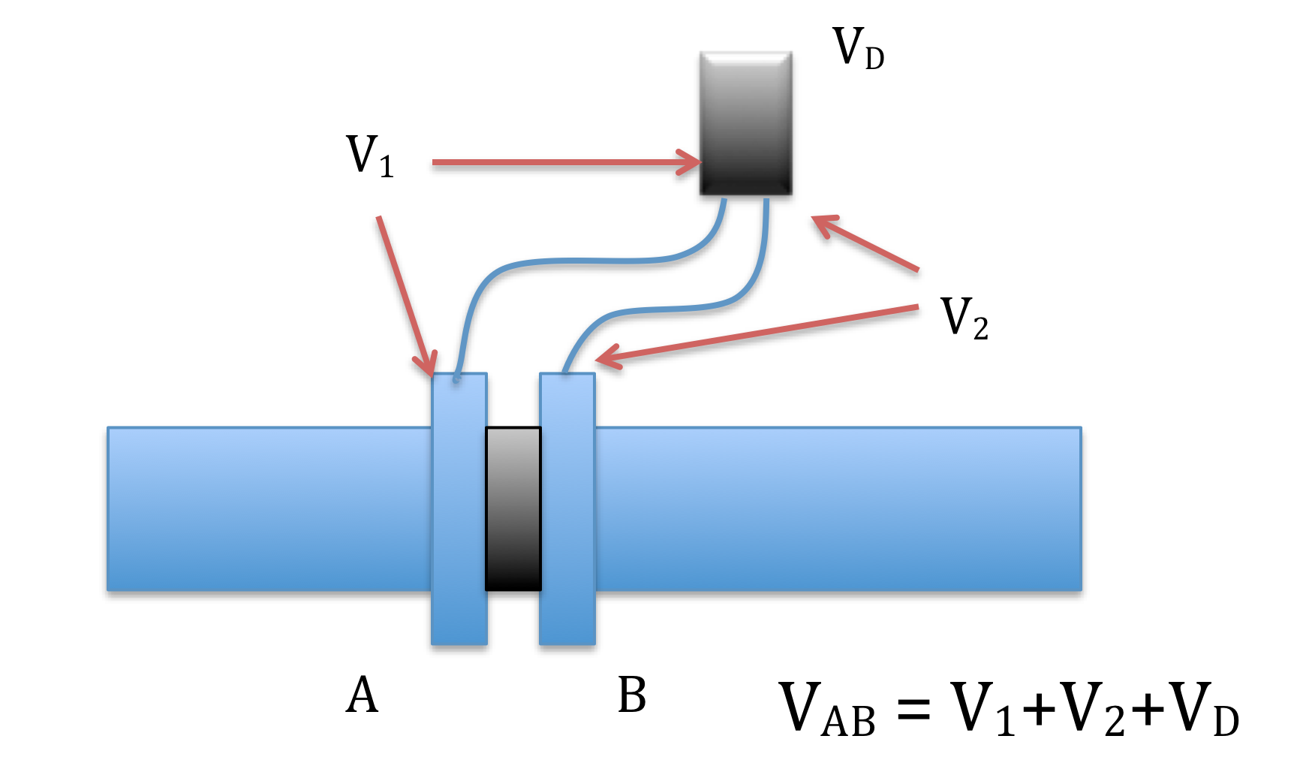
Conductor length matters

Slide 10
Conductor length matters
Resulting V_{AB} relates to inductance L and rate of change of current, di/dt
V = L • di/dt
Consider lightning, with high di/dt
V = 0.2μH/ft • 15,000A/μs
V = 3,000V/ft
= higher than you expected

Slide 11
Some ground mat designs may provide little protection
Ground mats are wire designs in various orientations:
Spiral
Zig-zag
Grid

Slide 12
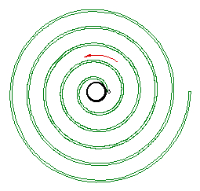
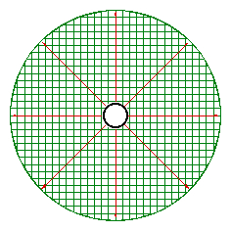
Some ground mat designs may provide little protection
Spiral or single wire mat
Grid type mat

Slide 13
Some ground mat designs may provide little protection
Remember the discussion about conductor length…?
Increased conductor length = increased inductance = higher voltage
Mats vary in inductance with design
Voltage gradient under AC fault conditions with any mat design: likely OK
Voltage gradient with lightning: big difference

Slide 14
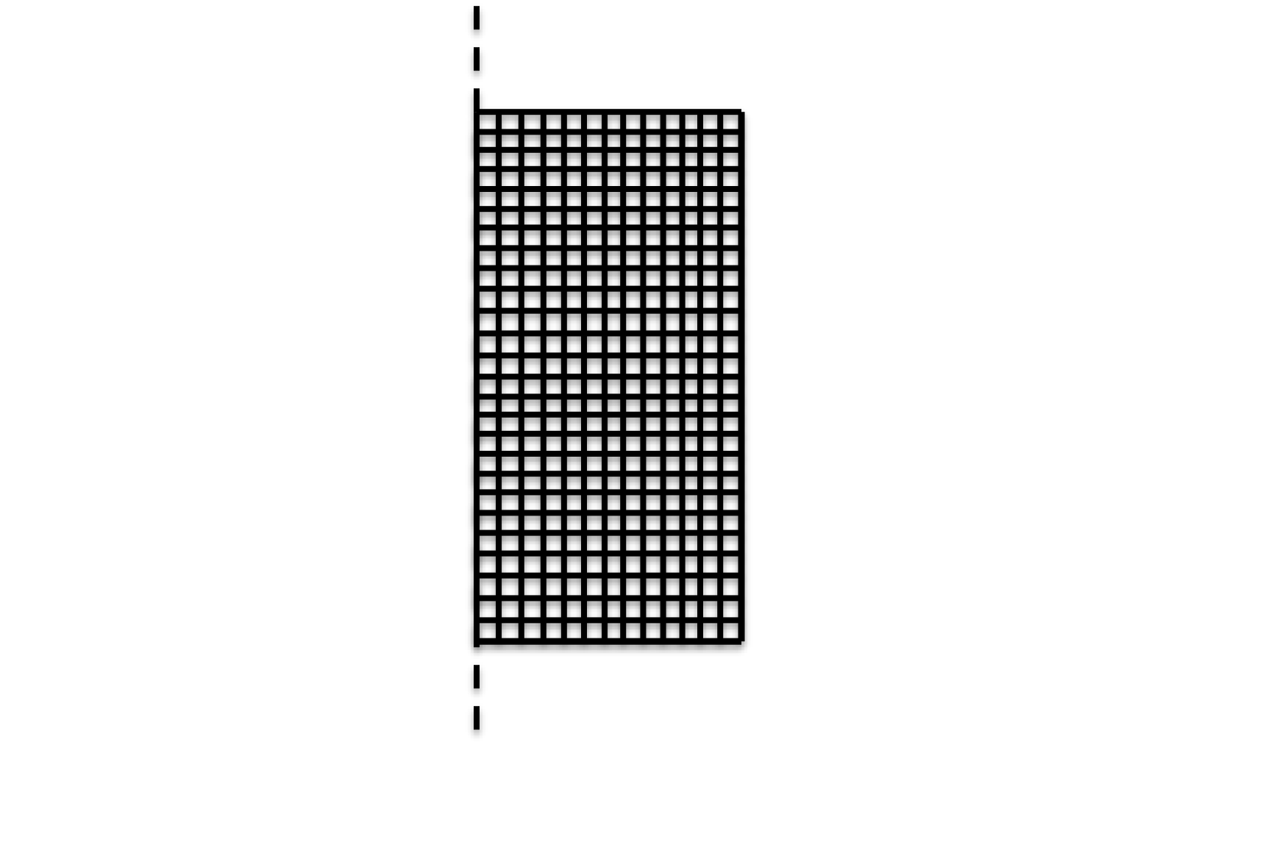
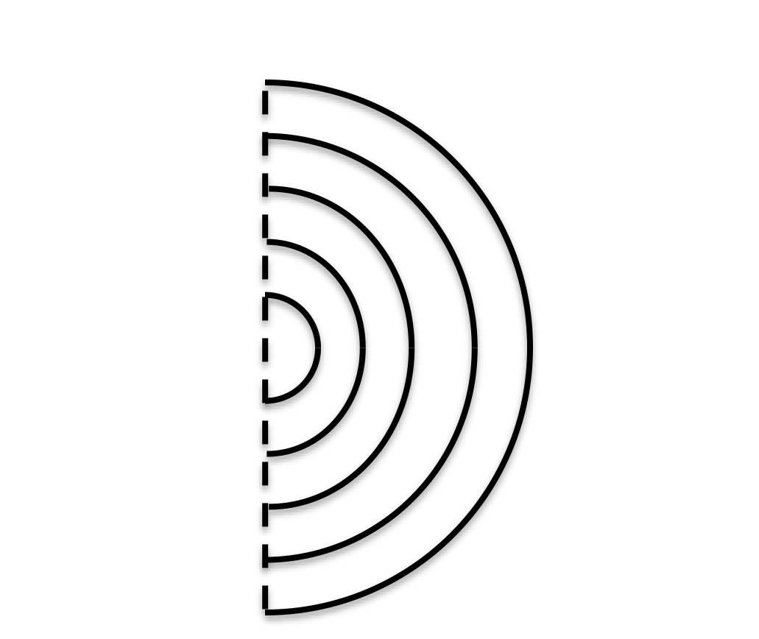
Some ground mat designs may provide little protection
Single wire
Grid
V
V

Slide 15
Some ground mat designs may provide little protection
Single wire/spiral mat
Grid mat
Radial Distance (In.) | Touch Potential (kV) | Step Potential (kV/ft)
6 | 0 | 0
18 | 48 | 48
30 | 154 | 106
42 | 310 | 156
54 | 507 | 196
66 | 726 | 219
Radial Distance (In.) | Touch Potential (V) | Step Potential (V/ft)
6 | 0 | 0
18 | 57 | 57
30 | 83 | 26
42 | 101 | 18
54 | 115 | 14
66 | 124 | 10
Note values in kV
Note values in V
Ref 1

Slide 16
Conductor length isn’t key in all applications
Where insulation can break down, or personnel can contact different structures, consider conductor length:
Insulated joints
Insulated fittings
Bonding grounding systems, mats, fences

Slide 17
Conductor length isn’t key in all applications
Applications where you can’t control conductor length:
AC mitigation systems (generally)
Decouplers in electrical grounding systems
Conductor length can’t reasonably be shortened
Other factors are more important in these examples: dealing with AC induction and faults

Slide 18
Total isolation of structures is risky
Some attempt to provide isolation between structures to prevent “bad things” from happening
The idea: Keep the bad stuff on one side, don’t allow it to reach the other side
Reality: not possible, introduces new major risks (arcing, ignition, shock hazard)

Slide 19
Total isolation of structures is risky
Protection methods are needed between any two isolation structures where high voltage may occur
Over-voltage protection is simple to apply
Limits voltage, allows current to flow

Slide 20
Total isolation of structures is risky
Current flow on structures is not a problem
Important factor: how does current enter/exit the structure?
Apply mitigation or over-voltage protection at other points that act as “exit” point

Slide 21
Decouplers are not one-way devices
Decouplers are over-voltage and AC mitigation devices
Devices have a threshold in each polarity and block DC inside that range, and conduct outside the range
Decouplers conduct AC continuously

Slide 22
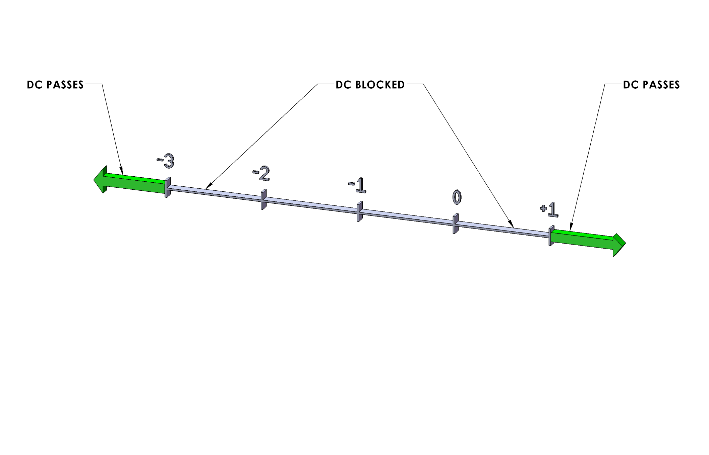
Decouplers are not one-way devices
Decoupler Threshold of -3V/+1V Shown

Slide 23
Decouplers are not one-way devices
If decouplers were one-way devices, then they must withstand full reverse voltage and not conduct
If true, then voltage in reverse direction could not be limited or controlled
Result: over-voltage conditions, device would fail at some point

Slide 24
AC induction always has fault risk
“I just want to mitigate the steady-state AC, but we don’t have fault exposure”
AC is induced on pipelines from overhead power lines
Magnetic field surrounds current flow on line, induces current/voltage on pipe
Many variables determine resulting voltage level, but any steady-state AC comes from induction phenomenon

Slide 25
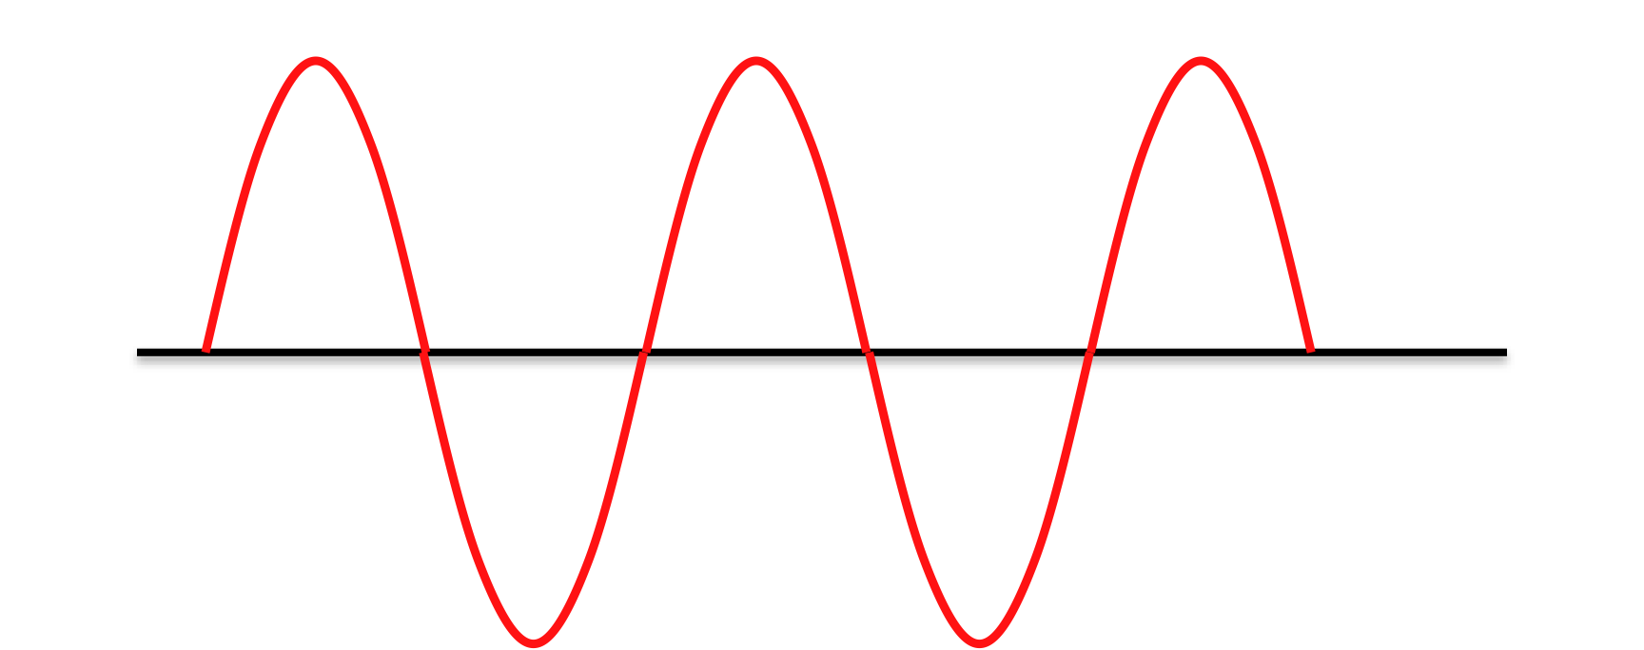
AC induction always has fault risk
Steady-state
Fault

Slide 26
AC induction always has fault risk
AC fault is just a higher amplitude version of steady-state induction
Same phenomena governs both – it’s all magnetic induction
Conclusion: any measured steady-state AC will increase under fault conditions

Slide 27
Lightning ≠ AC or DC
Characteristics of lightning are not similar to AC or DC, and produce different effects
Lightning waveform is unique
Conductor length discussion applies to lightning, unlike AC or DC

Slide 28
Lightning ≠ AC or DC
Current
Magnitude
Fast rise time
High magnitude
Slope =
di/dt
Time in microseconds

Slide 29
Lightning ≠ AC or DC
Keep conduction paths short
Reference nearby structures to each other
Don’t leave structures ungrounded
Conductors don’t need to be large to handle lightning current - est. #6AWG

Slide 30
Monolithic joints need protection
Monolithic joints are factory assembled and tested
Have higher voltage withstand than bolted flanged joints
…but not unlimited

Slide 31
Monolithic joints need protection
Over-voltage protection needed
Without it, designer may be trying to totally isolate two structures under all conditions
Without protection, end result is same, but arc is initiated at perhaps 25kV instead of 5kV

Slide 32
Leave equipment grounds as designed
Equipment grounds can affect CP
AC powered equipment has a dedicated grounding conductor
Grounding conductor carries AC fault current if equipment fails, cable short, etc
Breaker in panel senses current and clears fault
Without this ground, fault clearing will be affected

Slide 33
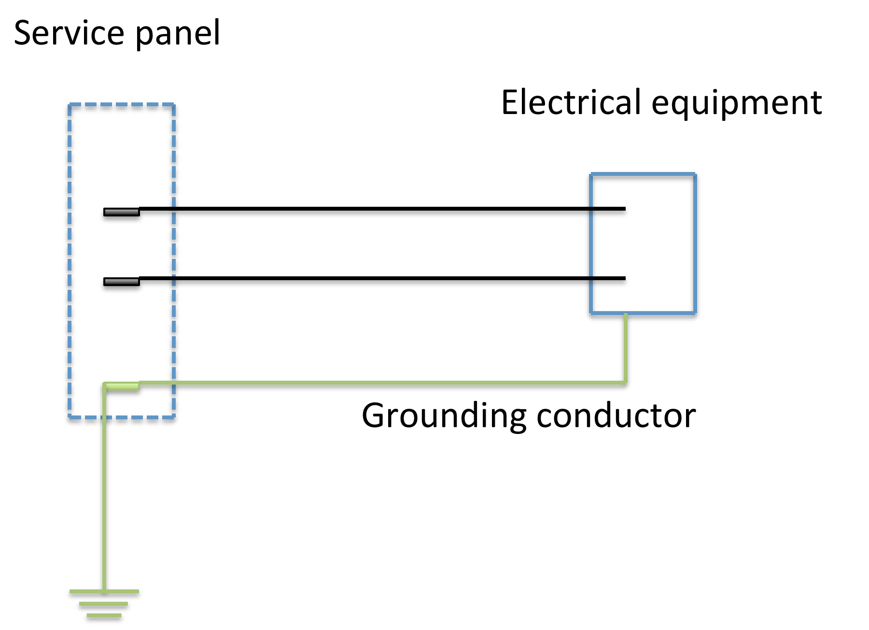
Leave equipment grounds as designed

Slide 34
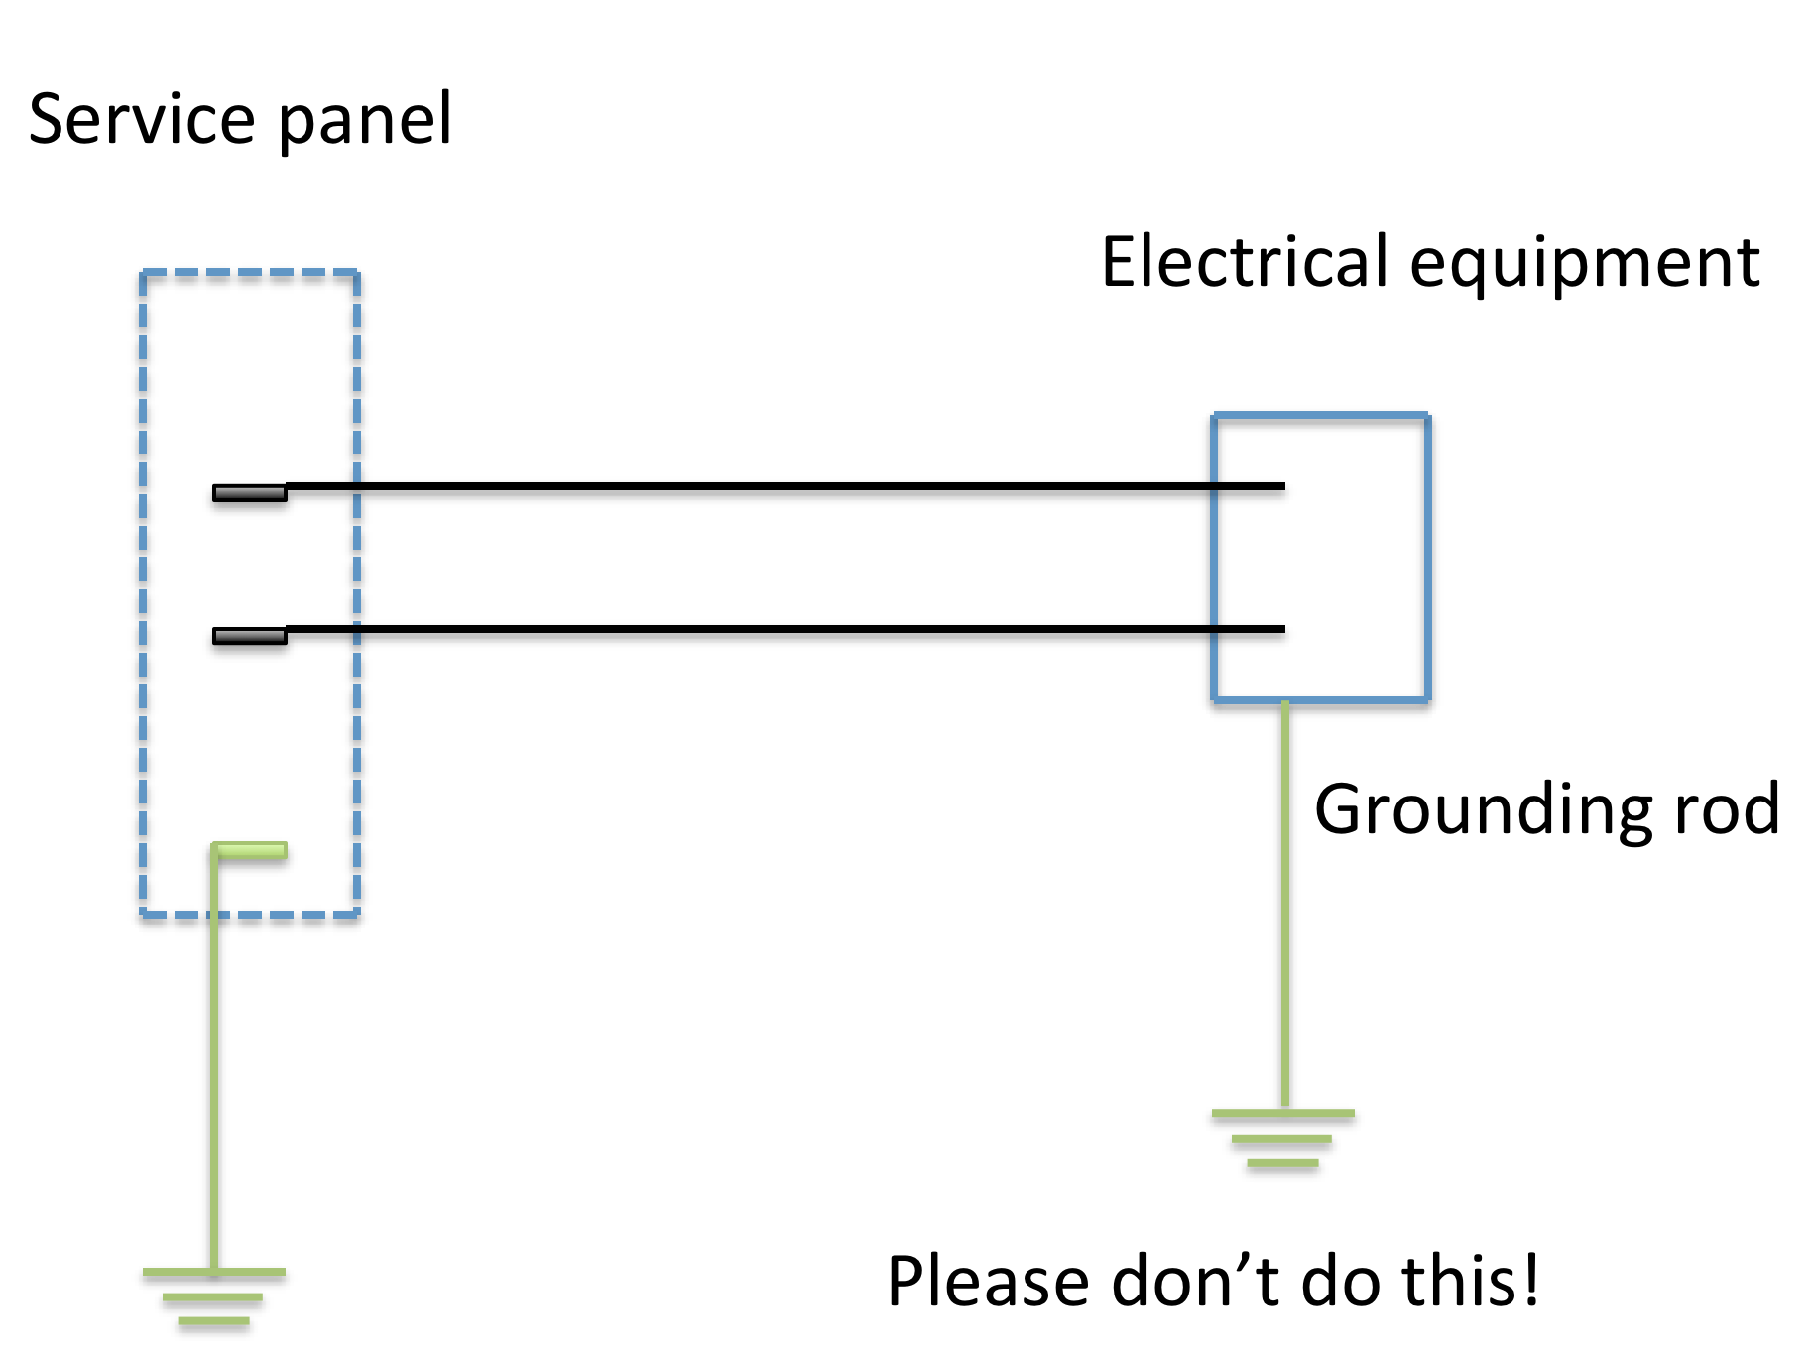
Leave equipment grounds as designed

Slide 35
Leave equipment grounds as designed
Solve CP problems with the grounding conductor intact
Use certified decoupler to provide DC isolation and AC continuity of the ground, or other techniques

Slide 36
Questions?
For further questions, contact:
Mike Tachick
mike@dairyland.com
Phone 608-877-9900
Ref 1: NACE 2005 Henry Tachick Paper #05617

