Slide 1
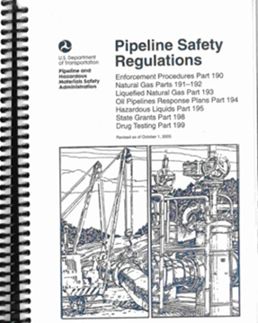
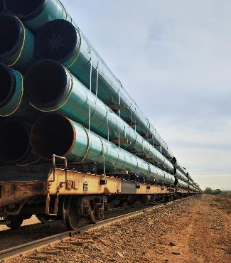
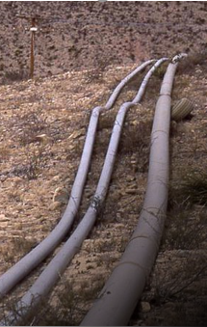
Pipeline and Hazardous Materials Safety Administration
Office of Pipeline Safety
Pipeline Safety – Hazardous Liquid Pipeline and Valve Rules
January 6, 2023

Slide 2
Safety of Hazardous Liquid Pipelines
Pipeline and Hazardous
Materials Safety Administration
Docket No: PHMSA-2010-0229
Amdt No 195-102
Publication Date: October 1, 2019
Effective Date: July 1, 2020

Slide 3
Safety of Hazardous Liquid Pipelines
Reporting requirements (195.13 and 15)
Expanded use of Leak Detection Systems (195.134 and .444)
Increased use of in-line inspection tools (195.120)
Periodic assessments of pipelines not subject to IM (195.416)
IM revisions and clarifications
  Prioritizing Repair (195.401(b)(3))
  Information Analysis (195.452(g))
  Required Actions (195.452(h))
  Verifying Covered Segments (195.452(j)(2))
Extreme weather events and natural disasters (195.414)
Self Executing Provisions
  MSDS requirements (195.65)
  Underwater Inspection (195.454)

Slide 4
Safety of Hazardous Liquid Pipelines
What can or should you be doing now?
Reporting requirements (195.13 and 15)
Expanded use of Leak Detection Systems (195.134 and .444)
New PLs (after 10/1/2019)
Existing PLs (prior to 10/1/2019): inquire about their evaluation and identify their path to compliance by 10/1/2024.

Slide 5
Safety of Hazardous Liquid Pipelines
What can or should you be doing now?
Pipelines Affected by Extreme Weather and Natural Disasters (195.414)
The regulation is in full effect, and we had some events that qualify. (Hurricane Isaias, Laura, Marco, TX Freeze …)

Slide 6
Safety of Hazardous Liquid Pipelines
What can or should you be doing now?
Periodic Assessments of Pipelines not Subject to IM (195.416)
You can inquire about their status and what their plans are for completing but nothing is immediately due. Compliance by 10/1/2029

Slide 7
Safety of Hazardous Liquid Pipelines
What can or should you be doing now?
Revised IM Regulations (195.452)
IM changes went into effect on 7/1/2020.
(c) Review to ensure they are performing ILI on baselines as the preferred method.
(g) Integration of (21 items) must be completed by 10/1/2022. Review their information analysis.
(h)(1) Ensure they update process to take prompt action and repairs.
(h)(2) are the following the discovery requirements.

Slide 8
Safety of Hazardous Liquid Pipelines
What can or should you be doing now?
Revised IM Regulations (195.452)
(j)(2) Ensure they are verifying the risk factors annually. First one was due 7/1/2021.
(n) Inquire about IM pipeline can accommodate ILI. All must accommodate by 7/2/2040.

Slide 9
Hazardous Liquid Rule
Self Executing Provisions – Safety Data Sheets
New Code section: 195.65
Effective Date: July 1, 2020
High Level Overview:
  Operators must present MSDS sheets to On Scene Coordinators, and local responders.

Slide 10
Hazardous Liquid Rule
Integrity Assessment for Certain Underwater HL pipeline facilities located in a HCA
New Code section: 195.454
Effective Date: July 1, 2020
High Level Overview:
  Certain pipelines will have to be assessed every 12 months.

Slide 12
Valve Rule
Amendments to Parts 192 and 195 to Require Valve Installation and Minimum Rupture Detection Standards
Docket No: PHMSA-2013-0255
Amdt No 192-130, 195-105
Publication Date: April 8, 2022
Effective Date: October 5, 2022
Certain Sections Effective Date: April 10, 2023

Slide 13
Valve Rule
Major Provisions
Definitions (192.3, 195.2)
RMV Installation (192.179, 195.258) [4/10/2023]
HL Valve Spacing (195.260) [4/10/2023]
Emergency Plan Changes (192.615, 195.402(e))
Investigation of Failure, Incidents and Accidents (192.617, 195.402(c))
Notification of Potential Rupture (192.635, 195.417)
Valve Maintenance (192.745, 195.420)
IM Valve Risk Analysis (192.935, 195.452)

Slide 14
New Definitions
Entirely replaced onshore hazardous liquid or carbon dioxide pipeline segments, for the purposes of §§ 195.258, 195.260, and 195.418, Entirely replaced onshore transmission pipeline segments means, for the purposes of §§ 192.179 and 192.634, means where 2 or more miles of pipe, in the aggregate, have been replaced within any 5 contiguous miles within any 24-month period.
Notification of Potential Rupture means the notification to, or observation by, an operator of indicia identified in § 195.417 of a potential unintentional or uncontrolled release of a large volume of commodity from a pipeline.
Rupture-mitigation valve (RMV) means an automatic shut-off valve (ASV) or a remote-control valve (RCV) that a pipeline operator uses to minimize the volume of hazardous liquid or carbon dioxide released from the pipeline and to mitigate the consequences of a rupture.

Slide 15
RMV Installation
For onshore transmission pipeline segments with diameters greater than or equal to 6 inches that are constructed after April 10, 2023,
For all onshore hazardous liquid or carbon dioxide pipeline segments with diameters greater than or equal to 6 inches that are constructed after April 10, 2023,
… the operator must install rupture-mitigation valves (RMV) or an alternative equivalent technology whenever a valve must be installed to meet the appropriate valve spacing requirements of this section (and § 195.260.)

Slide 16
HL Valve Spacing
For newly constructed or entirely replaced onshore hazardous liquid or carbon dioxide pipeline segments, … that are installed after April 10, 2023, valve spacing must not exceed 15 miles for pipeline segments that could affect or are in HCAs, …, and 20 miles for pipeline segments that could not affect HCAs.
.

Slide 17
Post Failure, Accident and Incident Investigation
This section is effective now (October 5, 2022)
Investigating and analyzing pipeline accident, incidents and failures.
  The term “failure” does not mean a release of product.
  Failures refer to equipment or part has become inoperable, not function properly, or unreliable.

Slide 18
Post Failure, Accident and Incident Investigation
Each operator must establish and follow procedures for investigating and analyzing failures and incidents …, including:

Slide 19
Post Failure, Accident and Incident Investigation - Lessons Learned
sending the failed pipe, component, or equipment for laboratory testing or examination, … determining the causes and contributing factor(s) … and minimizing the possibility of a recurrence.
develop, implement, and incorporate lessons learned from a post-failure or incident review … including personnel training and qualification programs, and design, construction, testing, maintenance, operations, and emergency procedure manuals and specifications.

Slide 20
Emergency Plan Updates
This section is effective now (October 5, 2022)
Establishing and maintaining adequate means of communication with the appropriate public safety answering point (i.e., 9–1–1 emergency call center), …
Operators must determine the responsibilities, resources, jurisdictional area(s), and emergency contact telephone numbers for both local and out-of-area calls … organization that may respond to a pipeline emergency, and inform the officials about the operator’s ability to respond to the pipeline emergency and means of communication during emergencies.
Operators may establish liaison with the appropriate local emergency coordinating agencies, …, in lieu of communicating individually with each fire, police, or other public entity.

Slide 21
Notification of Potential Rupture
… a notification of potential rupture means refers to the notification to, or observation by, an operator …of a potential unintentional or uncontrolled release of a large volume of hazardous liquids (gas) from a pipeline:
(1) An unanticipated or unexplained pressure loss outside of the pipeline’s normal operating pressures, as defined in the operator’s written procedures.
(2) An unanticipated or unexplained flow rate change, pressure change, equipment function, or other pipeline instrumentation indication at the upstream or downstream station that may be representative of an event meeting paragraph (a)(1) of this section; or
(3) Any unanticipated or unexplained rapid release of a large volume of hazardous liquid (gas), a fire, or an explosion, in the immediate vicinity of the pipeline.

Slide 22
RMV Capabilities
Following “notification of potential rupture,” RMVs must be closed as soon as practicable, but within 30 minutes
  Operators of non-HCA Class 1 pipelines and non-HCA HL pipelines can request exemption if they can demonstrate to PHMSA that an RMV would be infeasible
For GT, operators may request to leave RMVs open following “notification of potential rupture” if PHMSA is notified and it is coordinated with the appropriate local emergency responders prior to the incident
RMVs must be monitored or controlled by remote or on-site personnel
  ASVs do not need to monitor valve status remotely if the operator has the capability to monitor pressure or flow rate within each pipeline segment located between RMVs on the line to identify and locate a rupture
Sets modeling requirements for ASVs based upon flow volumes, pressures, other operating conditions and any laterals or connected pipelines.

Slide 23
Valve Maintenance
This section is effective now (October 5, 2022)
195.420(b) maintenance requirements “expanded” beyond “mainline” valves.
Added 25% closure
Alternative technology must demonstrate response times during drills

Slide 24
IM P&M Measures – Valve Risk Analysis
Clarifies requirements for conducting RMV evaluations for HCAs as Preventive & Mitigative measures:
  For GT and HL: timing of leak detection and pipe shutdown capabilities, the type of gas being transported, operating pressure, the rate of potential release, pipeline profile, the potential for ignition, and location of nearest response personnel
  For HL only: the type of commodity carried, the rate of potential leakage, the volume that can be released, topography or pipeline profile, the potential for ignition, proximity to power sources, specific terrain within the HCA or between the pipeline segment and the HCA it could affect, and benefits expected by reducing the spill size.
Risk analyses and assessments … must be annually reviewed
e

Slide 26

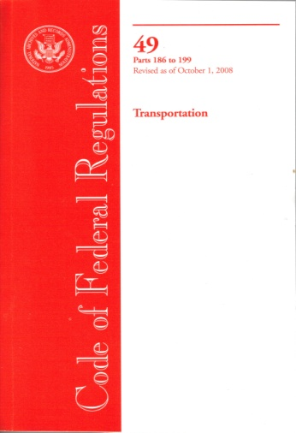
Additional Resources and Tools
PHMSA Homepage, Office of Pipeline Safety
  www.phmsa.dot.gov
Standards & Rulemaking
  http://www.phmsa.dot.gov/pipeline/regs
PHMSA Technical Resources
  https://www.phmsa.dot.gov/technical-resources/pipeline/pipeline-technical-resources-overview
  GPAC Meeting slides for reference at “Public Meetings” tab (https://primis.phmsa.dot.gov/meetings/)
PHMSA’s Stakeholder Communications Site
  http://primis.phmsa.dot.gov/comm
For Federal Regulations (Official Version)
  www.ecfr.gov
- 26 -

Slide 27


Pipeline Safety Questions…
Contact a Community Liaison
HEADQUARTERS
Karen Lynch, Program Manager
EASTERN REGION
Karen Gentile Connecticut, Maine, Massachusetts, New Hampshire, New Jersey, New York, Rhode Island, Vermont | Nita Raju Delaware, Maryland, Ohio, Pennsylvania, Virginia, Washington DC, West Virginia
SOUTHWEST REGION
James ‘Jay’ Prothro Arkansas, Oklahoma, Texas (North) | Bill Lowry Louisiana, New Mexico, Texas (South)
SOUTHERN REGION
Artie Buff Georgia, North Carolina, South Carolina, Tennessee, Puerto Rico | James Kelly Alabama, Florida, Kentucky, Mississippi
CENTRAL REGION
Angela Pickett Kansas, Missouri, Iowa, Illinois, Michigan, Minnesota | Sean Quinlan North Dakota, South Dakota, Indiana, Nebraska, Wisconsin
WESTERN REGION
Dave Mulligan Arizona, California, Colorado, Hawaii, Nevada, Utah | Tom Finch Alaska, Idaho, Montana, Oregon, Washington, Wyoming
Just Search
“Community Liaisons” on www.phmsa.dot.gov

Slide 28
William Lowry PE
bill.lowry@dot.gov
Thank You!!
https://www.phmsa.dot.gov

