Slide 1
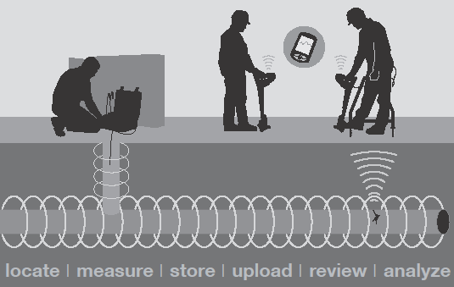
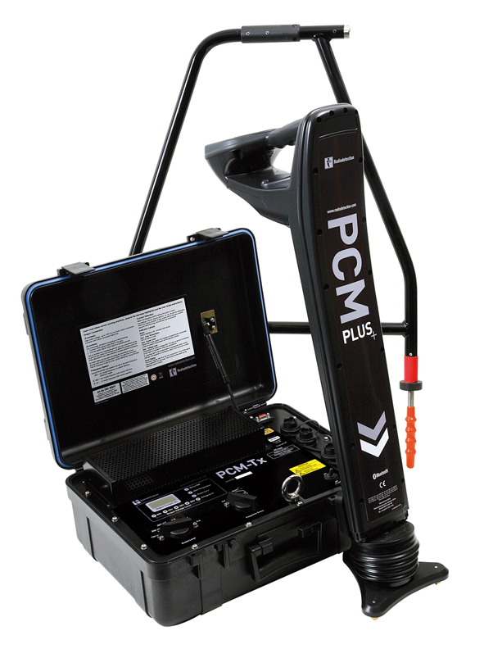
Current Attenuation and ACVG Surveys
Gary Moss

Slide 2
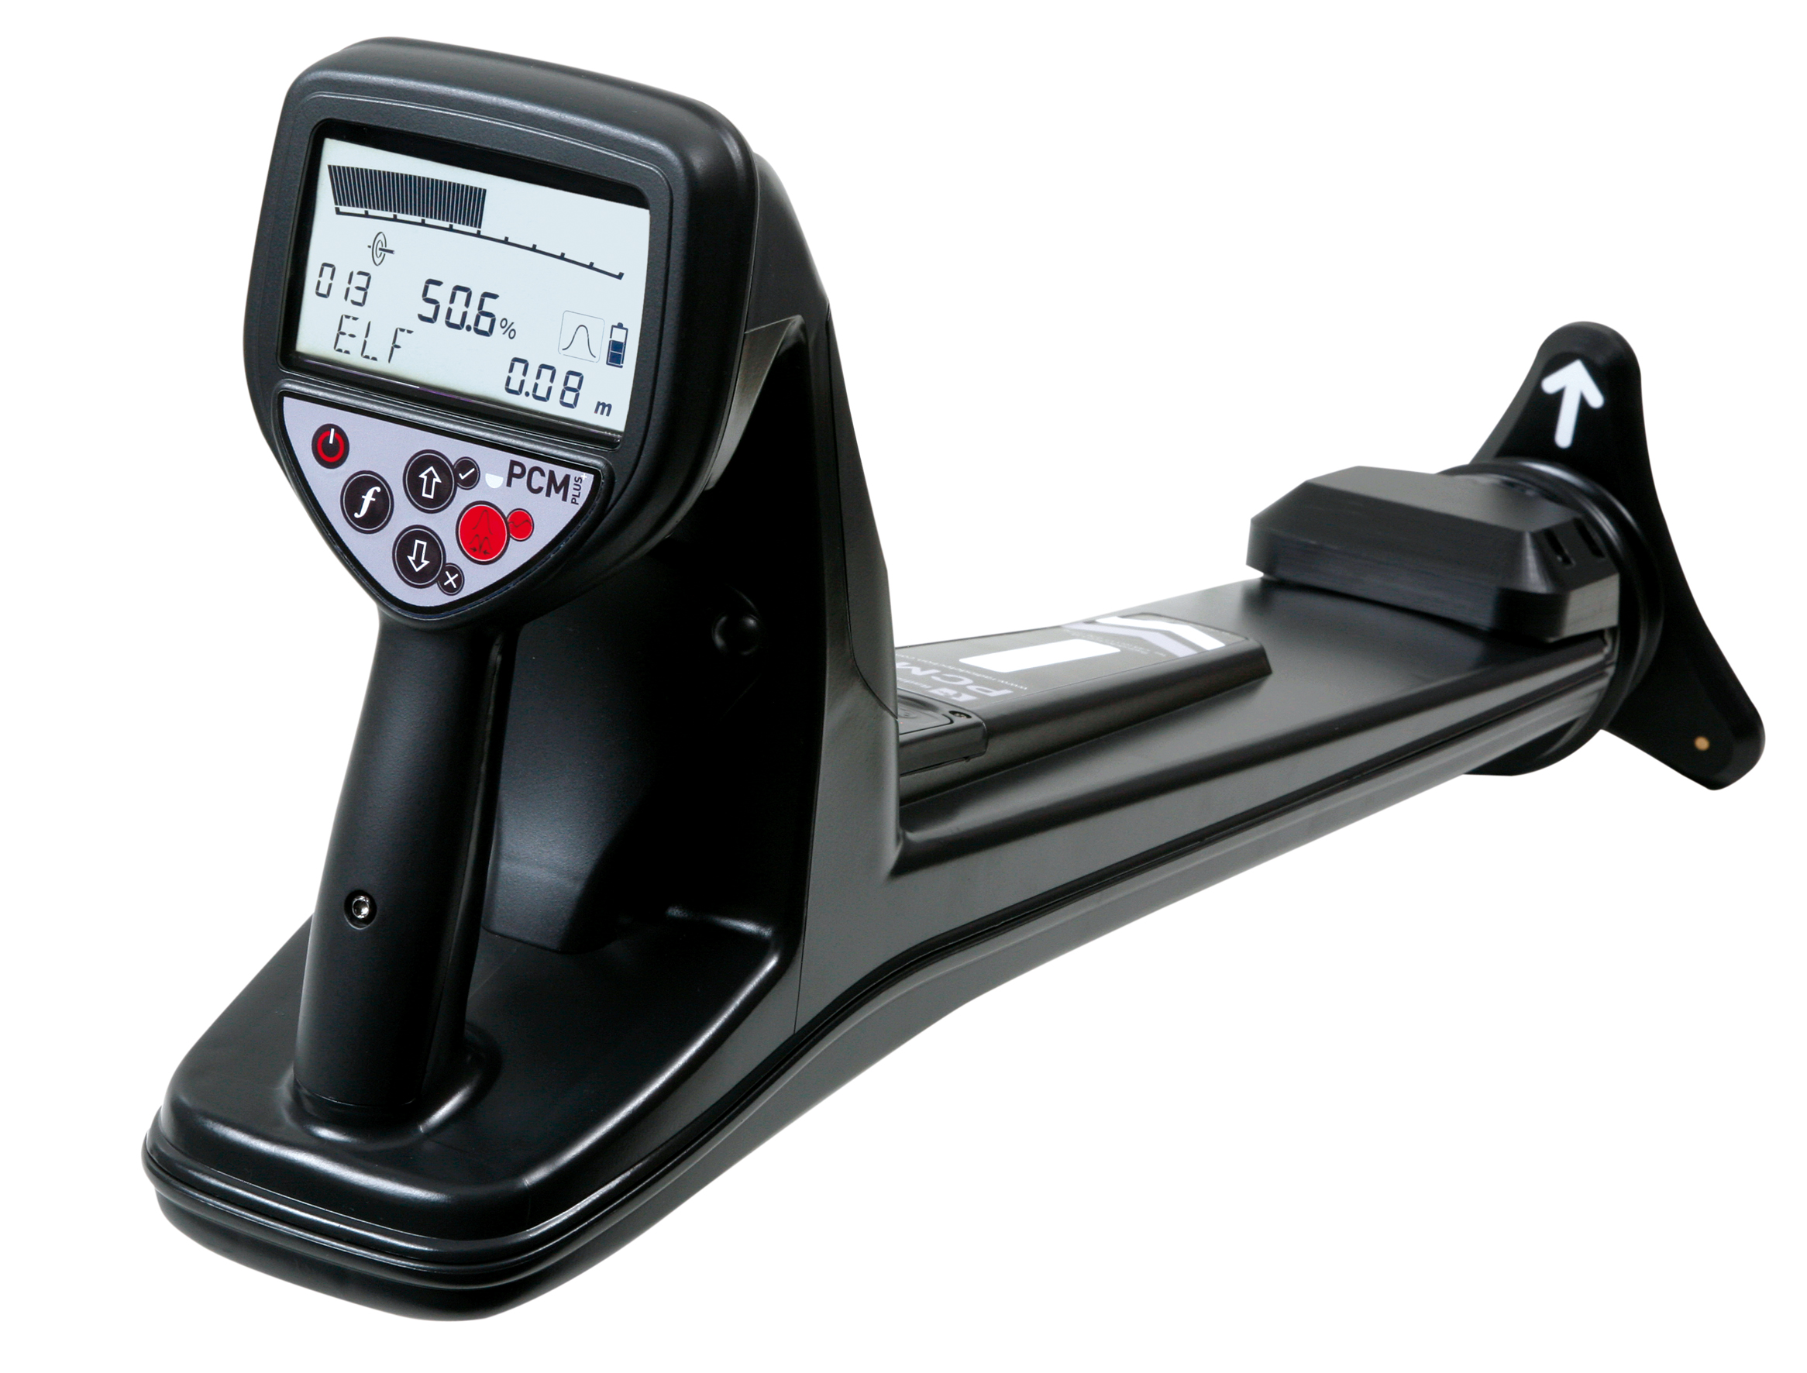
The PCM Performs Three Broad Functions
Locating Pipes and Cables
Current Attenuation Surveys
ACVG Surveys

Slide 3
The PCM can….
Find contacts with other structures
Evaluate pipe coating for defects
Perform periodic pipeline surveys
Find defective insulation joints
3

Slide 4
Pipe and Cable Locators Don't
Find Pipes and Cables...
?

Slide 5
...They Find Electro-Magnetic Fields

Slide 6
Why Does It Matter?
Because electro-magnetic fields do things that pipes and cables don’t do.
Buried conductors don’t move, but the fields they’re tracing are subject to…

Slide 7
…Distortion
Which is Affected By:
Grounding
Peak or Null Antennas
Congestion
Frequency Applied

Slide 8
Distortion - Grounding
Typical rectifier installation
Provides a perfect pipe connection point
Anode provides a perfect ground connection point
NACE Rocky Mountain Section Short Course 2015

Slide 9
Distortion – Grounding: PCM+ Connection To Pipeline
Disconnect the rectifier output from both pipe and Anode
Connect the PCM transmitter in place of the rectifier
NACE Rocky Mountain Section Short Course 2015

Slide 10
Distortion - Peak or Null Antennas
Signal
response
Signal
response
1
2
3
1
2
3
Peak
Null
Different aerial orientations can
be used for different responses
NACE Rocky Mountain Section Short Course 2015

Slide 11
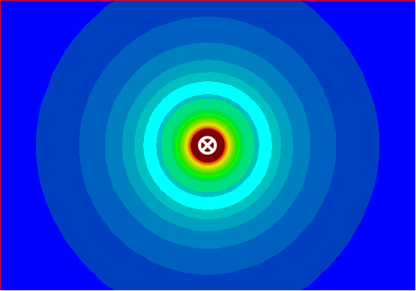
Distortion - Peak or Null Antennas
In a clean electro-magnetic field, the peak and null antennas agree
NACE Rocky Mountain Section Short Course 2015

Slide 12
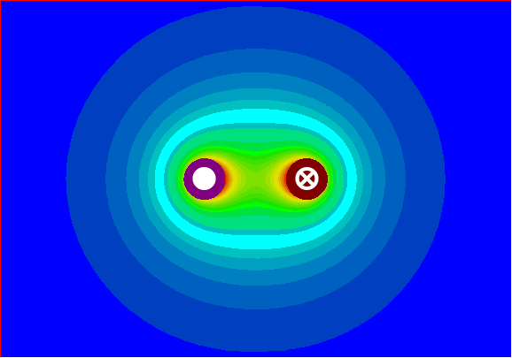
Distortion - Peak or Null Antennas
In a distorted electro-magnetic field, the peak and null antennas do not agree, and the peak is always more accurate
NACE Rocky Mountain Section Short Course 2015

Slide 13
Distortion - Congestion
Congestion creates a distorted field, which effects locate accuracy, depth estimation and current measurement.
Congestion can be created by a nearby line carrying the signal, a “T” in the line, a bend in the line or a change in the depth of the pipe.
Take your current and depth readings where peak and null agree and move several paces away from a bend or a “T” when taking your reading.
NACE Rocky Mountain Section Short Course 2015

Slide 14
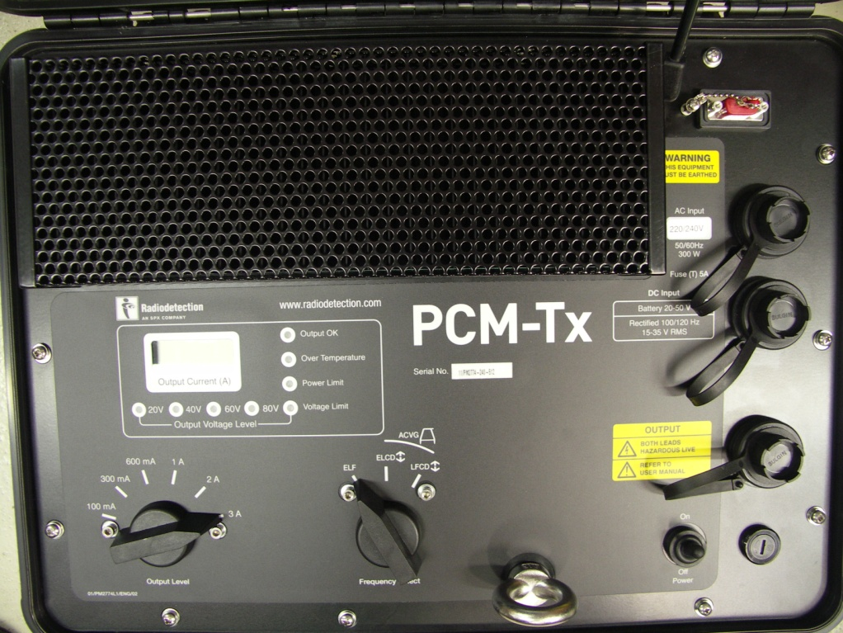
Distortion – Frequency
Why Do We Use 4Hz ?
To enable coating defects to be located the PCM+ uses very low frequency signal
4hz
Almost DC
Sticks to the pipeline
Less bleed off or coupling to other utilities
Increased distance (up to 19 Miles)

Slide 15
Benefits of Low Frequency

Slide 16
Transmitter Settings – Output Frequency
ELF
Extra low frequency
4Hz & 98Hz / 128Hz
ELCD
Extra low frequency & current direction
4Hz, 8Hz & 98Hz / 128Hz
LFCD
Low frequency & current direction
4hz, 8hz & 512hz / 640hz
NACE Rocky Mountain Section Short Course 2015

Slide 17
Transmitter Settings – Signal Output
Constant current output
100mA
300mA
600mA
1A
2A
3A
NACE Rocky Mountain Section Short Course 2015

Slide 18
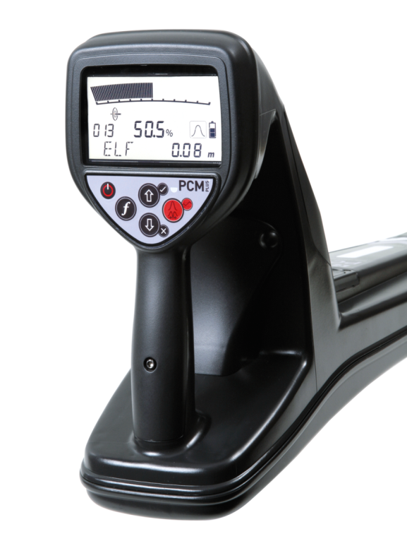
Taking Current Attenuation Measurements
Use an independent ground and try to mimic your CP circuit when possible
Take your first measurement at least 150 feet from your connection point
Make sure rectifiers are not influencing the signal (turn off AND disconnect if necessary)
Isolate your circuit whenever possible (disconnect bonds for better surveys)
NACE Rocky Mountain Section Short Course 2015

Slide 19
Taking Current Attenuation Measurements
Take readings at equal distances and record your distances
Every 50 feet is a good standard (others can be used dependent on location)
Use it as a macro tool and depth of cover tool (use A-frame for micro)
Look for anomalies with more than a 5% change normally
Make sure unit is upright and perpendicular to the pipe
NACE Rocky Mountain Section Short Course 2015

Slide 20
Taking Current Attenuation Measurements
Stay on Peak and check peak and null readings and verify depth when readings are suspect
Take multiple readings in one location if you are suspect of the accuracy
Know what is in the area of your pipe and what it’s connected to
Use current direction to verify that signal is flowing back toward transmitter on pipe
NACE Rocky Mountain Section Short Course 2015

Slide 21
Practical Example

Slide 22
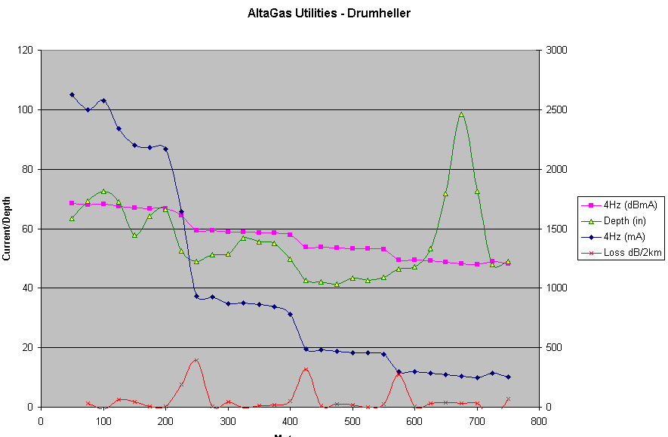
Current Attenuation Graph
Actual PCM Results
3 steps are different looking in mA but nearly identical in dB

Slide 23
Distribution of Current 1kHz vs. 4Hz

Slide 24
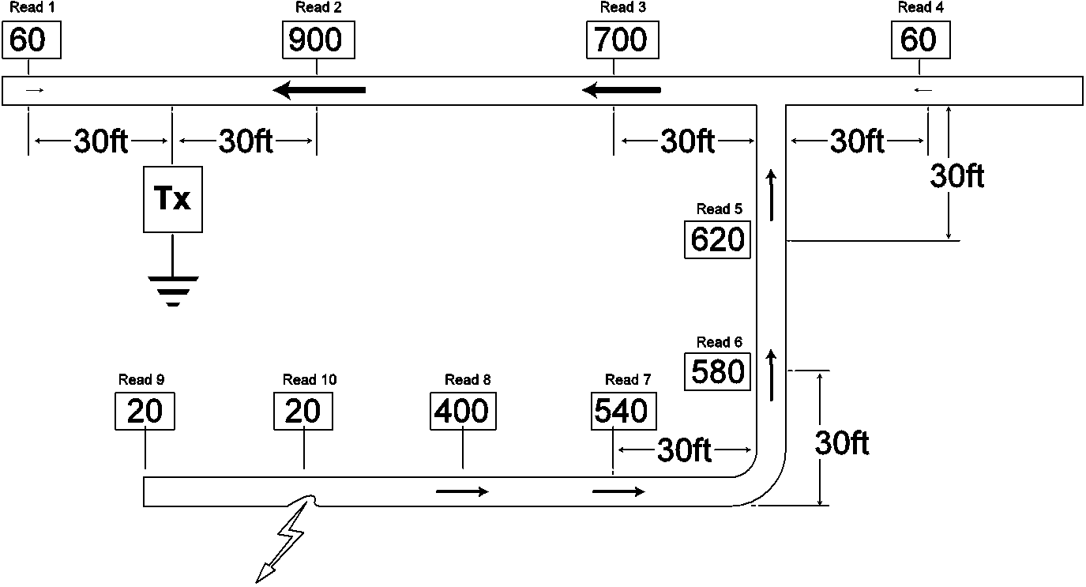
Low Frequencies Go To The Short

Slide 25
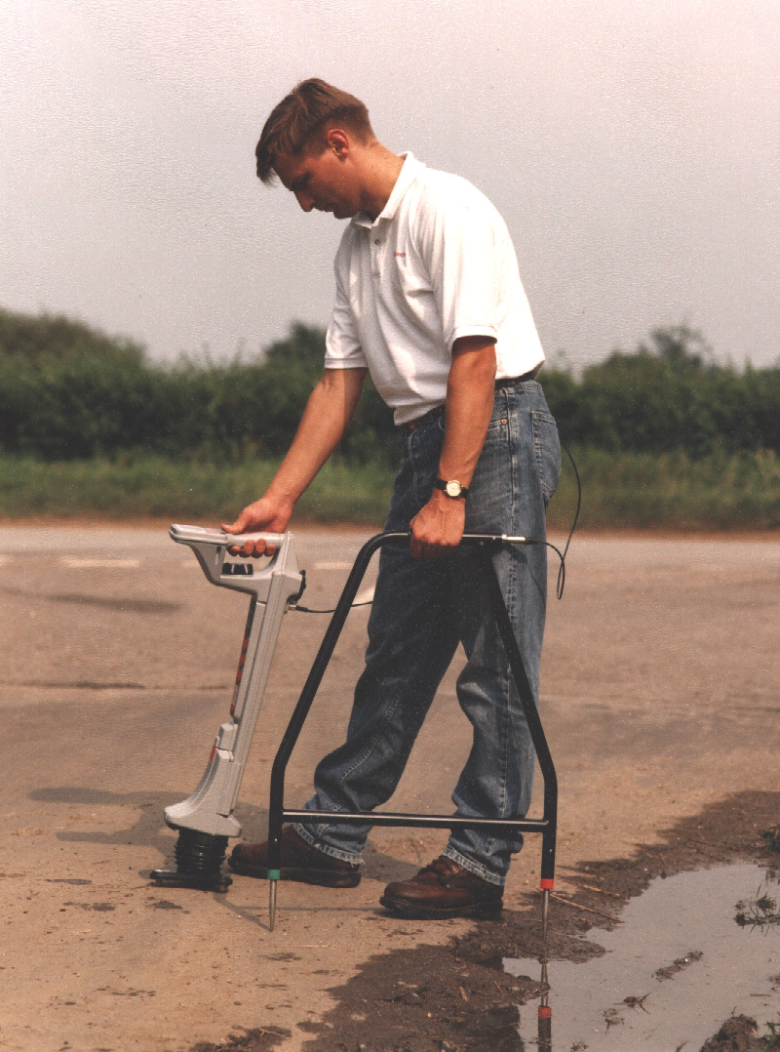
ACVG Is Used to Pinpoint Defect Location
Once survey is complete, use the A-Frame accessory to pinpoint defects
Connect the A-Frame to the locator
Set locator to ACVG
Must use either ELCD or LFCD
NACE Rocky Mountain Section Short Course 2015

Slide 26
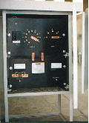

Transmitter Connections
CP Rectifier
AC Feed
ACVG Tx
-
+
Rectifier
Test Station
Pipeline
Anodes
NACE Rocky Mountain Section Short Course 2015

Slide 27
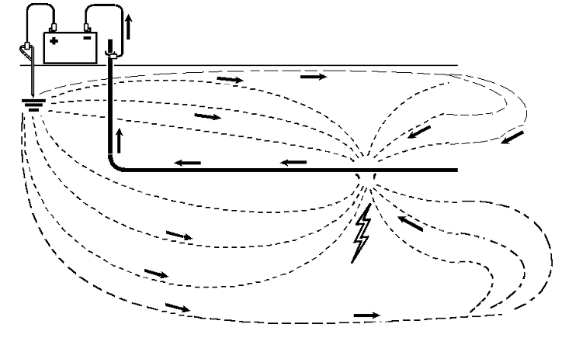
ACVG - Pool of Potential
NACE Rocky Mountain Section Short Course 2015

Slide 28

ACVG – Current Flow
Current from the transmitter creates a voltage gradient around coating defects
Current density greatest at interface between the defect and the surrounding environment
Current density function of soil resistivity & Tx output
Transmitter
NACE Rocky Mountain Section Short Course 2015

Slide 29
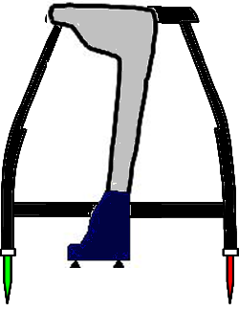
ACVG – Using the A Frame
Directional Display
Front of receiver
GREEN
RED
Keep the green pin facing forward
NACE Rocky Mountain Section Short Course 2015

Slide 30
Finding Coating Defects
NACE Rocky Mountain Section Short Course 2015

Slide 31
ACVG – Receiver Readings
An increase in voltage gradient will cause an increase in current density near a given coating defect on the pipeline under test
Signal current and voltage effects viewed on instrument’s display
Signal current direction is displayed as an arrow
Voltage is identified as decibels (dB)
44 dB
47 dB
50 dB
49 dB
46 dB
43 dB
NACE Rocky Mountain Section Short Course 2015

Slide 32
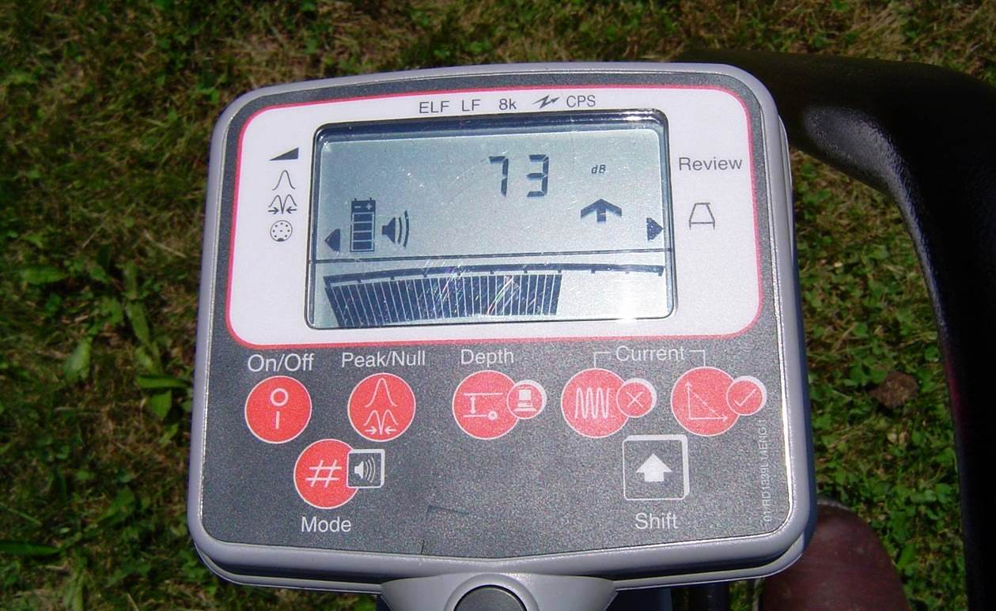
ACVG – Receiver Readings
NACE Rocky Mountain Section Short Course 2015

Slide 33
ACVG – Receiver Readings
Take 4 readings in a cross pattern - two in line with the pipe and two perpendicular to the pipe
All four arrows should point to the defect
Record highest dB reading
NACE Rocky Mountain Section Short Course 2015

Slide 34
Categorizing the Results*
0 – 30dB Ignore
30dB – 60dB Minor
60dB – 80dB Intermediate
80dB+ Major
*Categories apply to normalized results @1A of 4Hz current. There is a formula for calculating the normalized results.
NACE Rocky Mountain Section Short Course 2015

Slide 35
Normalizing the Results
This gives you the number of dB to add or subtract from the reading, depending on whether the PCM (4Hz) current is above or below one Amp.
dB = 20*log(i/iref).
The iref is 1000 mA (one Amp). In the case of 500 mA the formula is 20 X log (500/1000), which equals +6 dB.
If the number is negative you add it and if it is positive you subtract it.
3.0A = +10dB relative to 1A
2.0A = +6dB relative to 1A
1.0A = 0dB relative to 1A
600mA = -4dB relative to 1A
300mA = -10dB relative to 1A
100mA = -20dB relative to 1A
31.6mA -30dB relative to 1A
10mA = -40dB relative to 1A
1mA = -60dB relative to 1A
NACE Rocky Mountain Section Short Course 2015

Slide 36
ACVG Summary
Use an independent ground and try to mimic your CP circuit when possible
Take readings parallel and along the pipe. When you see an arrow reversal go perpendicular to the pipe and make sure all four arrows point to the defect
You do not have to be right on top of the pipe when surveying
On concrete and asphalt use wet sponges or rags on the probes or wet the ground around the probes.
Take readings at equal distances usually about every ten feet
Use the largest dB reading seen around the anomaly for you records
Record all faults seen with dB readings and footages or GPS coordinates.
Take a PCM current reading at the site of the defect and adjust your dB reading to normalize for one Amp of current
NACE Rocky Mountain Section Short Course 2015

