Slide 1
AC MITIGATION
SOLUTIONS TO AN
ON-GOING ISSUE
Charlie Poore
NACE Senior Corrosion Technologist #53904

Slide 2
AC Interference
One of the most pressing issues we face today in the corrosion industry
Increasingly congested ROW’s – collocated power lines
Higher Voltages
Pipeline coatings and application techniques have improved vastly over the past decade
Less frequent holiday locations –
smaller holiday size = higher current discharge

Slide 3
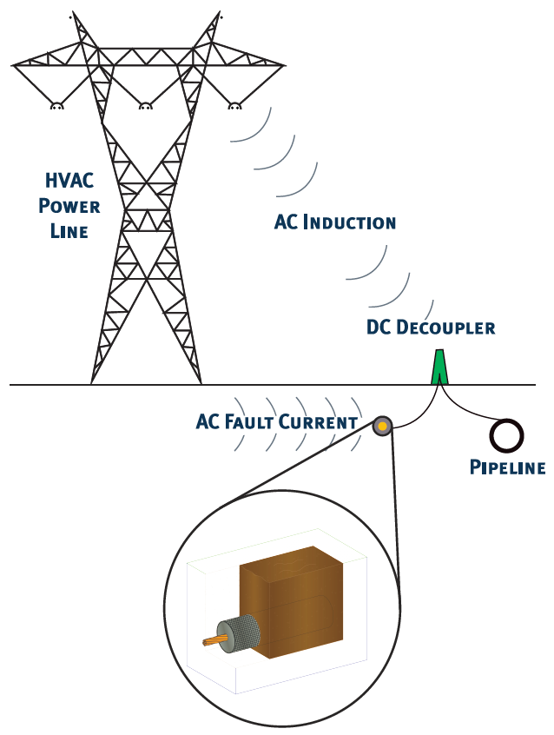
AC Interference
Variable current discharges based on power line energy demand
Mitigation electrode may traverse many difference soil resistivity’s and corrosive environments
Electrodes need to function in all environments, for long periods of time

Slide 4
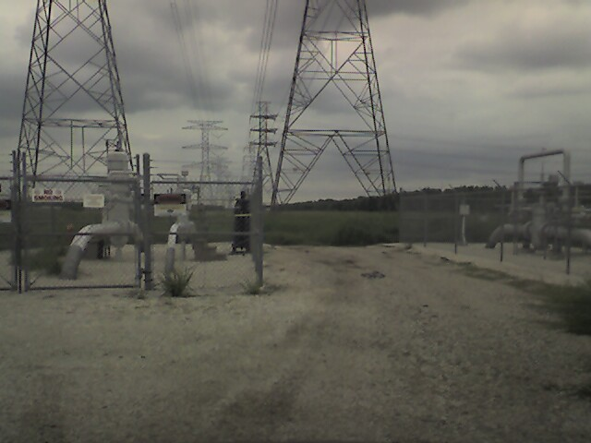
COMMON ROW TODAY

Slide 5
AC Interference is Widespread Across our Operating Systems
Houston, TX – DOW pipelines
  51 pipelines inside corridor
  230kV-500kV overhead lines
El Paso, TX - Nustar
  El Paso Electric to install 130kV system in ROW
Farmington, NM – Tri-State
  Proposed 130kV line
  41 potential pipeline crossings

Slide 6
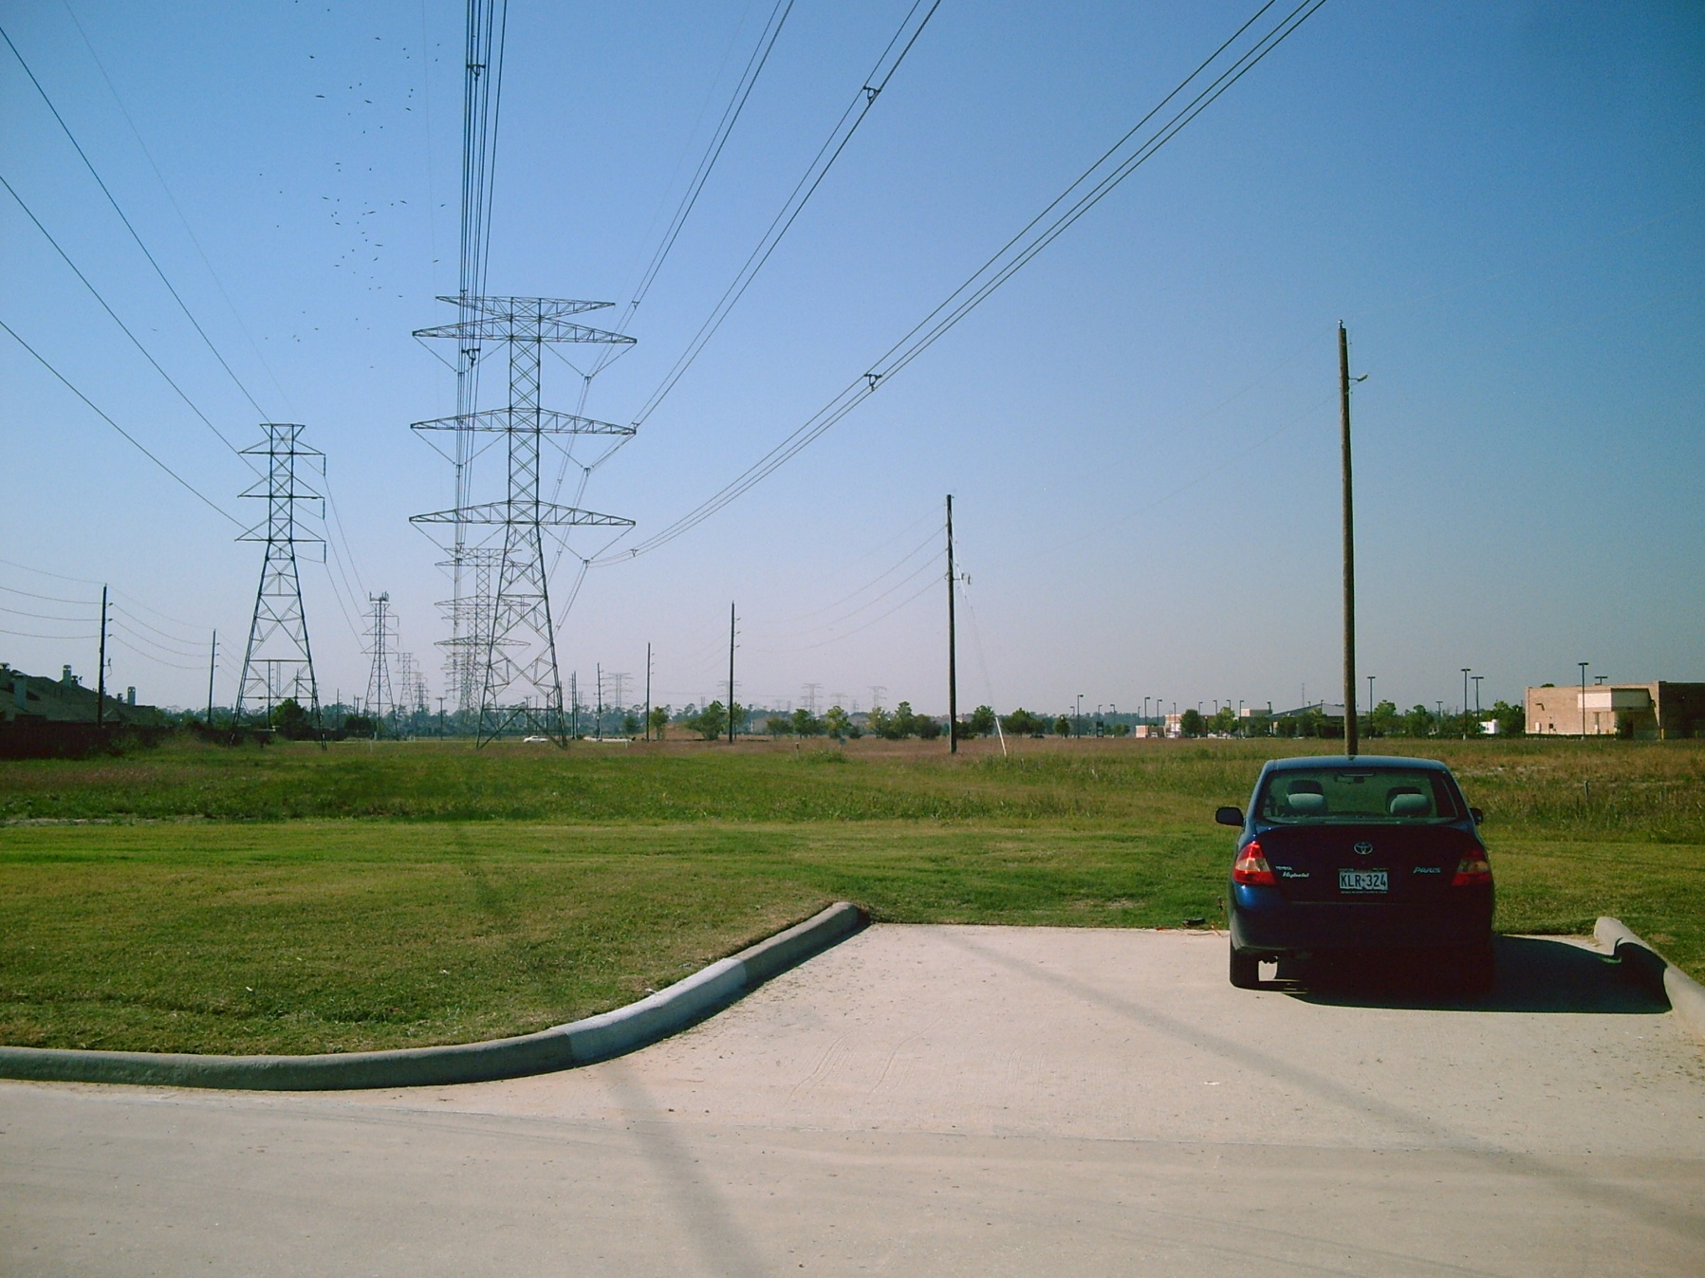
PRACTICAL EXAMPLE

Slide 7
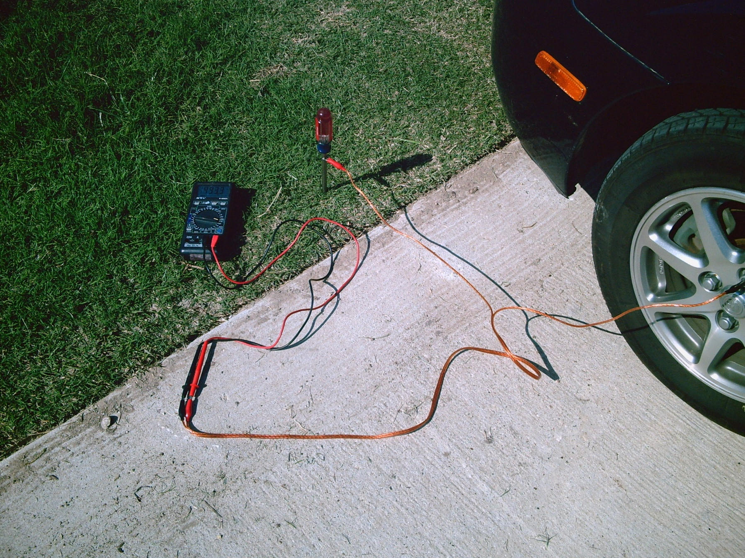

Slide 8
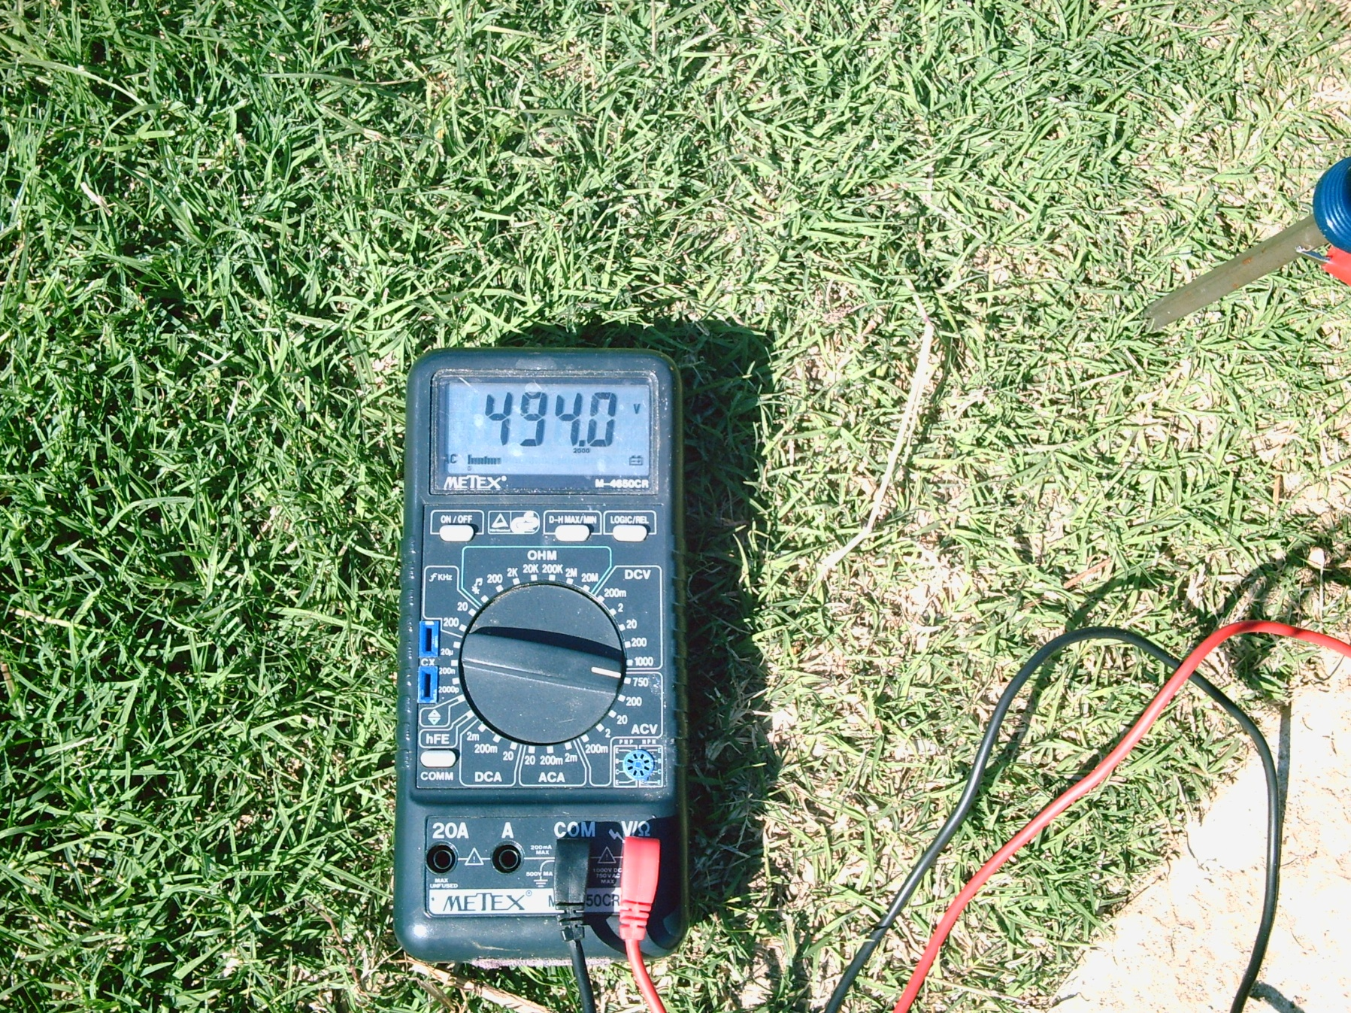

Slide 9
AC MITIGATION TOOLS
DIFFERENT SOFTWARE PROGRAMS
SOIL RESISTIVITY TESTING
SOIL CONDITIONS
LOAD INFORMATION FROM POWER COMPANIES
COATINGS/CONDITION OF PIPE
WEATHER
FUTURE DEMANDS

Slide 10

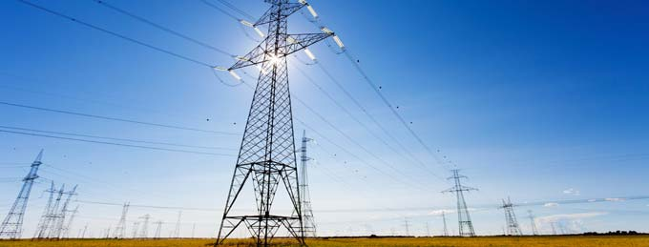
AC Mitigation Modeling
is a Snapshot in Time
Modeling today is based on current conditions
  – loads, coating requirements
AC Mitigation needs will change over time as conditions,
loads and requirements change

Slide 11
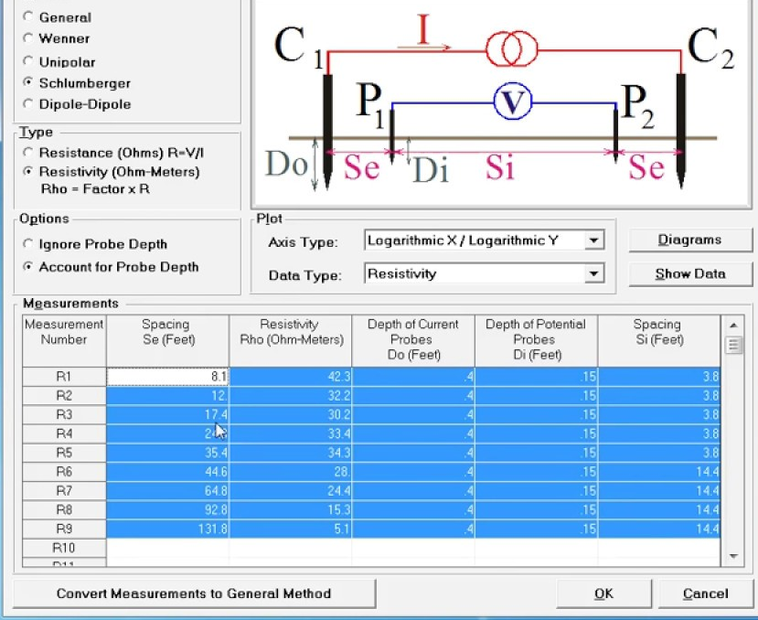
CDEGS Modeling of AC Mitigation Electrodes
Powerful software for examining ground resistivity and current dissipation characteristics
Ability to model custom designs and situations
On-site resistivity testing completed to provide accurate models

Slide 12
AC MITIGATION MATERIALS
BARE COPPER CABLE
COPPER ENCASED IN COKE BREEZE
COPPER ENCASED IN CONDUCTIVE CONCRETE
SOCK ELECTRODE-typically copper wire with some type of backfill
ZINC RIBBON

Slide 13
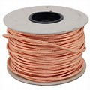
BARE COPPER

Slide 14
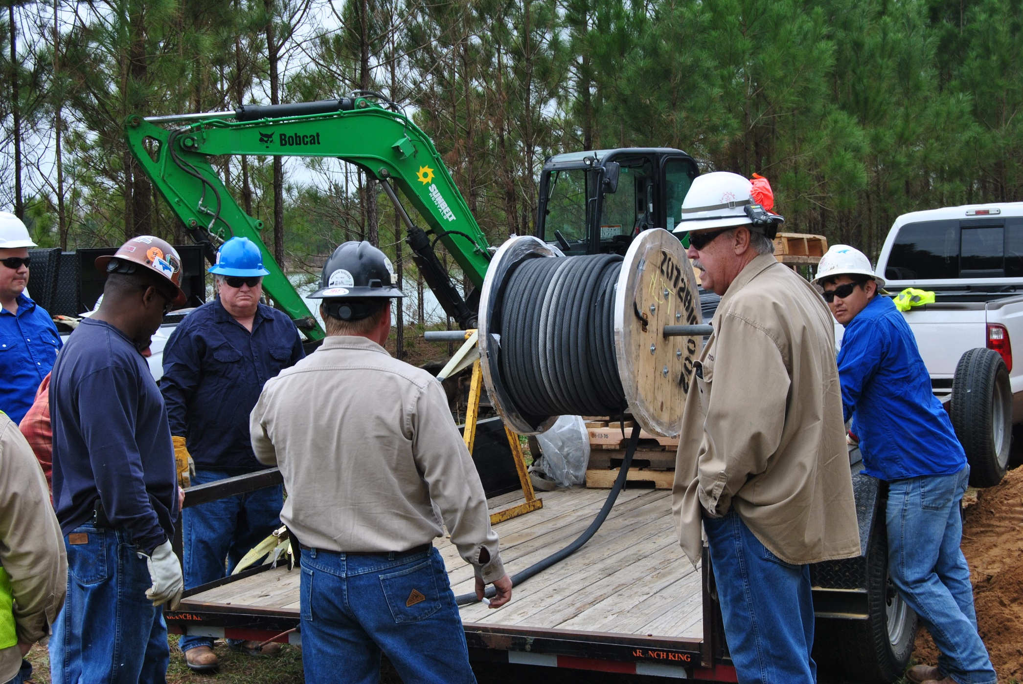
SOCK ELECTRODE

Slide 15
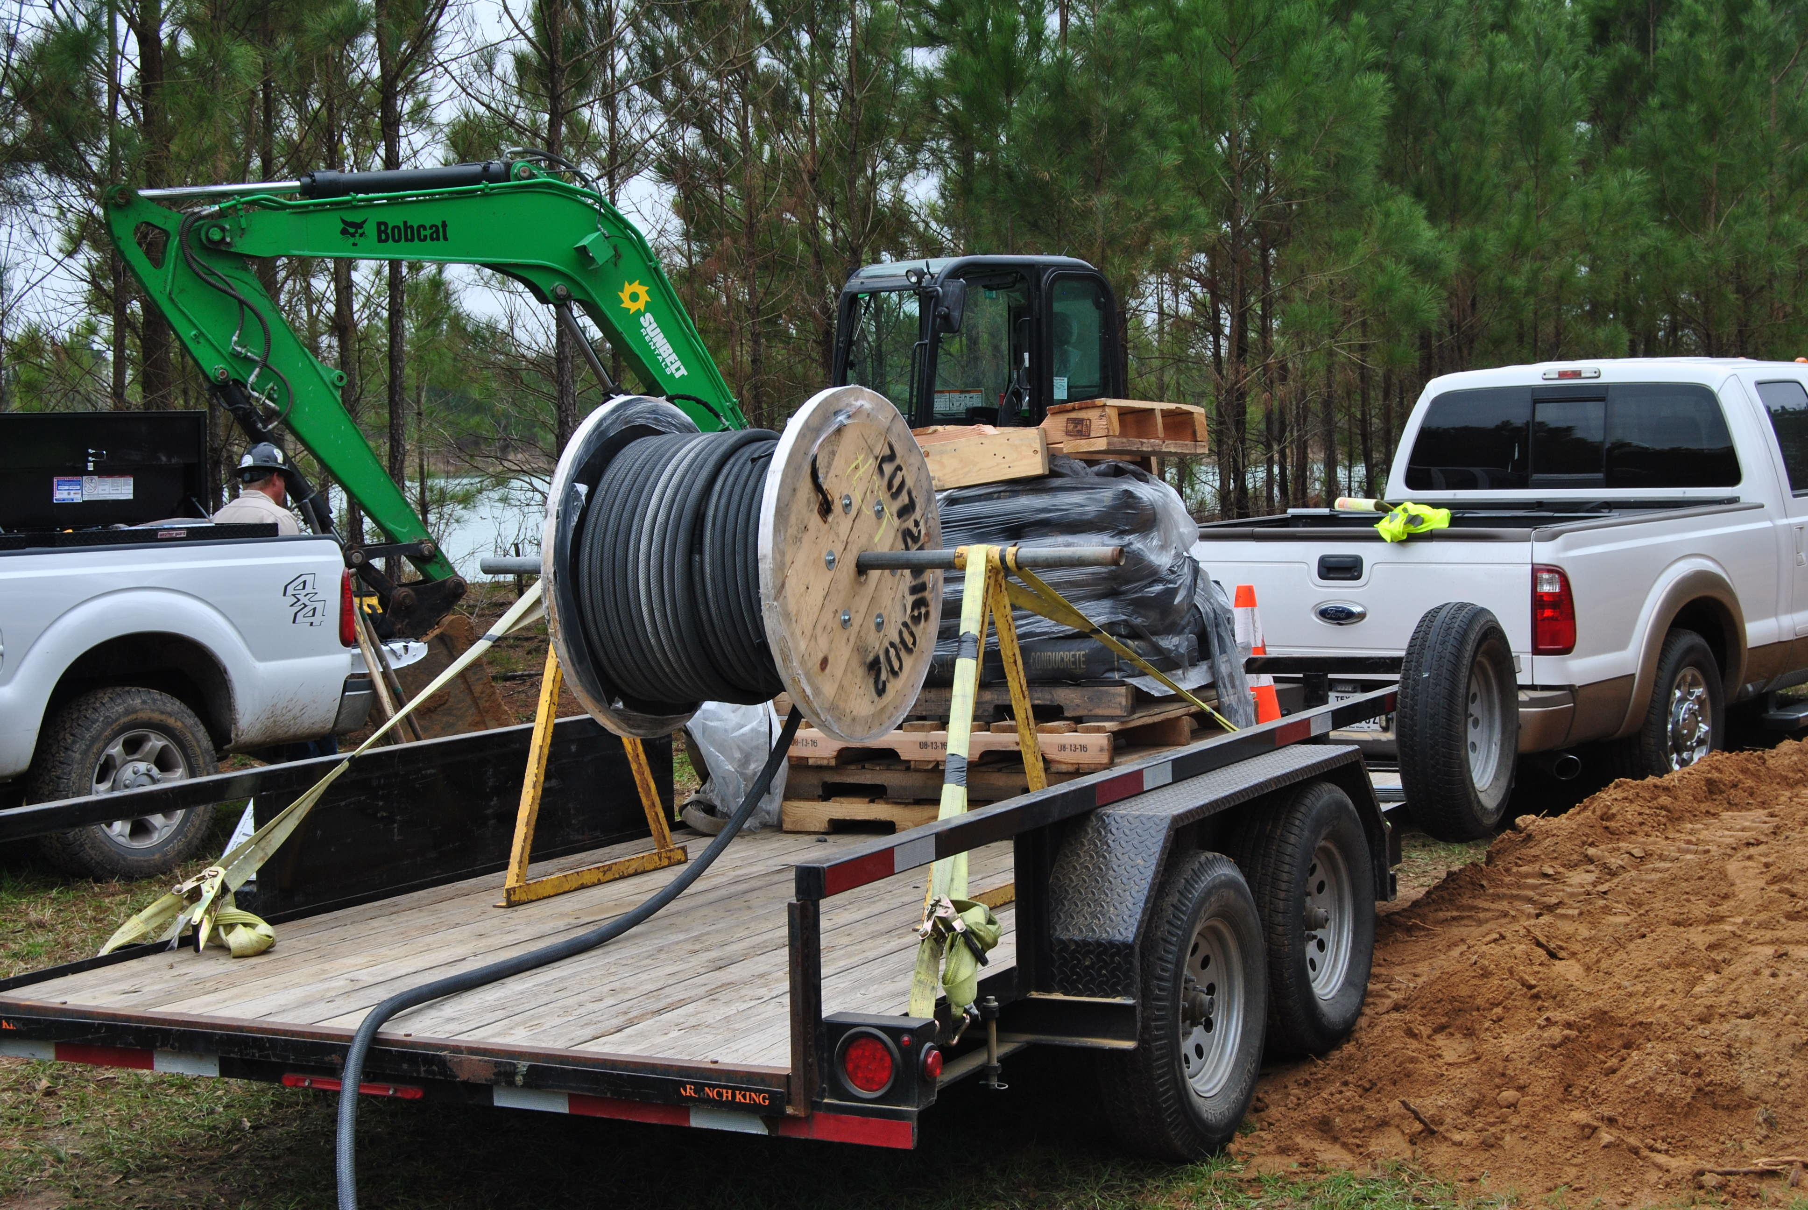
SOCK ELECTRODE

Slide 16
ZINC RIBBON

Slide 17
Material issues to consider
BARE COPPER CABLE-subject to corrosion, theft
COKE BREEZE-issues of moving water/environmental concern
CONDUCTIVE CONCRETE-dirty installation-requires specialized equipment
SOCK ELECTRODE- splicing, damage to sock during installation process
Zinc-soil or environmental issues that may effect its performance

Slide 18
INSTALATION METHODS
Trenching
Vibratory Plowing
Horizontal drilling
Directional drilling
Point Drain

Slide 19
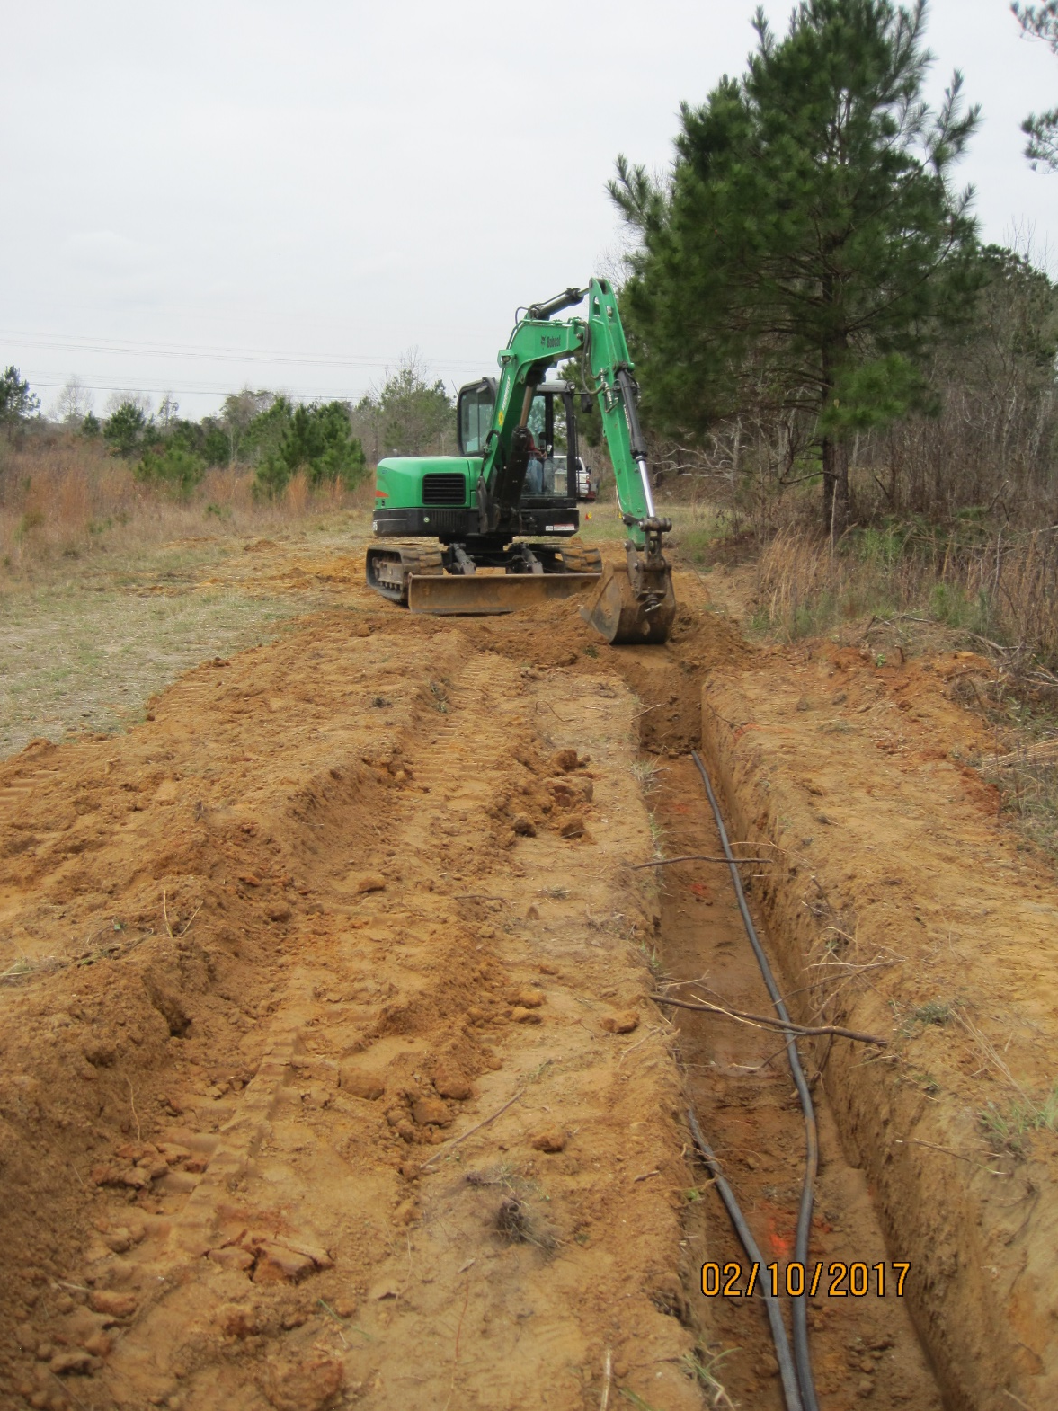
TRENCHING SOCK ELECTRODE

Slide 20
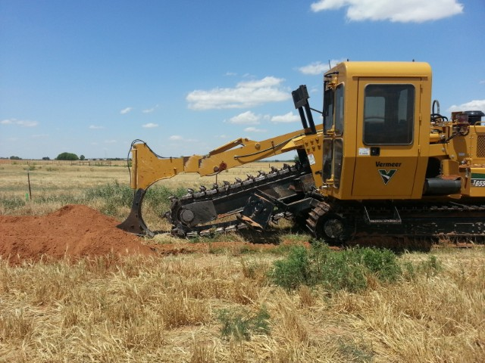
ZINC RIBBON PLOW INSTALATION

Slide 21
TRENCHING /PLOWING INSTALLATION
Company SOP-can you place over top of existing pipe?
Is trenching/vibratory plowing allowed?
Room in the ROW?
Product in pipeline-Hazardous/Explosive?
Time frame-during or after Construction

Slide 22
DIRECTIONAL BORING INSTALLATION
Length of bore-determine size of cable
Existing infrastructure
Underground structures
Geology

Slide 23
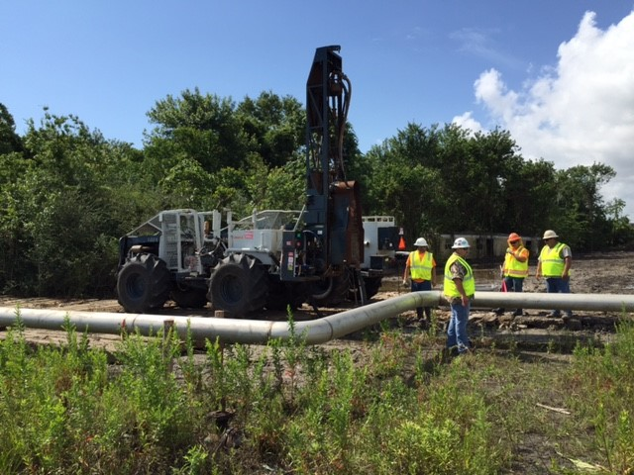
POINT DRAIN

Slide 24
POINT DRAINS
TYPICALLY BARE COPPER WIRE
TYPICALLY USES SOME TYPE OF BACKFILL AROUND COPPER WIRE-BACKFILL-COKE BREEZE OR CONDUCTIVE CONCRETE
ADVANTAGE-SPACE SAVING-LEAVES ROW AVAILIBLE FOR FUTURE PROJECTS/PIPELENES
DISADVANTAGE-NOT AS EFECTIVE AS HOROZONTAL FOOTPRINT,MAY REQUIRE MORE POINT DRAINS TO ACHIEVE MITIGATION
SPACE/DRILL RIG ACCESS-OVERHEAD HVAC LINES

Slide 25
CDEGS MODELING RESULTS
ANALYTICAL LOOK AT DIFFERENT MITIGATION MATERIALS

Slide 26
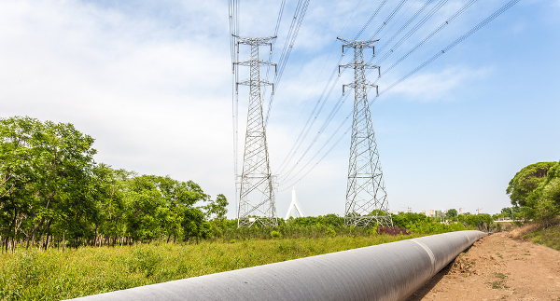
CDEGS Modeling of AC Mitigation Electrodes
– 100 ohm-m Soil
100 ohm-m soil, 1000 ft length
Conductor | Resistance to Ground (ohms)
1/0 bare copper | 0.8992
Conductive Backfilled Electrode | 0.8195
Zinc ribbon 7/8 x 5/8" | 0.8114
1/0 Copper, 6"x6" Conductive Column | 0.7344
Size matters-typically larger footprint lower resistance
Conductive backfilled conductors are capacitive in nature – providing excellent surge dissipation characteristics

Slide 27
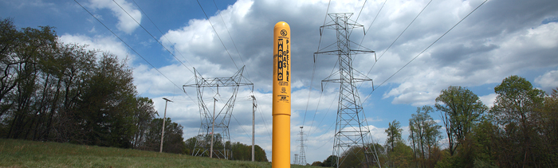
CDEGS Modeling of AC Mitigation Electrodes
– 1000 ohm-m Soil
1000 ohm-m soil, 1000 ft length
Conductor | Resistance to Ground (ohms)
1/0 bare copper | 8.5797
Conductive Backfilled Electrode | 7.7761
Zinc ribbon 7/8 x 5/8" | 7.9096
1/0 Copper, 6"x6" Conductive Column | 6.9165
Difference in resistance to ground between conductive backfilled conductor and Zinc negligible
Size of cable in sock does not play significant role in resistance to ground-overall “footprint” that is modeled

Slide 28

Questions?
Charlie Poore
NACE/AMPP Senior Corrosion Technologist #53904
Email: charlie.poore@mesaproducts.com
Phone: 505-250-7481

