Slide 1
COMPOSITE SOLUTIONS

Slide 2
COMPOSITE REPAIRS
A composite wrap is a permanent repair method suitable for non-leaking pipe defects.
Composite repair systems are currently used to repair pitting, dents, gouges and external corrosion.
Internal corrosion can not be arrested, therefore, a composite can not permanently repair defects associated with internal corrosion.
Serve as an alternative to traditional pipeline repair methods
Cut outs/replacement
Full encirclement steel split sleeves

Slide 3
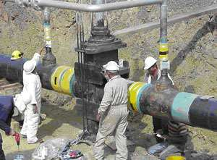
COMPOSITE REPAIRS
Advantages over traditional repair methods
No hot work
No pressure reduction/interruption in service
Reduction in emissions
Quicker
Cheaper
Safer
Disadvantages
Not able to UT after being repaired
Quality control done in the field
Without proper application a composite will not work as engineered

Slide 4
COMPOSITE REPAIR SYSTEM DEFINITION
The repair system is defined as the combination of the following elements for which qualification testing is completed.
substrate (pipe)
surface preparation
composite material (repair laminate)
filler material
adhesive
application method

Slide 5
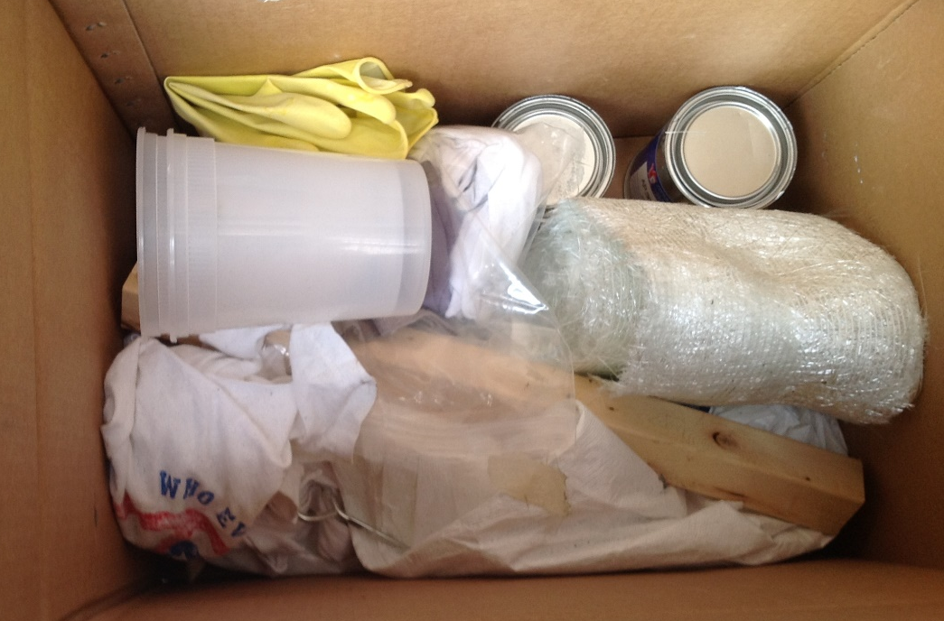
COMPOSITE SYSTEMS
Repairs are engineered using test data that combines specific manufacturing, surface and material preparation and installation techniques.
Don’t deviate from the preparation or installation techniques.
Don’t substitute repair materials

Slide 6
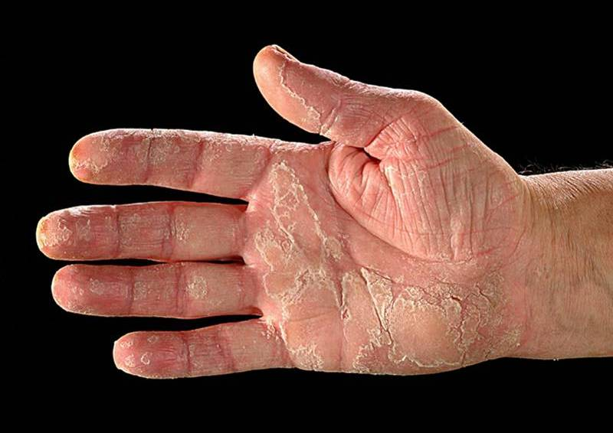
PPE
Minimum requirements:
Disposable overalls; keep resin off clothes and skin
Rubber gloves; use thick ones
Safety boots
Safety glasses – use goggles when mixing or if people working overhead
Remove soiled PPE before entering clean areas

Slide 7
COMPOSITE REGULATIONS
DOT
CFR 192.713 & 195.585
“Repaired by a method that Reliable engineering tests and analyses show that can permanently restore the serviceability of the pipe”
ASME
PCC-2 (Post Construction Committee)
16 Composite Testing Criteria
B 31.4 & B 31.8
Specifies composites can be used on ≤ 80% general corrosion pitting, and on some dents, gouges, wrinkles, etc. that are still piggable.
OQ Qualifications Needed for Training & Instillations
Some training qualifications may be more extensive than others.
Consider this when looking at the total cost of a system

Slide 8
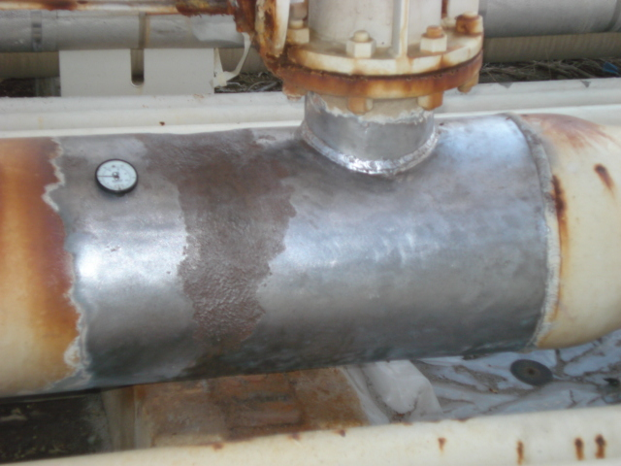
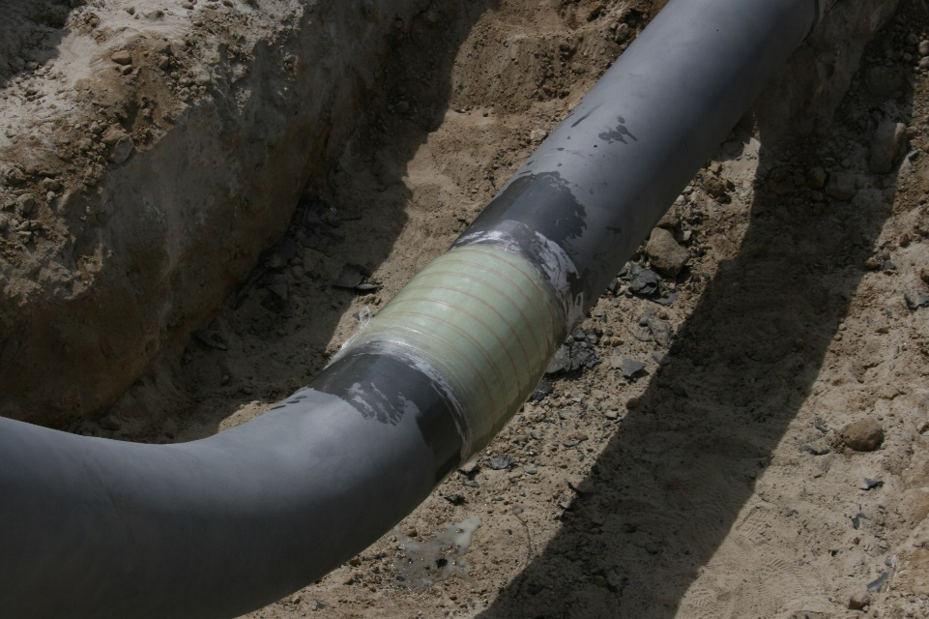
Choosing A Composite Repair System
Application Parameters
Pipeline features and the pipe defect characteristics will determine which system is right for you.
Many repair systems will require exact measurements to size EACH repair.

Slide 9
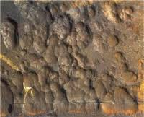
APPLICATION PARAMETERS
% of Wall Loss:
Custom repairs sized for your exact parameters
Many allow you to neglect the remaining strength, in the pipe, when sizing a composite repair.
Defect Size:
Must over lap a minimum of 2” on each side

Slide 10
APPLICATION PARAMETERS
Pressure:
This is rarely the limiting factor for composite repairs.
Some systems may require a reduction in pressure for installation.
Temperature:
Extreme temperatures require special resins
Reduce repair lifespan

Slide 11
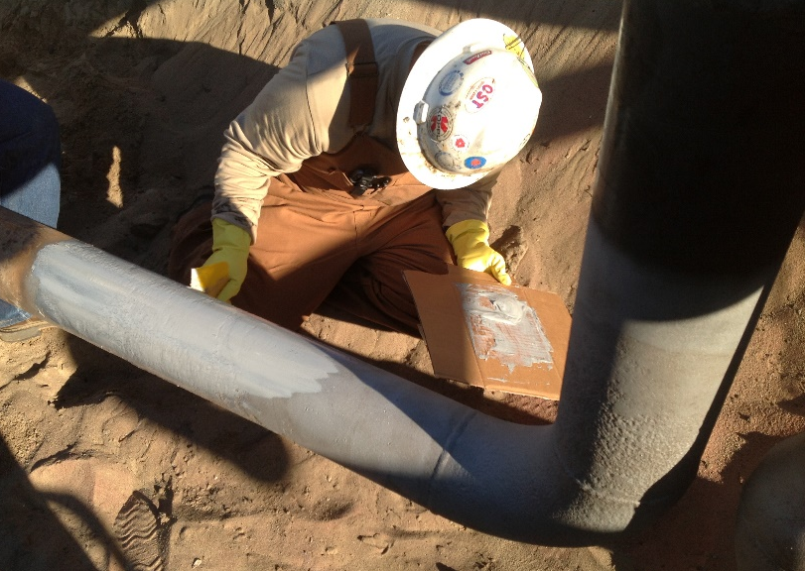
APPLICATION PARAMETERS
Pipe Features:
Is it a straight piece of pipe?
If not, some systems are eliminated.
A complete composite package, for a company, should be able to cover all pipeline features in their system.

Slide 12
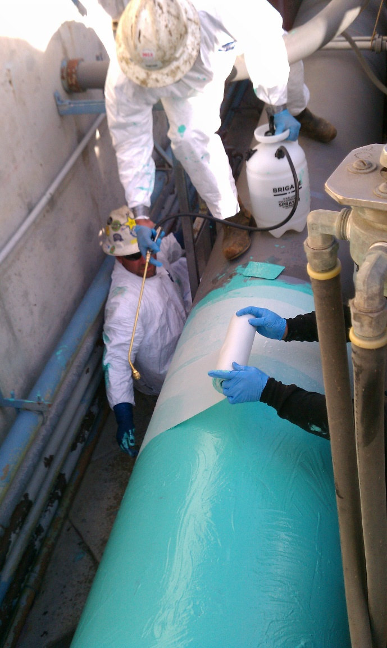
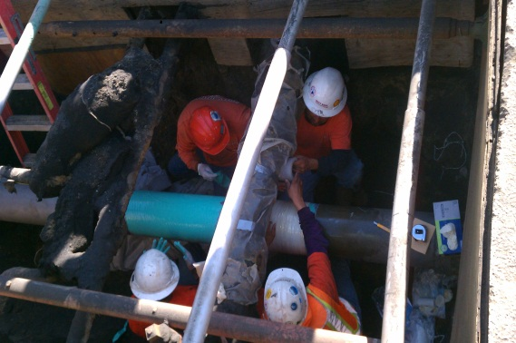
APPLICATION PARAMETERS
Repair Area Access:
Room to work
Pipe preparation
Remote locations

Slide 13
MEASURING STRENGHT
Nothing is specifically approved
Must meet minimum requirements
Strength sets the systems apart
Load Transfer
Lap Sheer Strength
Tensile Strength
Testing information is always available

Slide 14
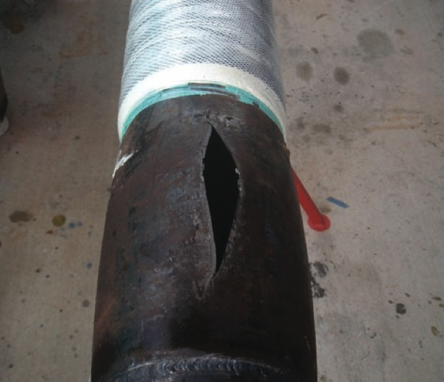
Load Transfer
External defects are filled with a high compressive strength material
The hoop load is transferred though this material to the composite
The composite distributes the load throughout it’s layers around the pipe.

Slide 15
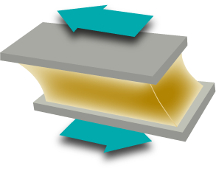
Choosing A Composite Repair System
Composite System Strength
Lap Shear Strength
The strength demonstrated by the diagonal pull of two substrates until adhesive failure.
The name comes from the lap joint created by the test samples and the shear action used to pull the samples apart.

Slide 16
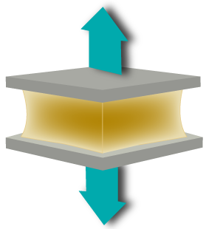
Choosing A Composite Repair System
Composite System Strength
Tensile Strength
Measures the force required to pull something to the point where it breaks.
The tensile strength of a material is the maximum amount of tensile stress that it can take before failure, for example breaking.

Slide 17
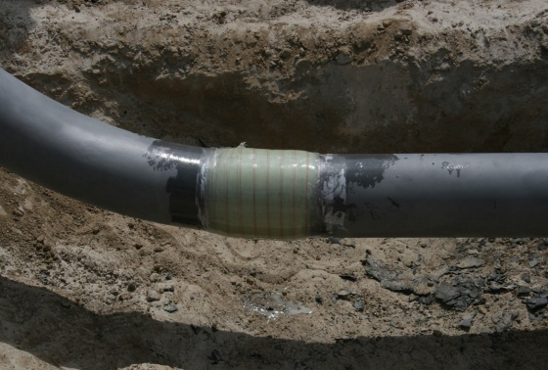
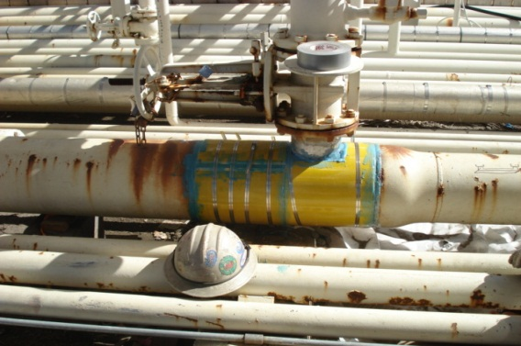
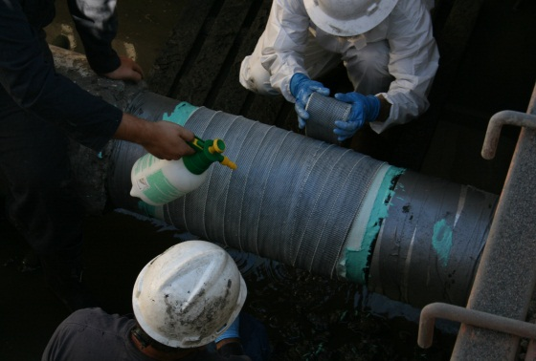
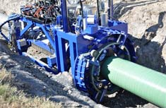
COMPOSITE REPAIR TYPES
Prefabricated
Wet Lay Ups
Pre-Impregnated
Field Wet Out
Machine Installations

Slide 18
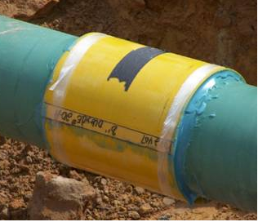
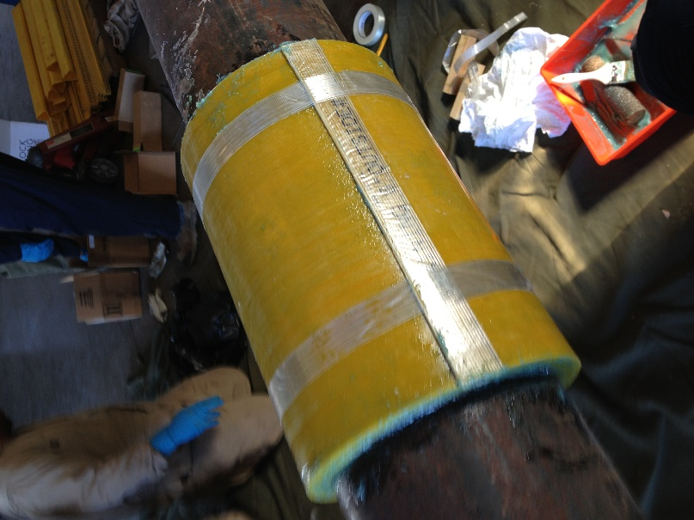
PREFAB COMPOSITES
Benefits
Uniform Quality Control
Less Messy
Prepackaged Kits
(one size fits all)
Disadvantages
Only Straight Pipe
Set Number of Wraps
Not For Internal Corrosion

Slide 19
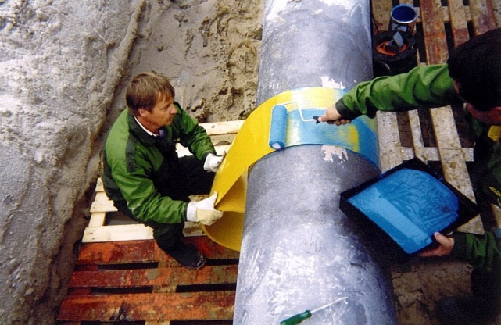
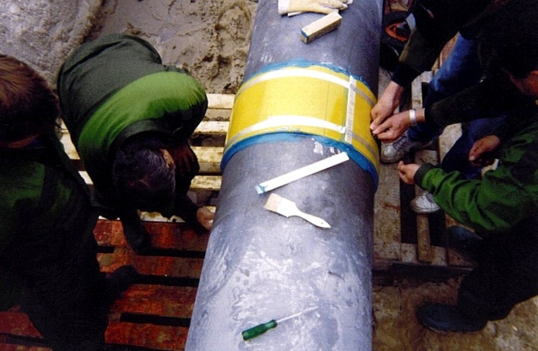
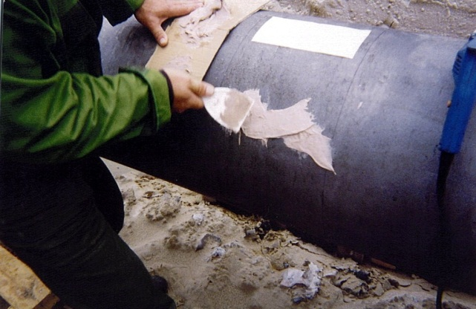
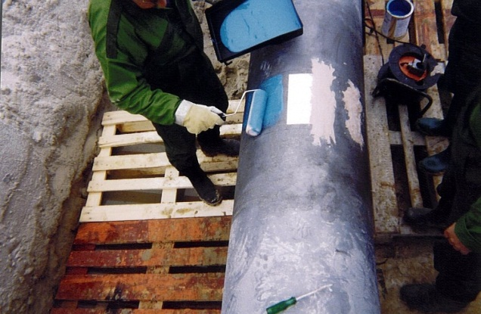
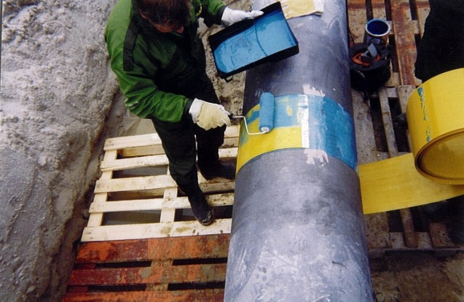
PREFAB INSTALLATION
*General Installation Procedures – OQ Qualification Needed For Installation

Slide 20
WET LAY UP COMPOSITES
Benefits
Can Repair Irregular Pipe Features
Higher Temperatures
Engineered To Each Specific Application
Disadvantages
QC Must Be Done In Field (In Most Cases)
Messier
Installation Time May Be Longer
Not For Internal Corrosion

Slide 23
This snapshot of our repair calculator shows how the input is used to calculate the repair. Note that we always use the long term strength of the composite so we can design external corrosion repairs to the lifetime of the host pipe.

Slide 24
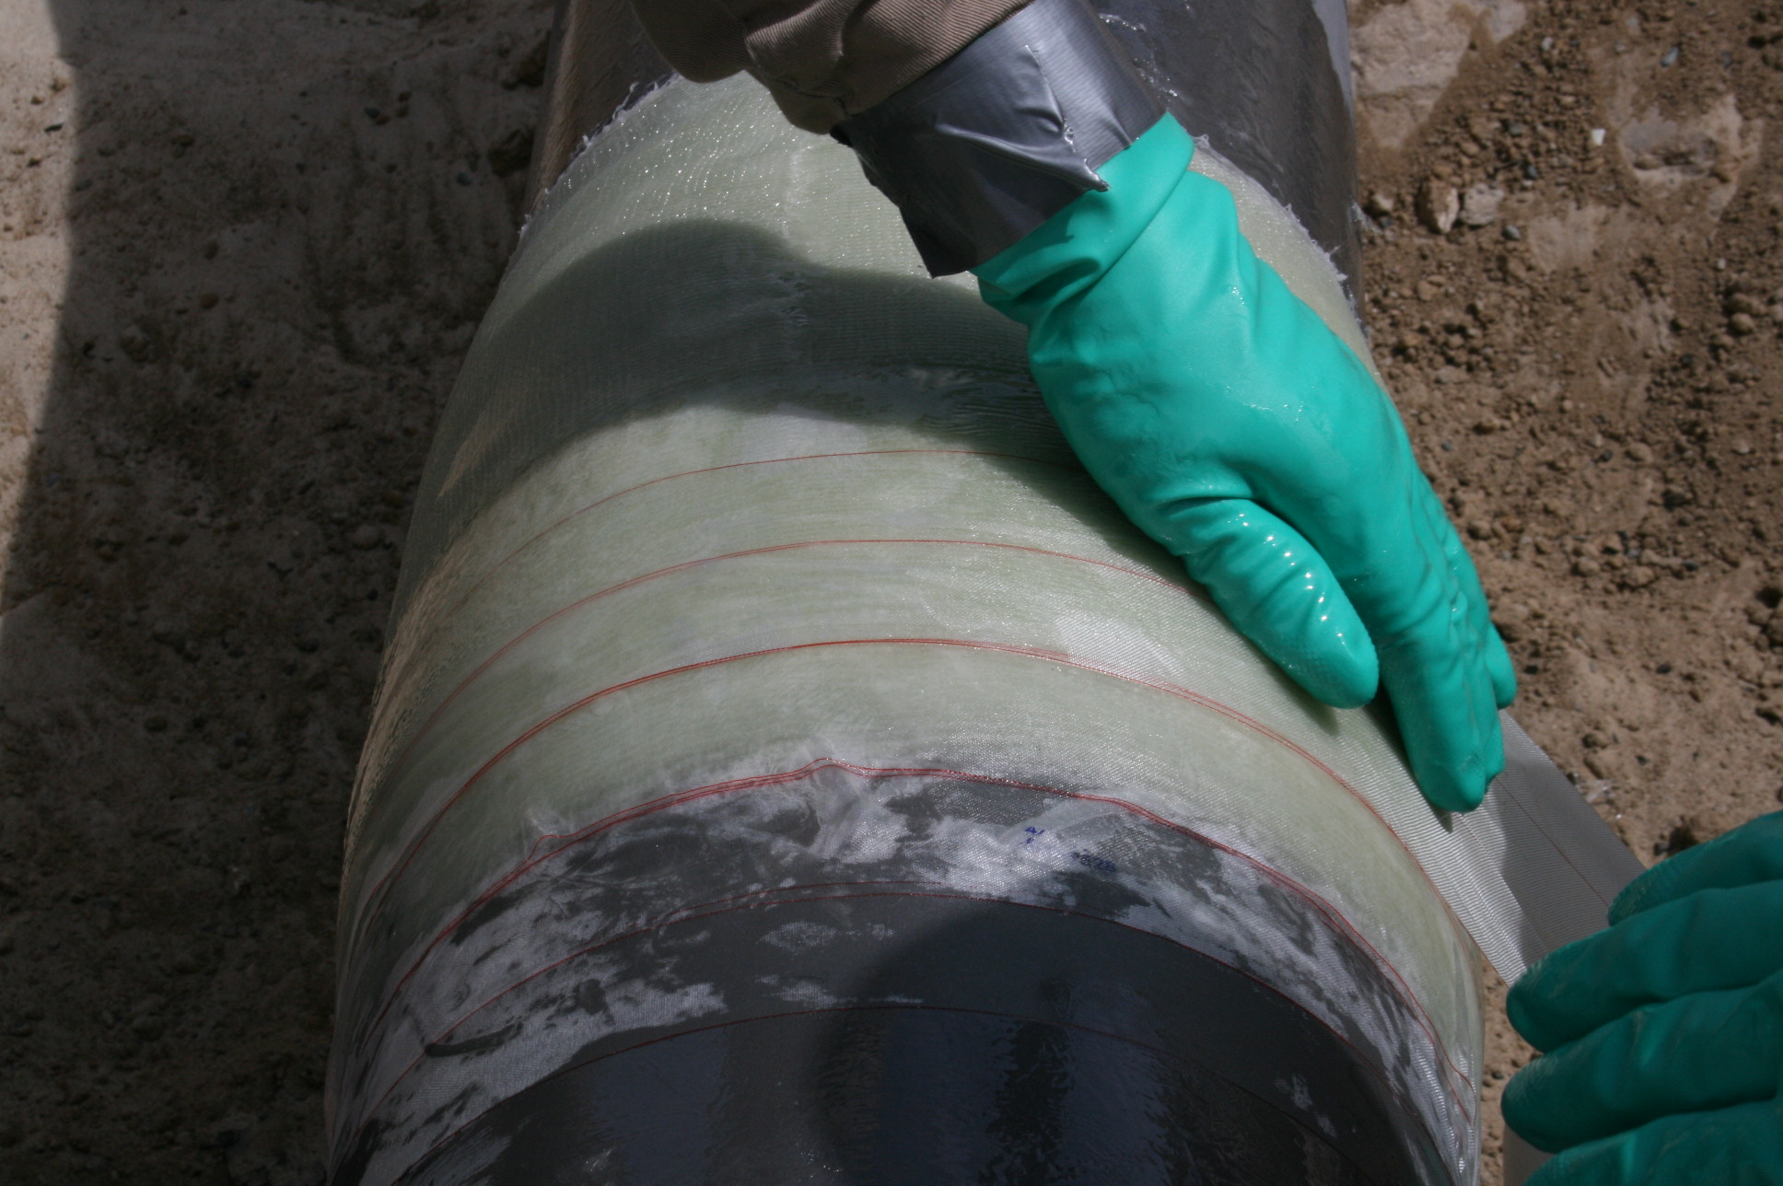
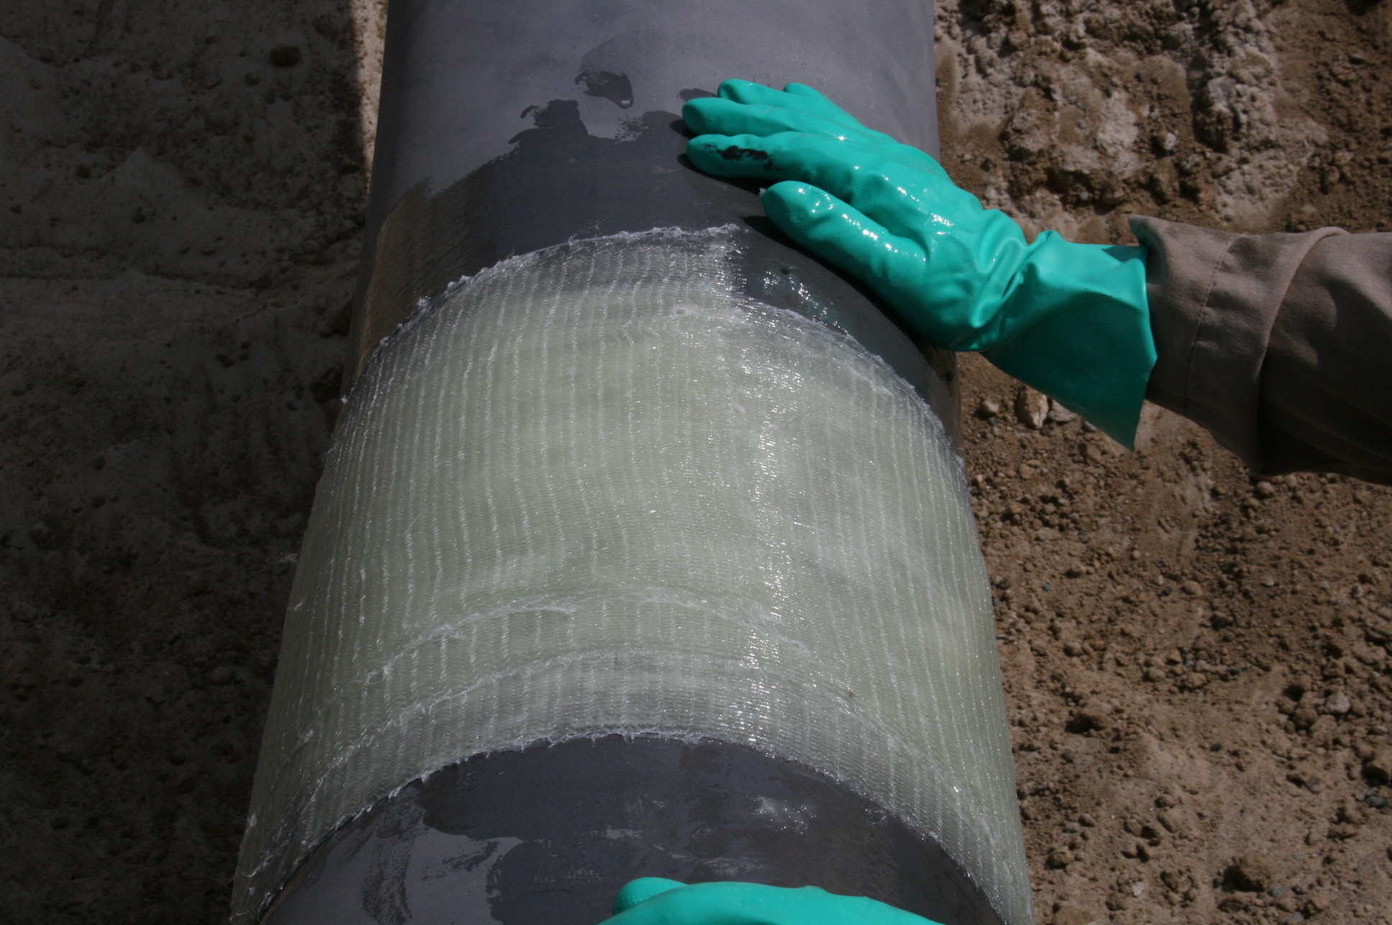
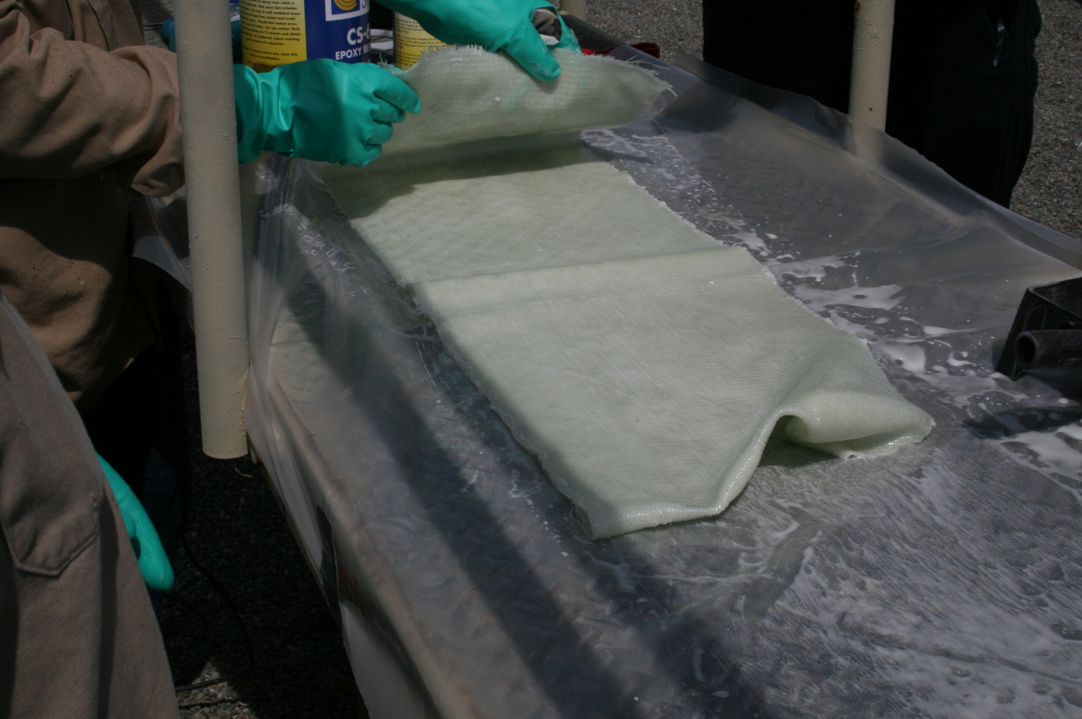
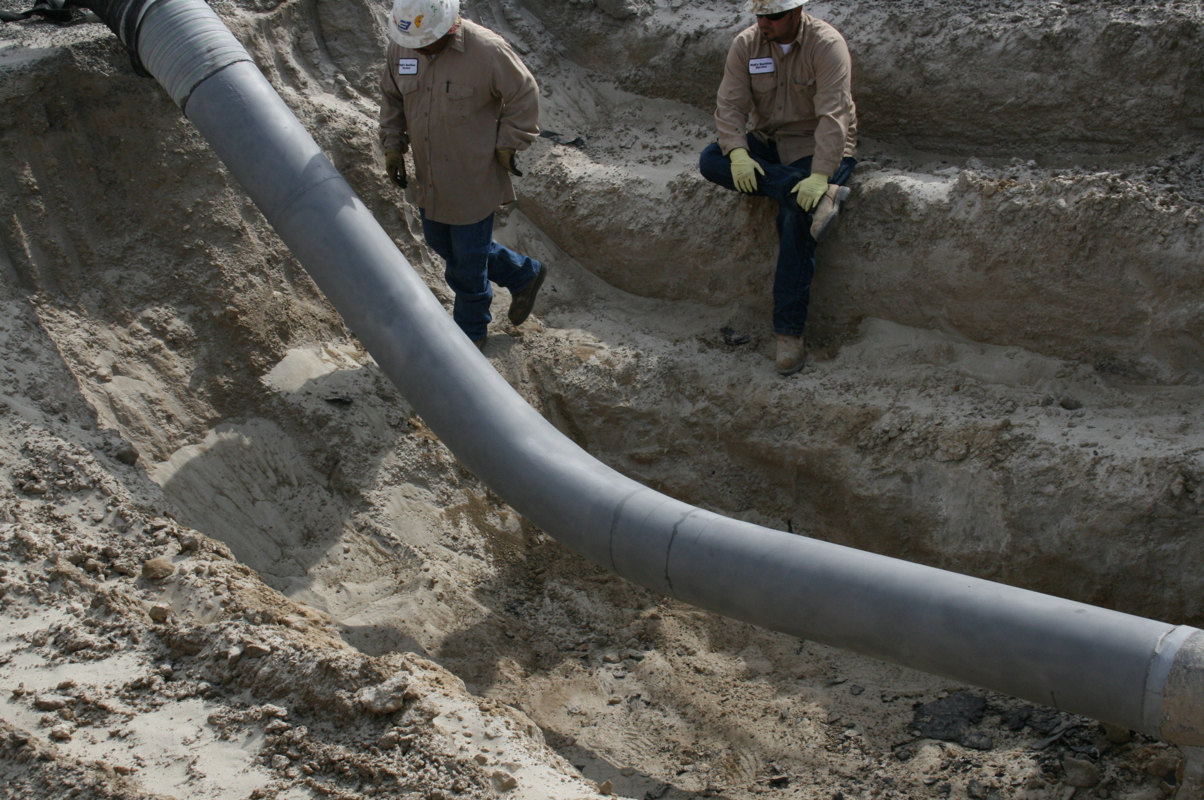
WET LAY UP INSTALLATION Field Impregnated

Slide 25
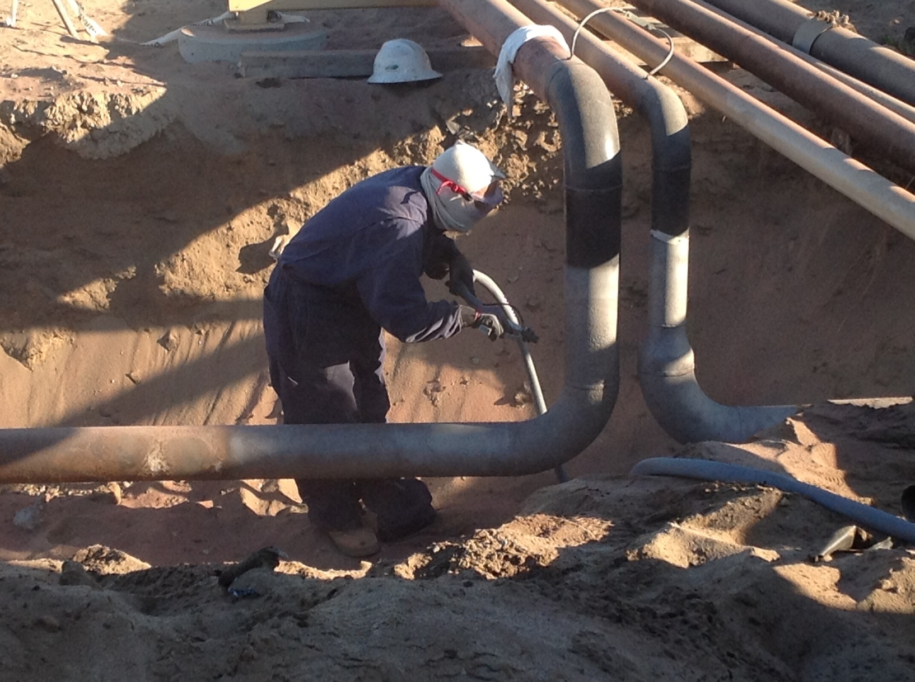
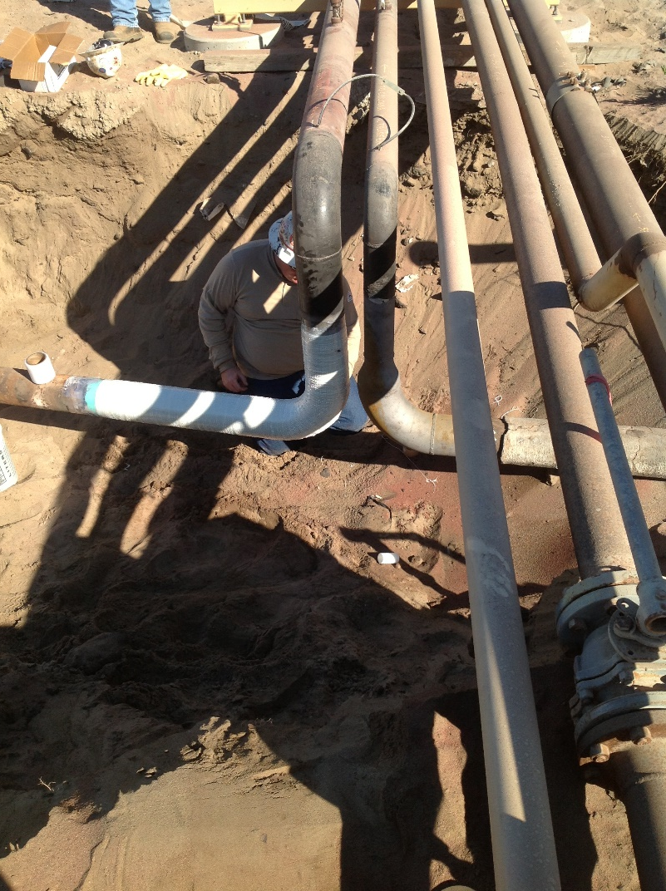
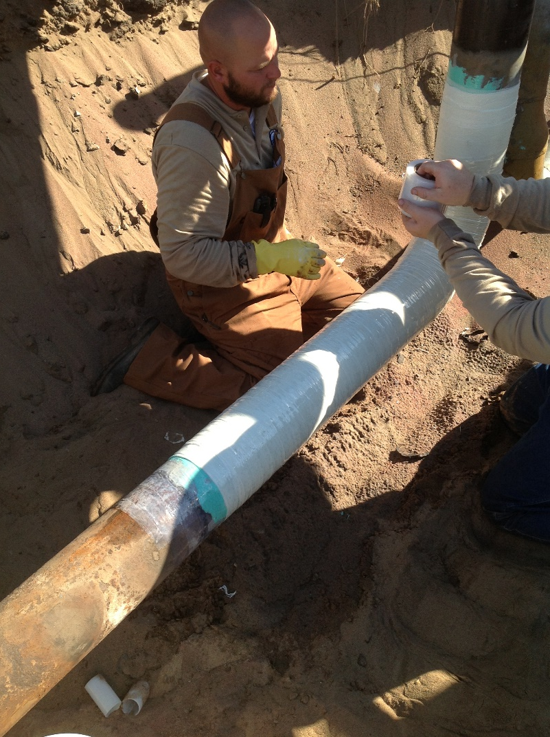
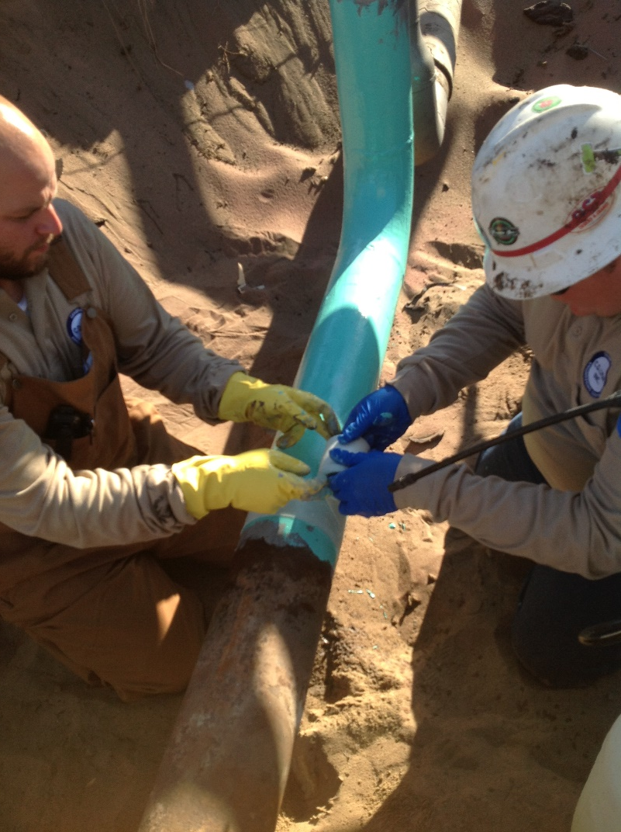
WET LAY UP INSTALLATION Factory Pre-Impregnated

Slide 26
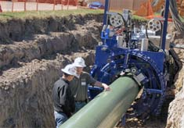
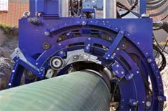
MACHINE INSTALLATION
Benefits
Long Runs Of Pipe
30% Cheaper Than Replacing Pipe
Disadvantages
Must Excavate The Pipe Completely
Too Expensive For Small Runs (<50ft)

Slide 27
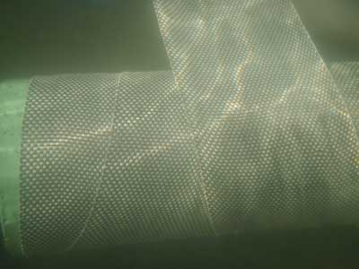
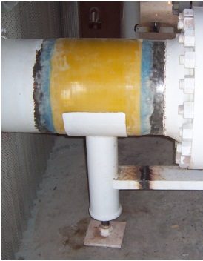
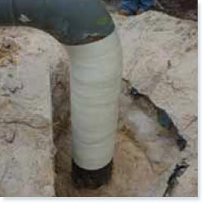
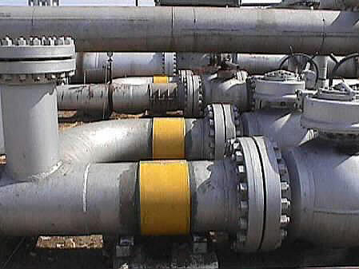
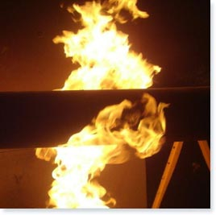
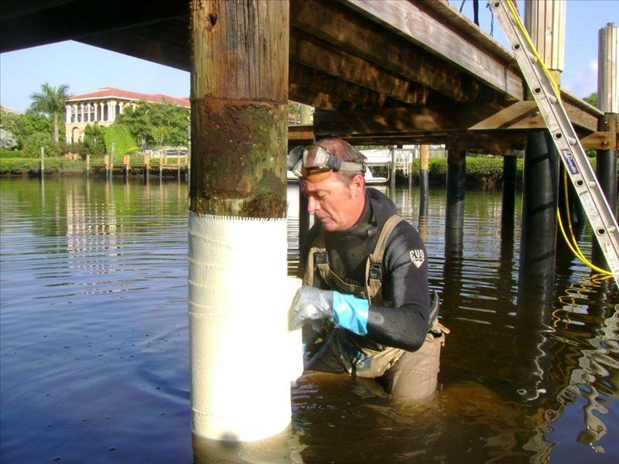
OTHER COMPOSITE USES

Slide 28
Our Capabilities
We Can Engineer The Job
Help Choose The Best System For Your Application
We Can Supply The Materials
We Can Train Installers
Provide Installation Oversight
Provide Composite Marking System For Smart Pig Detection

