Slide 1
DC INTERFERENCE
CHARLIE POORE
NACE SENIOR CORROSION TECHNOLGIST #53904

Slide 2
Detection and Confirmation
Mitigation and Monitoring
Part 1

Slide 3
Poll: IS “DC Interference” coming up in your pipeline integrity or corrosion meetings?
Every single day
We talk about it quite a bit
I’ve heard the term before
Never heard of it

Slide 4
Cathodic Protection in General Terms is….
Application of DC current to the exterior of the pipeline to electrochemically inhibit naturally occurring corrosion.
+ Potential -
Polarized Potential
Native Potential
Location (MP)

Slide 5
INTERFERENCE
Hear the word Interference we typically think AC Interference-buzzword last 10 years
Definition of interference-”the action of interfering or the process of being interfered with”
Definition of Interfere-”take part or intervene in an activity without invitation or necessity or to prevent a process or activity from continuing or being carried out properly.

Slide 6
INFLUENCE
The capacity to have an effect on the character, development, or behavior of someone or something, or the effect itself

Slide 7
DC INTERFERENCE is Any Adverse Effect on The Electrical Potentials of a Buried or Submerged Structure
Not To Be Confused With:
STRAY CURRENT
Current traveling through any un-intended path. May cause STRAY CURRENT CORROSION.
INFLUENCE
Change in a structure to electrolyte potential reading, but not necessarily the structure
Impacts Buried Structures such as …
Pipelines
Well Casings
Metal Fences
Electrical Transmission
Distribution Equipment
Telephone Equipment
Electrical Grounding Equipment
Residential Copper Plumbing
Residential Propane Piping

Slide 8
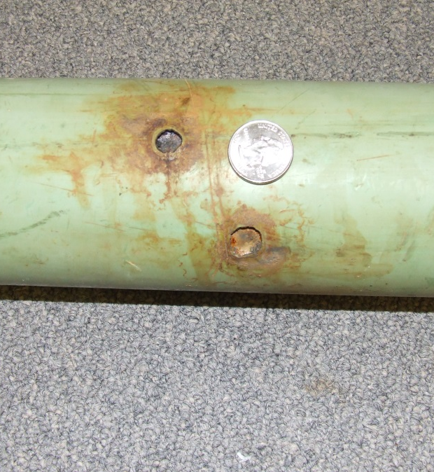
The consequences can be:
Inaccurate Cathodic Protection Potential Readings
Ineffective Cathodic Protection
Stray Current Corrosion

Slide 9
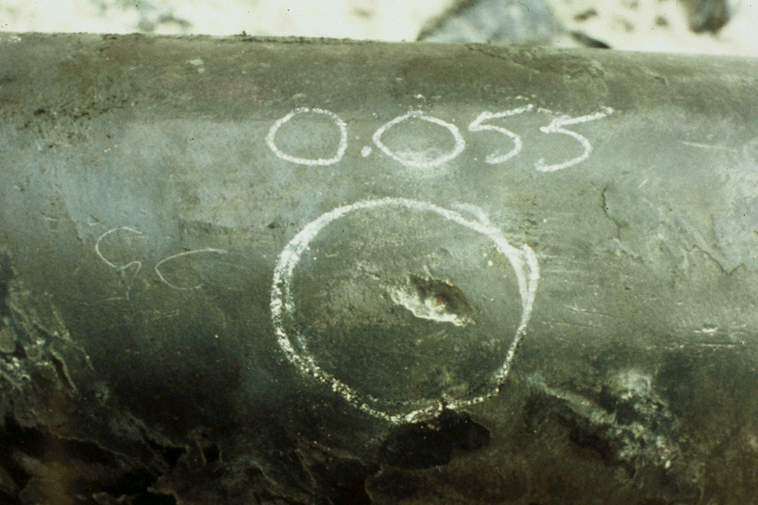
Stray Current Corrosion Carbon Steel Example…Faradays Law
$$W=KIt$$
If 10 mA discharging for 1 year, then..
W = (20#/A-Yr)
(0.01A)
(1 Yr)
W = .20#

Slide 10
DC INTERFERENCE can be…
STATIC
DYNAMIC
Relatively Constant Magnitude
Follows Same Geographic Path
Examples:
CATHODIC PROTECTION SYSTEMS
HIGH VOLTAGE DC SYSTEMS
LARGE SCALE DC WELDING
Fluctuating in Magnitude and Direction
Can Change Geographic Path
Examples
DC TRANSIT SYSTEMS-lose DC leg-earth becomes return
LARGE SCALE DC WELDING
TELLURIC CURRENTS
NATURALLY OCCURING STRAY CURRENTS CAUSED BY DISRUPTIONS IN EARTH’S MAGNECTIC FIELD FROM SUNSPOT ACTIVITY.

Slide 11
Detection of DC Interference-NACE/AMPP SPO 169 Standard
During external corrosion control surveys, personnel should be alert for electrical or physical observations that could indicate interference from a foreign source such as the following:
9.3.1.1 Pipe-to-electrolyte potential changes or fluctuations on the affected structure caused by a foreign source;
9.3.1.2 Changes or fluctuations in the line current magnitude or direction caused by a foreign source;
9.3.1.3 Localized pitting in areas near or immediately adjacent to a foreign structure
9.3.1.4 Damage to external coatings in a localized area near an anode bed or near any other source of stray current.

Slide 12
Early Warning Signs...
Severe Pitting Corrosion
Changes in CP Current Magnitude and Direction
“Low Potentials vs. surrounding area or vs. previous survey.
+ Potential -
Polarized Potential
Native Potential
Location (MP)

Slide 13
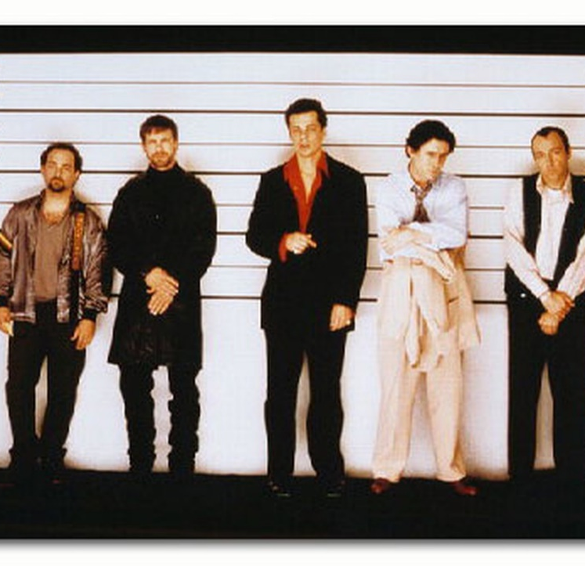
The Usual Suspects
1. “Low” or Positive CIS potentials near foreign crossing.
2. Potentials more negative than expected near a foreign current source.
3. Significant corrosion damage uncovered during an ILI validation dig or ECDA dig.

Slide 14
Field Investigation
Pipe-to-soil potential measurement
Abnormally ‘high’ or more electro-negative
Abnormally ‘low’ potential or more electro-positive
ANODIC or CATHODIC INTERFERENCE?
or
EARTH VOLTAGE GRADIENT?

Slide 15
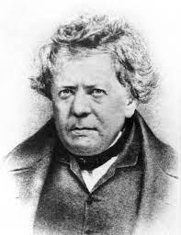
DC INTERFERENCE vs. Earth Voltage Gradient… OHM’s Law
EVG
Ground Gradient
Anode Influence
IR Drop
+
V=IR where:
V = Voltage Gradient
I = Current
R = Passing Through Earth Resistance
All DC current will create an EVG
EVG does not, by itself, indicate the presence of DC interference
Image source(s):
*Peabody, A. W., and Ronald L. Bianchetti. Peabody’s Control of Pipeline Corrosion, TX: NACE International, the Corrosion Society, 2001.

Slide 16
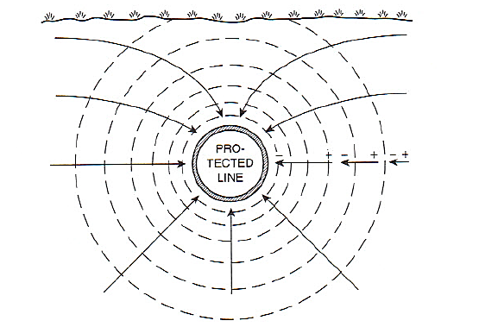
Earth Voltage Gradient
Cathodic Gradient
Pipelines and Protected Structures
Anodic Gradient
CP Ground beds
Image source(s):
*Peabody, A. W., and Ronald L. Bianchetti. Peabody’s Control of Pipeline Corrosion, TX: NACE International, the Corrosion Society, 2001.

Slide 17
Earth Voltage Gradient
BARE PIPE
COATED PIPE
Cathodic Effects can be widespread
~95% of the EVG is within 10 diameters of the holiday
Coated Pipe
Bare

Slide 18
Understanding Remote Earth
A location on the earth far enough away from the affected structure that the earth potential gradients associated with current flowing in the earth to/from the affected structure are insignificant
Image source(s):
*Peabody, A. W., and Ronald L. Bianchetti. Peabody’s Control of Pipeline Corrosion, TX: NACE International, the Corrosion Society, 2001.

Slide 19
Cathodic Interference
Foreign pipeline passing through intense Cathode gradients
Overlapping EVG is more NEGATIVE than remote earth
Image source(s):
*Peabody, A. W., and Ronald L. Bianchetti. Peabody’s Control of Pipeline Corrosion, TX: NACE International, the Corrosion Society, 2001.
Notes:
Gradients on a cathode will attract positive current toward the surface of the protected pipeline.

Slide 20
Cathodic Interference
PIPE-TO-SOIL POTENTIAL READINGS ARE MORE POSITIVE NEAR THE POINT OF CROSSING IN A CATHODIC GRADIENT
HOWEVER, THERE MAY BE NO ACTUAL CURRENT DISCHARGING
Image source(s):
*Peabody, A. W., and Ronald L. Bianchetti. Peabody’s Control of Pipeline Corrosion, TX: NACE International, the Corrosion Society, 2001.

Slide 21
Anodic Interference
Foreign pipeline passing through intense Anode gradients
Overlapping EVG is more POSITIVE than remote earth
Image source(s):
*Peabody, A. W., and Ronald L. Bianchetti. Peabody’s Control of Pipeline Corrosion, TX: NACE International, the Corrosion Society, 2001.

Slide 22
Anodic Interference
HOWEVER, THERE MAY BE NO ACTUAL CURRENT COLLECTING
PIPE-TO-SOIL POTENTIAL READINGS ARE MORE NEGATIVE NEAR THE POINT OF CROSSING IN AN ANODIC GRADIENT
Image source(s):
*Peabody, A. W., and Ronald L. Bianchetti. Peabody’s Control of Pipeline Corrosion, TX: NACE International, the Corrosion Society, 2001.

Slide 23
Poll: Did you How would you rate your own knowledge of DC Interference?
This is way over my head
I have a few questions
I know DC interference pretty well
I should be teaching this webinar

Slide 24
Potential Testing Techniques
DC Interference

Slide 25
Consider…
Reference cell placement
Soil conditions
Structure depth
Coating condition…bare?
Foreign Structure anodic or cathodic gradients
EVG gradients due to ICCP or galvanic anodes

Slide 26
Investigate...
Identify source of stray DC current
Interrupt suspected source(s)
Use caution here…must be able to verify each source contribution
Conduct transverse P/S potential measurements
and /or
Conduct transverse EVG measurements
Conduct limited CIS to define boundaries of influence
Measure Polarization Waveform

Slide 27
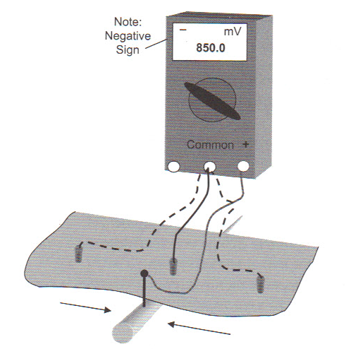
Transverse P/S potential measurement
NORMAL OPERATING CONDITION INDICATED
UTILIZES SINGLE REFERENCE CELL
HIGH INPUT IMPEDANCE MULTIMETER
STRUCTURE CONTACT
REMOTE P/S READINGS ARE NORMALLY MORE NEGATIVE THAN CLOSE READINGS

Slide 28
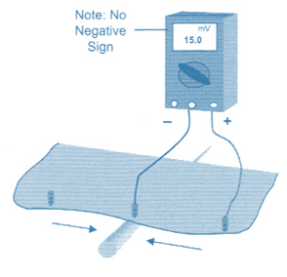
Transverse P/S potential measurement
UTILIZES TWO BALANCED REFERENCE CELLS
CURRENT PICKUP BY STRUCTURE
HIGH INPUT IMPEDANCE DIGITAL MULTIMETER
THIS IS NOT A P/S MEASUREMENT
ALL MEASUREMENTS MUST INCLUDE ACCURATE RECORDING OF VOLTAGE MAGNITUDE AND POLARITY WITH REFERENCE TO PIPE

Slide 29
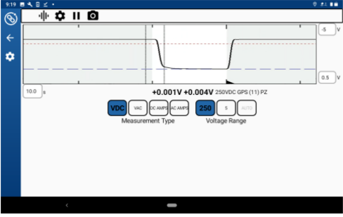
Polarization Wave Form Analysis
Use Data Logger or Field Data Computer
Select “Graph”
Set timeframe to match interruption cycle
Adjust graph limits to show entire wave form

Slide 30
Polarization Wave Form Analysis
Location #1
Polarization from source #1 (Local)
Serious influence from group #2 (Foreign)
No Depolarization from group #2, not “Picking up” on pipeline. Reference Cell is likely within EVG.
Need to interrupt Group #2 during annual
Operator “Off”

Slide 31
Location #2
Location where damage was found previously
Almost zero influence from Operator CP source
Note IR change and re-polarization when Foreign group 2 is off
Foreign “Off”

Slide 32
Current Testing Techniques
DC Interference

Slide 33
YOUR PIPELINE
Current Testing for DC Interference
Foreign Pipeline
Gradient Area of Influence

Slide 34
YOUR PIPELINE
4-wire Test Station
i
x
x - i

Slide 35
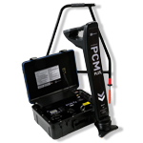
YOUR PIPELINE
Current Mapping
i
S
S - i

Slide 36
YOUR PIPELINE
Coupon Test Station
Measure potentials at depth
Measure Current Magnitude and Direction

Slide 37
YOUR PIPELINE
In-Line Inspection

Slide 38
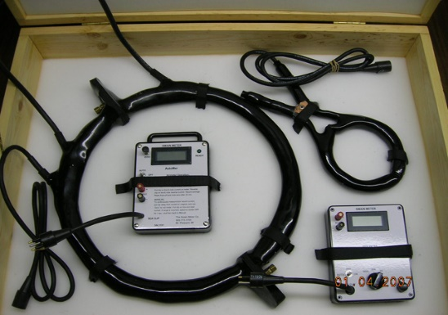
YOUR PIPELINE
Clamp-on Meter

Slide 39
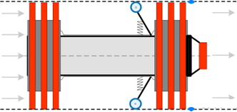
YOUR PIPELINE
Additional Test Procedures
CURRENT MAPPING
4-WIRE TEST STATION
COUPON TEST STATION
CLAMP-ON METER
INLINE INSPECTION

Slide 40
Poll: Which of these technologies or techniques are you already familiar with?
Select All That Apply
Coupon Test Stations
Four-Wire Current Measurement Test Stations
Depolarization Testing
Current Measurement via Inline Inspection

Slide 41
SUMMARY
Understand earth voltage gradient (EVG) effects
Understand anodic/cathodic interference characteristics
Understand available tools, testing techniques & data interpretation
Polarization Measurement
Transverse P/S potential measurement
Transverse EVG measurement
4 wire test station
Current mapping
ILI
Clamp-on ammeter
Coupon test station

Slide 42
✓
Detection and Confirmation
Mitigation and Monitoring
Part 2

Slide 43
Poll: Which of these describes your company?
We’ve got a good handle on DC interference ourselves
We’ve got an expert we call on when needed
We need some help figuring out where to start

Slide 44
What We Established in Part 1…
Our pipeline is picking up stray current from somewhere.
Possibly a foreign pipeline CP system
+ Potential -
Potential
Location (MP)

Slide 45
What We Established in Part 1…
Our pipeline is picking up stray current from somewhere.
Possibly a metallic connection or bond
+ Potential -
Potential
Location (MP)

Slide 46
What We Established in Part 1…
Our pipeline is picking up stray current from somewhere.
Possibly from DC transit or another DC source
+ Potential -
Potential
Location (MP)

Slide 47
What We Established in Part 1…
Our pipeline is giving back stray current somewhere.
This is where the corrosion issue occurs
+ Potential -
Potential
Location (MP)

Slide 48
Simple Mitigation Techniques
DC INTERFERENCE

Slide 49
Mitigating Anodic Interference
Turn Down the Foreign CP System
Not always practical
Easy for foreign operator to reverse without notice
Location (MP)

Slide 50
Mitigating Anodic Interference
Install a “Current Collection” System
Negatively affects foreign operator CP system
Location (MP)

Slide 51
Mitigating Anodic Interference
Relocate the Foreign CP System
Expensive but permanent
May be easement issues, consider deep anode beds
Location (MP)

Slide 52
Mitigating Anodic Interference
Re-Coat Our Pipeline in the Pickup Area
Expensive
Not a guaranteed fix, requires eliminating all coating holidays in the area
Location (MP)

Slide 53
Mitigating Cathodic Interference
Turn Down the Foreign CP System
Shrinks the Cathodic Gradient
Not always practical
Easy for foreign operator to reverse without notice
Location (MP)

Slide 54
Mitigating Cathodic Interference
Install “Current Discharge” Anodes
Moves the current discharge point
Practical and inexpensive
Requires monitoring and eventual replacement of anodes
Location (MP)

Slide 55
Mitigating Cathodic Interference
Increase our Cathodic Protection Current
“Push back” on foreign DC influence
Easy to do with well coated line
Requires monitoring
Location (MP)

Slide 56
Mitigating Cathodic Interference
Recoat Foreign Line in Interference Area
Reduce foreign CP gradient in the area
Expensive and hard to explain sometimes
Location (MP)

Slide 57
Mitigating Cathodic Interference
Bond to the Foreign CP System
Last Resort
Ties your CP systems together
Creates a “critical bond” that must be monitored on regulated pipeline
Location (MP)

Slide 58
Poll: Which mitigation approach is your typical go-to today?
Just bond it!
Field test first and see if it’s really interference.
Just leave it, you’re retiring soon anyway.

Slide 59
Monitoring the situation
DC INTERFERENCE

Slide 60
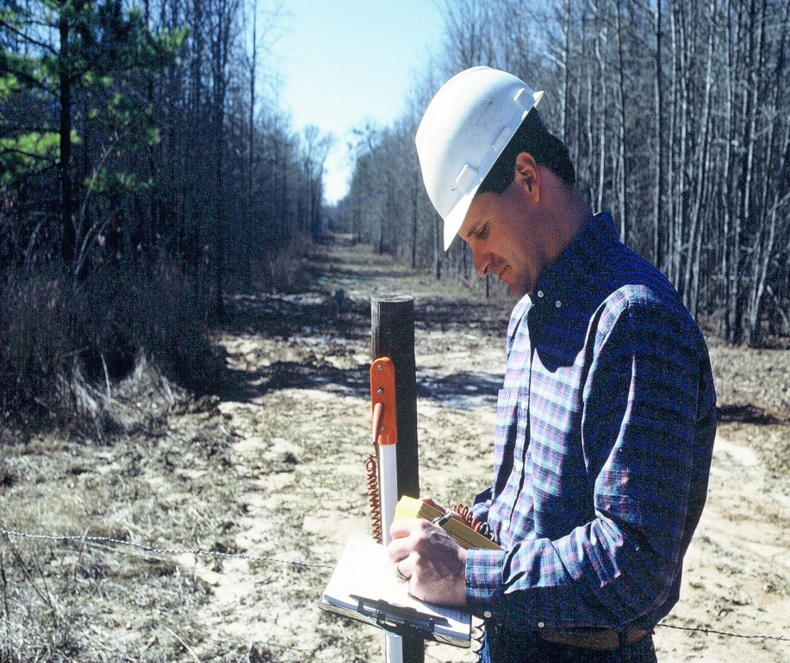
Monitoring Potentials
Monitoring is naturally incorporated into annual potential surveys.
Key Locations:
Near Foreign CP Systems
At Foreign Pipeline Crossings
Near DC Transit/Other Sources

Slide 61
Monitoring Potentials
My Pipeline
Test station placement is critical in avoiding foreign cathodic gradients
Stationary reference cells at depth should be considered for accurate readings
+ Potential (mV) -
Location (MP)

Slide 62
Using Coupon Test Stations
Coupon simulates a coating defect
On
Coupon is connected to the structure being protected.
Instant Off
Coupon can quickly be disconnected from the structure, eliminating ALL current sources affecting the protected structure.
Native State
A second coupon that is NEVER connected to the structure, giving it a true native state potential.
DC Current Density
Known coupon size allows for quick current measurement (Assuming you can disconnect the coupon)
100 cm² DC Native Coupon
100 cm² DC
Test Coupon
Reference Electrode

Slide 63
Monitoring Potentials AND Current
Stationary reference cells and coupon test stations allow for the use of data loggers and remote monitors.
Data collection over time is the key to detecting transient or dynamic DC interference
Remote monitors with level-set alarms can be used to detect and respond to DC interference quickly

Slide 64
QUESTIONS?
CHARLIE POORE
NACE/AMPP Senior Corrosion Technologist #53904
charlie.poore@mesaproducts.com
505-250-7481

